Slide 1
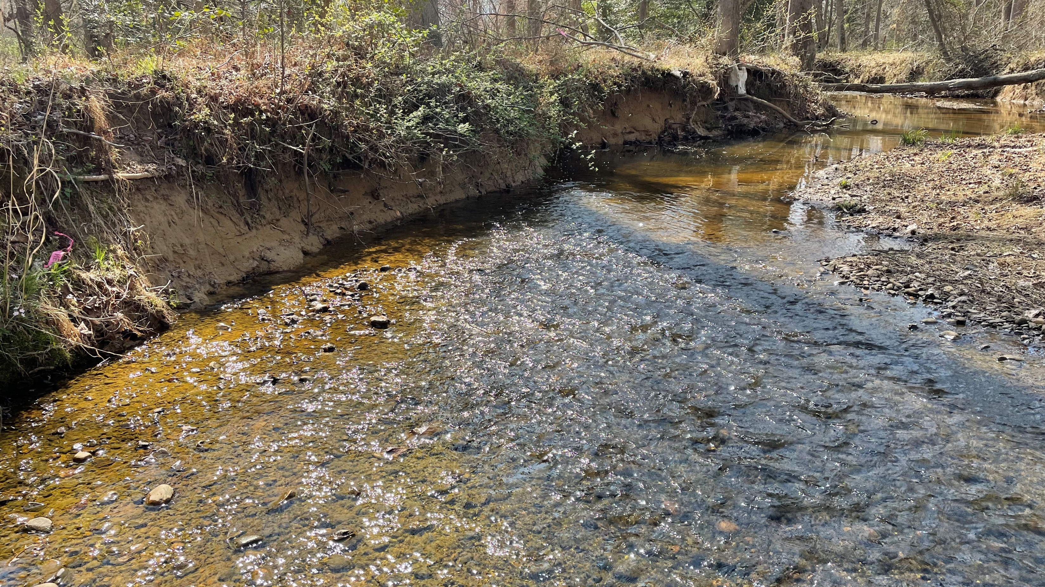
JMT Mill Swamp Mitigation Bank
April 7, 2025| Presented to: MDE Public Hearing

Slide 2
What changed?
The scope of the project has been reduced to exclude the high-quality wetlands and forest on the northside of Marshall Hall Road
An additional landowner has been added to provide better project connectivity downstream of Marshall Hall Road

Slide 3
Mill Swamp Mitigation Bank
Project Goals:
Provide flood storage to aid in flood risk management at Marshall Hall and Fenwick Road.
Prioritize flood and climate resiliency to promote long-term stability, in turn providing protection to surrounding communities and infrastructure.
Improve biological and ecological functions
Create an environmentally diverse and self-sustaining stream system
Create a robust and resilient riparian buffer
Provide sediment and nutrient reductions
Notes:
Add Photo?

Slide 4
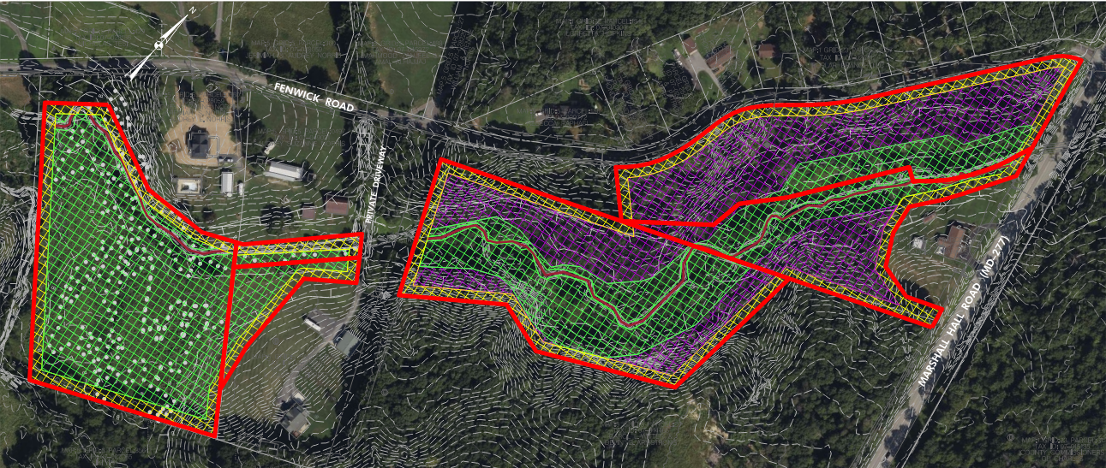
Mill Swamp Mitigation Bank
FENWICK ROAD
MARSHALL HALL ROAD

Slide 5
Mill Swamp Mitigation Bank
FENWICK ROAD
MARSHALL HALL ROAD

Slide 6
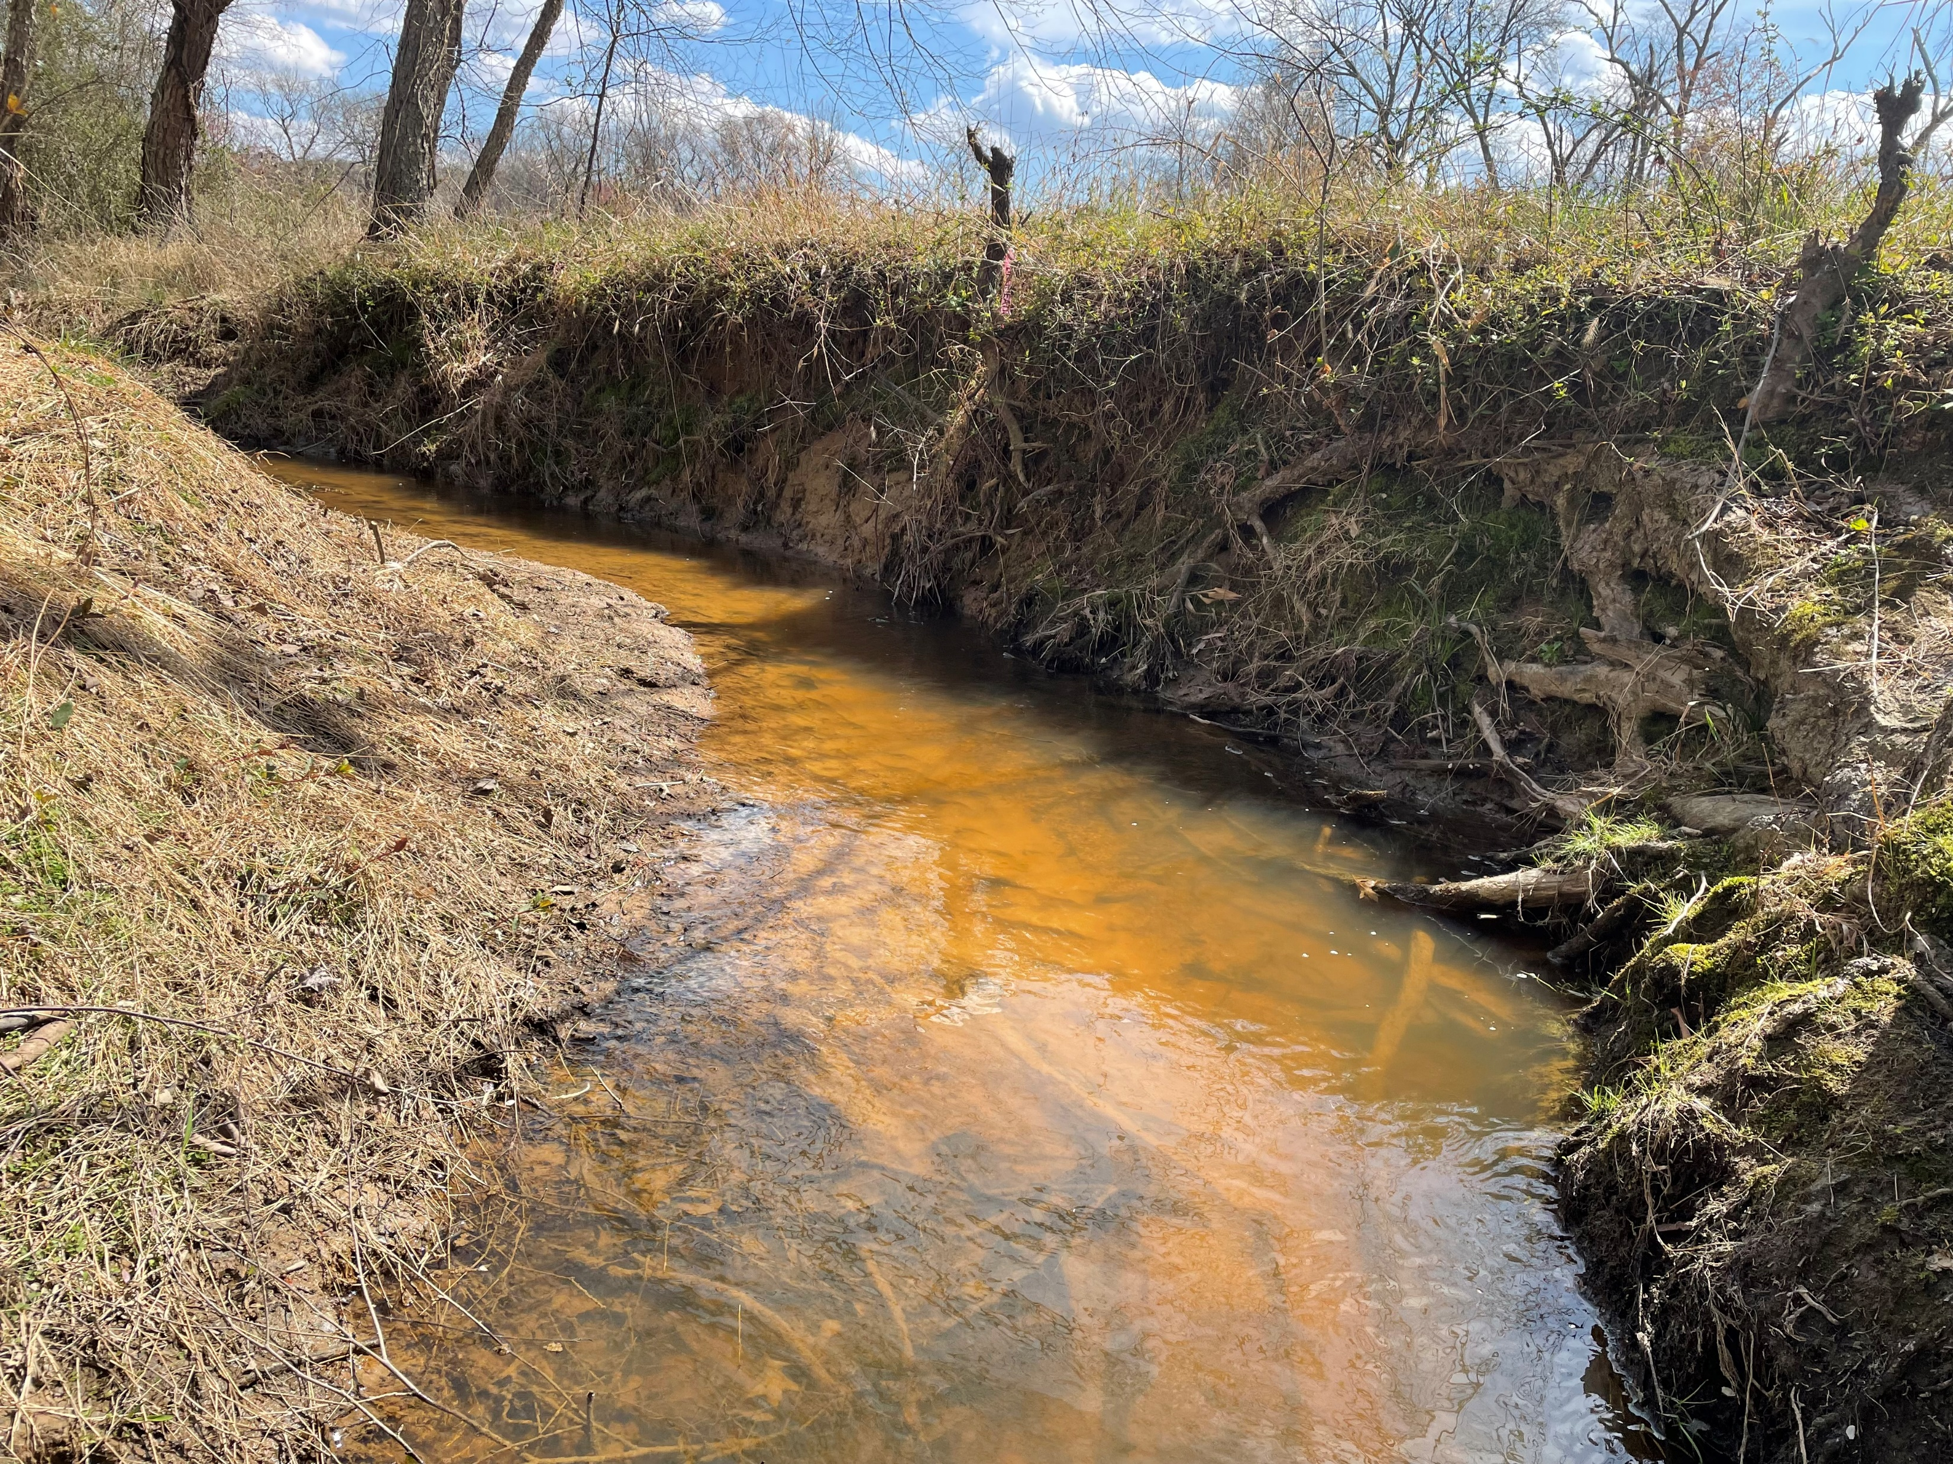
Mill Swamp Mitigation Bank
Pre and Post Construction Data Collection Efforts
Topographic Survey / Utility Investigations (Completed 2024)
Wetland / Waterway Delineations (In progress, anticipated complete spring 2025)
Forest Stand Delineation / Specimen Tree Surveys (In progress, anticipated complete spring 2025)
Stream Surveys / Functional Assessments (Completed 2024)
Habitat Evaluations (Completed 2024)
Stream Temperature Monitoring (Initial Completed 2023 & In progress for 2025)
Fish and Macroinvertebrate Sampling (Scheduled for Summer 2025)
Maryland Historic Trust / USFWS and DNR RTE Evaluations (Initial Evaluations Complete)

