Slide 1
Mechanicstown Cluster Subdivision
September 5, 2024

Slide 2
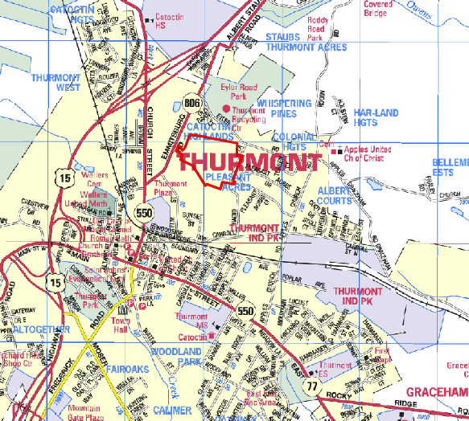
2
Correct Project Address:
122 Emmitsburg Road
Incorrect Address listed in Application:
124 Emmitsburg Road

Slide 3
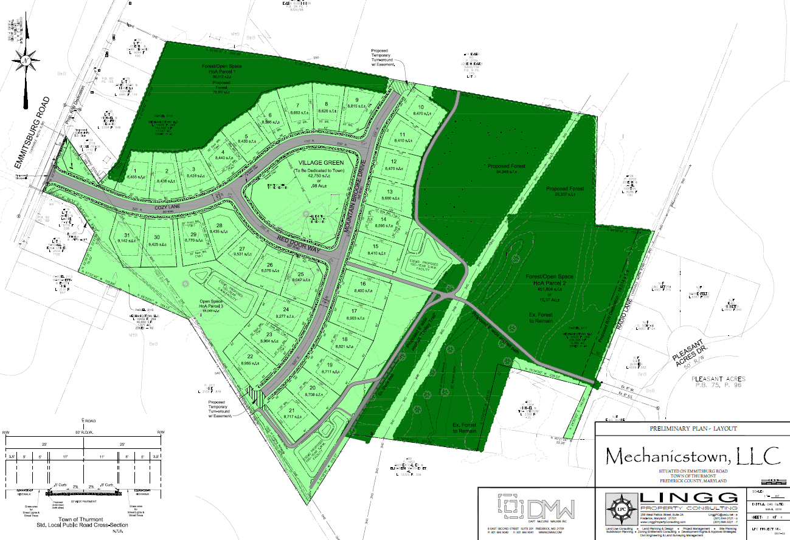
3

Slide 4
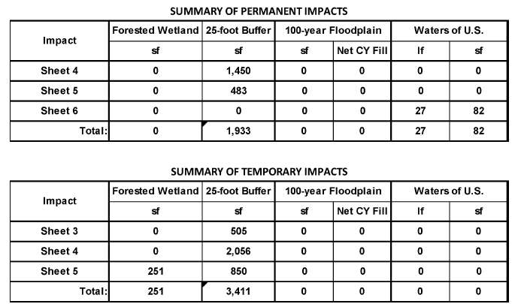
4

Slide 5
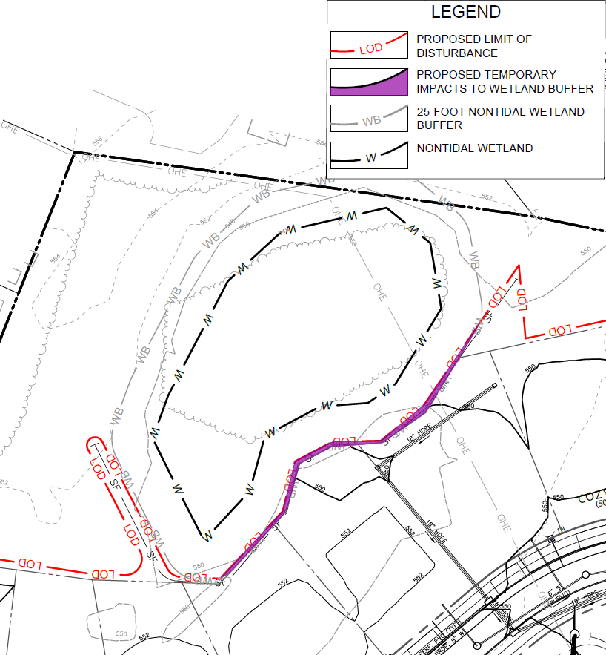

Slide 6
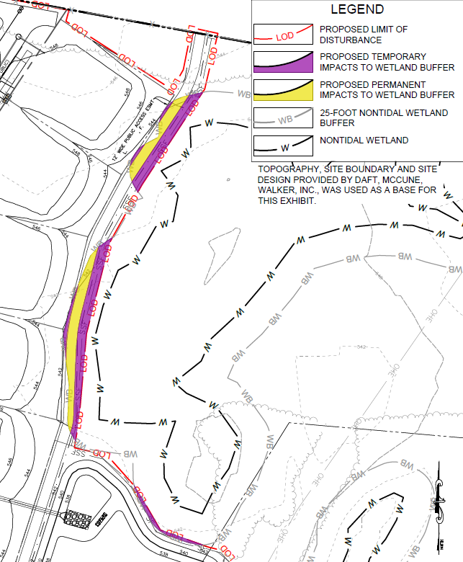

Slide 7
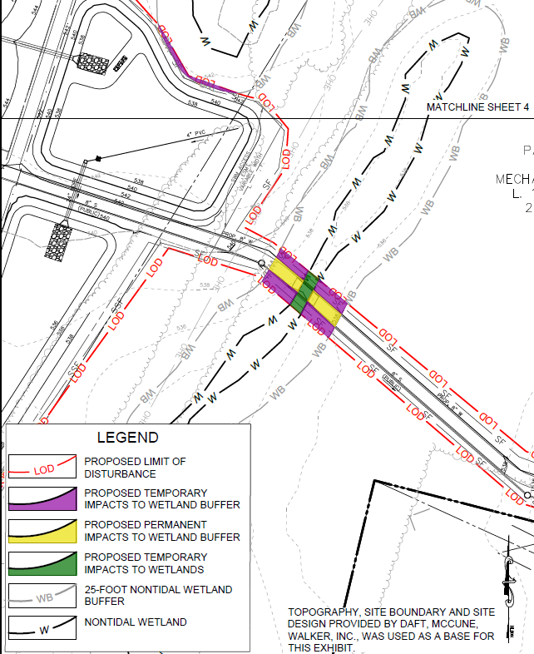

Slide 8
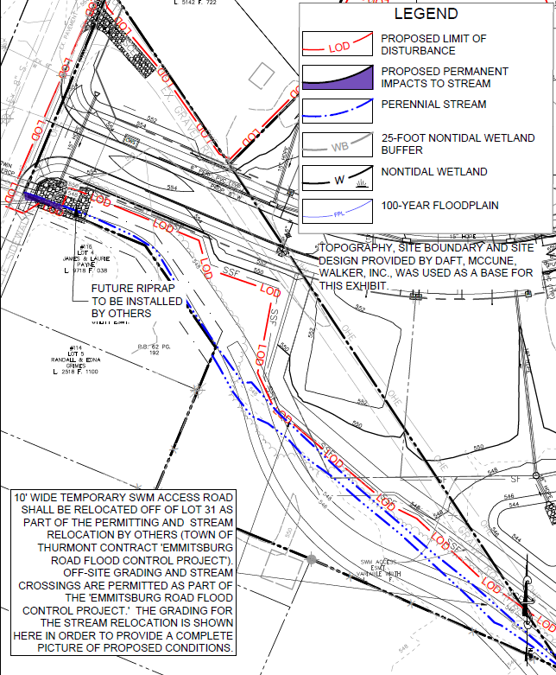

Slide 9
Thank you for your interest

