Slide 1
DOE/NNSA Response to a Nuclear/Radiological Incident
John Crapo
Office of Nuclear Incident
National Nuclear Security Administration
U. S. Department of Energy

Slide 2
Organizational Overview
The mission of the Energy Department is to ensure America’s security and prosperity by addressing its energy, environmental and nuclear challenges through transformative science and technology solutions
Established by Congress in 2000, NNSA is a semi-autonomous agency within the U.S. Department of Energy responsible for enhancing national security through the military application of nuclear science. NNSA

Slide 3
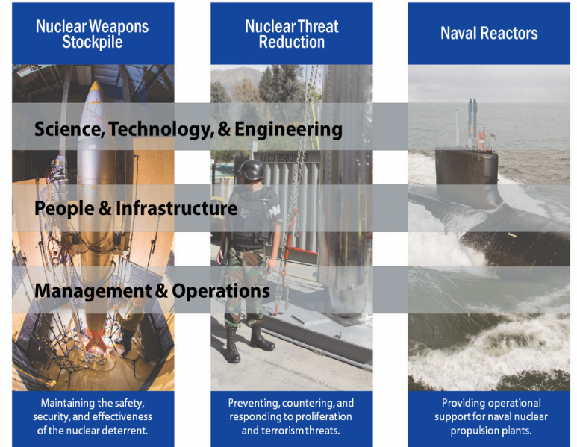
DOE/NNSA - Applying Technical Capabilities to National Security Challenges
Notes:
DOE/NNSA makes full use of all the resources at its disposal to fulfill its Nuclear Threat Reduction mission by:
Developing and implementing policy and technical solutions to eliminate proliferation-sensitive materials and limit or prevent the spread of materials, technology, and expertise related to nuclear and radiological weapons and programs around the world.
Providing expertise, practical tools, and technically informed policy recommendations required to advance U.S. nuclear counterterrorism and counterproliferation objectives.
Maintaining essential components of the U.S. capability to respond to nuclear or radiological crises and manage the consequences (domestically or internationally) of civilian radiation exposure resulting from a nuclear or radiological incident, especially those involving terrorism.

Slide 4
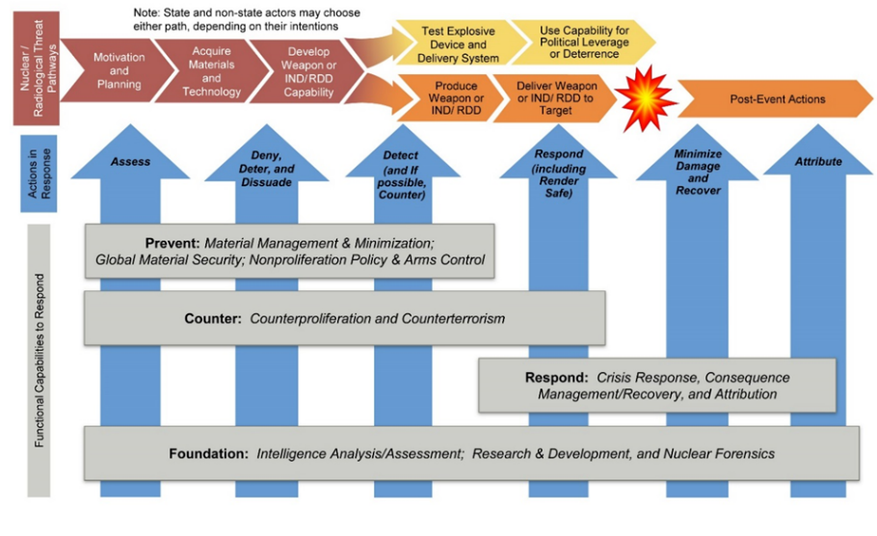
Strategic Approach to Nuclear Threat Reduction Mission
Notes:
DOE/NNSA applies its nuclear nonproliferation, counterterrorism, counterproliferation, and emergency response capabilities across the entire nuclear threat spectrum, from intent through crisis response, by following three general philosophies :
Prevent non-state actors and additional countries from developing nuclear weapons or acquiring weapons-usable nuclear materials, equipment, technology, and expertise; and prevent non-state actors from acquiring radiological materials for a radiological threat device.
Counter the efforts of both proliferant states and non-state actors to steal, acquire, develop, disseminate, transport, or deliver the materials, expertise, or components necessary for a nuclear or radiological threat device or the devices themselves.
Respond to nuclear or radiological terrorist acts, or accidental/unintentional incidents by searching for and rendering safe threat devices, components, and/or radiological and nuclear materials; conducting consequence management actions following an event to save lives and protect property and the environment; and enabling the provision of emergency services through close coordination and operational integration with the Department of Energy’s emergency management enterprise system.

Slide 5
Preventing Nuclear/Radiological Proliferation & Terrorism
Purpose - prevent non-state actors and additional countries from developing nuclear weapons or acquiring weapons-usable nuclear materials, equipment, technology, and expertise; and prevent non-state actors from acquiring radiological materials for a radiological threat device.
Approach
Material Management & Minimization
Global Material Security
Nonproliferation & Arms Control
Defense Nuclear Nonproliferation Research & Development
Nonproliferation Construction Program
Notes:
The Office of Material Management and Minimization (M³) achieves permanent threat reduction by minimizing and, when possible, eliminating weapons-usable nuclear material (WUNM) from civilian use around the world. The integrated M3 approach includes programs in three areas: HEU Reactor Conversion, Nuclear Material Removal, and Material Disposition
The Global Material Security (GMS) Program works to strengthen partner capacity and commitment to secure nuclear and radiological materials at their sources, reduce the risk of their illicit theft or acquisition by terrorists and/or proliferant states, and improve capacity to detect these materials when outside regulatory control.
The Nonproliferation and Arms Control (NPAC) Program strengthens the nonproliferation and arms control regimes by working to: (1) detect and deter undeclared nuclear materials and activities and diversion of declared material; (2) detect and deter illicit transfers of nuclear and dual-use materials, equipment, and technology; (3) enable verified nuclear weapons reductions; and (4) address evolving threats, challenges, and compliance concerns associated with the nonproliferation and arms control regimes.
The DNN R&D Program (DNN R&D) reduces the threat to national security by advancing U.S. capabilities to detect and monitor foreign nuclear fuel cycle and weapons development activities, SNM movement or diversion, and nuclear explosions. These same capabilities support nuclear arms control treaty monitoring and verification, operational interdiction and other nuclear security efforts across NNSA and the U.S. Government. This includes delivering space-based sensors to meet the Nation’s operational nuclear test treaty monitoring and Integrated Threat Warning/Attack Assessment requirements. And finally, it includes improving the speed, accuracy, confidence, and specificity of nuclear forensics analytic capabilities.
The Nonproliferation Construction program consolidates the construction costs for DOE/NNSA nuclear nonproliferation programs, which primarily are the construction projects associated with U.S. plutonium disposition efforts.

Slide 6
Countering Nuclear/Radiological Proliferation & Terrorism
Purpose
Counter the attempts of both proliferant states and non-state actors to steal, acquire, develop, disseminate, transport, or deliver the materials, expertise, or components necessary for a nuclear weapon, IND, or RDD
Approach
Develop/maintain a robust technical understanding of how to characterize, detect, and defeat the range of nuclear threat devices that a non-state actor could potentially construct
Use specialized knowledge of nuclear threat devices to inform U.S. and international policy relating to nuclear counterterrorism and counterproliferation
Strengthen WMD counterterrorism and nuclear/radiological incident response capabilities and preparedness at home and beyond

Slide 7
Responding to Nuclear/Radiological Threats and Terrorism
Purpose
develop and communicate timely, technically-defensible, and actionable decision support to key leaders tasked with protection public health and safety, restoration of essential government services, and providing emergency relief to governments, businesses, and individuals affected by the consequences of a radiological or nuclear incident
Approach
Model
Measure
Assess
Interpret
Notes:
Radiological substance release
Radiological terrorism event
Nuclear terrorism event

Slide 8
Planning for the Response
Notes:
Note: An alternative to supplementing an all hazards plan with a nuclear and radiological annex to account for changes in objectives and tasks might be to amend the all hazards plan itself.
DHS issued its first National Response Framework in 2008 that included emergency support functions, incident annexes, and the partner guides. A new response framework is under development.
FEMA is considering the need to revise the existing nuclear and radiological incident annex to the National Response Framework as an annex to a forthcoming FIOPs for the response and recovery mission areas.
This plan is based on FEMA’s Regional Planning Guide, which outlines the means to implement the planning process consistent with FEMA’s Comprehensive Preparedness Guide (CPG) 101.
State governments have the option to develop specific plans that are annexed to their emergency operations plans based on their assessment of the hazard risk, such as a nuclear and radiological annex. As of 2012, all regional offices, states, and Urban Areas Security Initiative locations must use the Threat and Hazard Identification and Risk Assessment process.
This plan is based on FEMA’s Comprehensive Preparedness Guide (CPG) 101.
Local governments have the option to develop specific plans that are annexed to their emergency operations plans based on their assessment of the hazard risk, such as a nuclear and radiological annex. Local governments often use the Hazard Identification and Vulnerability Assessment process to develop their Hazard Mitigation Plans.
Nuclear/Radiological Incident Annex to the Response and Recovery Federal Interagency Operational Plans October 2016 – FINAL
Preparedness Coordination
The Federal Radiological Preparedness Coordinating Committee
composed of 20 federal departments, agencies, and offices that work together to ensure that the United States is prepared for radiological incidents involving nuclear or radioactive materials, including acts of terrorism.
national-level forum for the development and coordination of radiological prevention and preparedness policies and procedures
provides policy guidance for federal radiological Response and Recovery Mission Area activities in support of state and local government radiological emergency planning and preparedness activities coordinates research study efforts of its member agencies related to state and local government radiological emergency preparedness to ensure minimum duplication and maximum benefits to local, state, and tribal governments coordinates consequence management planning and validating requirements of each agency, reviewing integration requirements and incorporating agency specific plans, procedures, and equipment into the response system
Radiological Emergency Preparedness Program
coordinates the national effort to provide state and local governments with relevant and executable planning, training, and exercise guidance and policies necessary to ensure that adequate capabilities exist to protect against, mitigate the effects of, respond to, and recover from incidents involving commercial nuclear power plants
assists state and local governments in the development and conduct of offsite radiological emergency preparedness activities within the emergency planning zones of NRC-licensed commercial nuclear power facilities.
Activities integrate and enhance local, state, and Federal Governments’ preparedness planning and response capabilities for all types of radiological emergencies.
Concept of Operations
Authorities + Roles & responsibilities of Federal agencies with primary authority for Federal response
Department of Defense, Federal Bureau of Investigation, Department of Energy, Department of State, Department of Homeland Security, Environmental Protection Agency, Federal Emergency Management Agency, National Aeronautics and Space Administration, US Customs and Border Protection, Nuclear Regulatory Commission, United States Coast Guard
Additional Federal agency capabilities
United States Department of Agriculture (USDA), National Oceanic and Atmospheric Administration, U.S. Army Corps of Engineers, Department of Health and Human Services, Department of the Interior Occupational Safety and Health Administration, Department of Transportation, Department of Veterans Affairs
Support and Coordination Elements
Federal Radiological Monitoring and Assessment Center,
Interagency Radiological Aerial Monitoring Concept of Operations
Interagency Modeling and Atmospheric Assessment Center
Advisory Team for Environment, Food, and Health
Nuclear/Radiological Incident Task Force

Slide 9
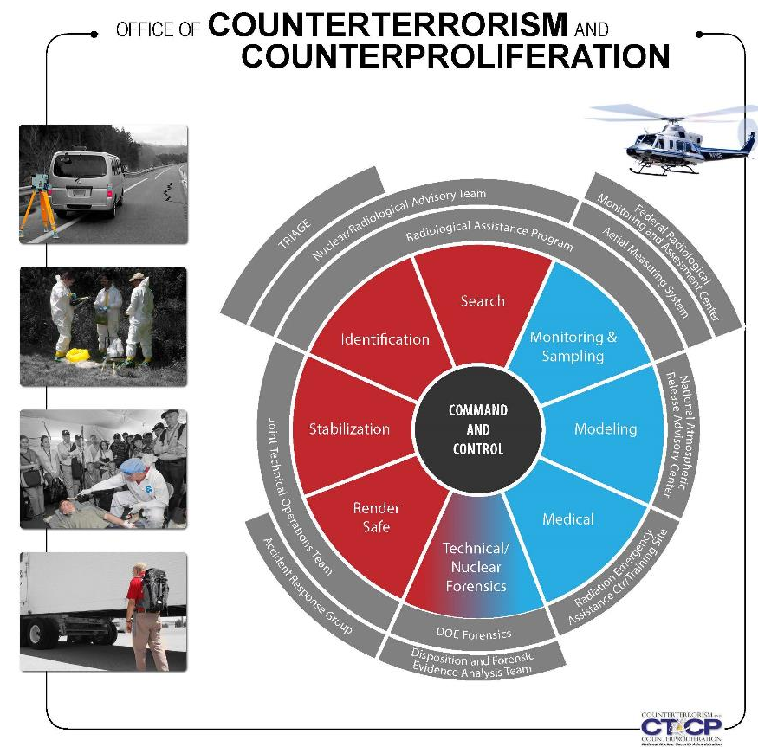
DOE/NNSA Nuclear/Radiological Threats & Terrorism Response Capabilities

Slide 10
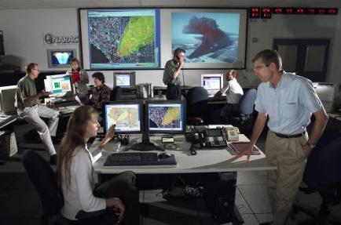
Model
National Atmospheric Release Advisory Center(NARAC)
Transport and diffusion models simulate the release and predict the extent of the hazard.
3-D modeling system with continuous representation of terrain.
Combines the model with data collected from the field and real-time meteorological conditions.
The Interagency Modeling and Atmospheric Assessment Center (IMAAC) is responsible for the production, coordination, and dissemination of consequence predictions for atmospheric hazardous material releases during actual or potential incidents requiring Federal coordination. The IMAAC generates the single Federal prediction of atmospheric dispersions and their consequences utilizing the best available resources from the Federal Government. NARAC is the primary provider of radiological/nuclear plume modeling for the IMAAC
Notes:
National Atmospheric Release Advisory Center (NARAC)
Overview:
The NARAC's mission is to provide timely and accurate real-time assessment advisories to emergency managers for rapid decision-making, during an emergency response involving a nuclear or chemical release. The NARAC’s computer-based system provides realistic plots and maps of radiation dose and exposure assessments, and estimates the amount of radiation contaminants released into the environment.
What they provide:
Transport and diffusion models simulate the release and predict the extent of the hazard.
The NARAC uses a 3-D modeling system with continuous representation of terrain.
NARAC is able to combine the model with data collected from the field and real-time meteorological conditions to refine the model.
This is an iterative process that will eventually end when the model represents the actual condition on the ground.
Rough number of responders:
As few as less than five responders and up to approximately twenty.
When they get there:
NARAC is a remote response asset. They are available in the first hours of the response.
How they fit into the BIG picture:
NARAC folds into FRMAC operations.
Where to find more information:
http://nnsa.energy.gov/aboutus/ourprograms/emergencyoperationscounterterrorism/respondingtoemergencies/consequencemanagem-2

Slide 11

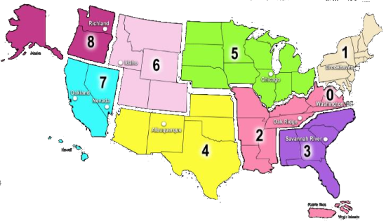
Measure/Preliminary Assessment
Radiological Assistance Program (RAP)
Regionally-based asset located at 9 DOE and NNSA sites throughout the country
Provides advice and radiological assistance for incidents involving radioactive materials that pose a threat to the public or the environment.
Provides field deployable teams of health physics professionals equipped to conduct radiological search, monitoring, and assessment activities.

Slide 12


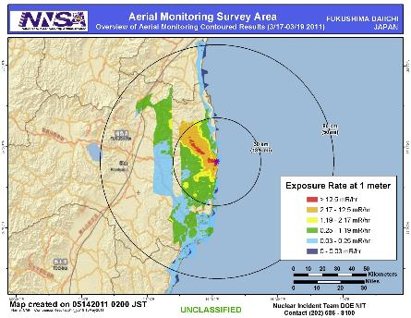
Measure
Aerial Measuring System (AMS)
The fixed-wing aircraft are deployed with the radiation detection system to collect information and determine the location of ground contamination.
The helicopters are used to perform detailed surveys of ground contamination.
Scientists are then able to rapidly develop maps of the radiological materials deposited on the ground and the potential radiation exposure to personnel in the affected areas.
Notes:
Aerial Measuring Systems (AMS)
Overview:
AMS provides specialized airborne radiation detection systems to provide real-time measurements of low levels of air and ground contamination.
What they provide:
The fixed-wing aircraft is deployed with the radiation detection system to collect information and determine the location of ground contamination.
The helicopters are used to perform detailed surveys of ground contamination.
Scientists are then able to rapidly develop maps of the radiological materials deposited on the ground and the potential radiation exposure to personnel in the affected areas.
Rough number of responders:
As few as three responders and up to approximately twenty.
When they get there:
The fixed wing aircraft could be onsite during the first day, and the rotary wing would follow (potentially could arrive on day two).
How they fit into the BIG picture:
AMS folds into FRMAC operations.
Where to find more information:
http://nnsa.energy.gov/aboutus/ourprograms/emergencyoperationscounterterrorism/respondingtoemergencies/consequencemanagem-0

Slide 13
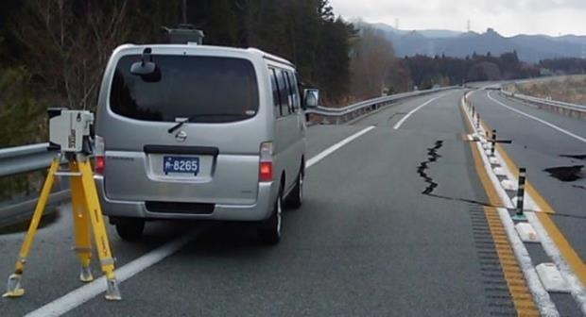
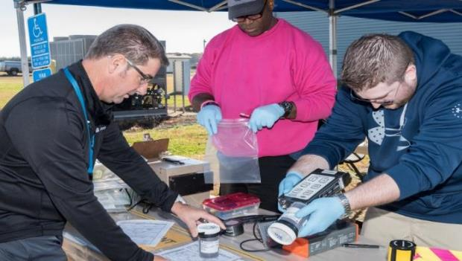

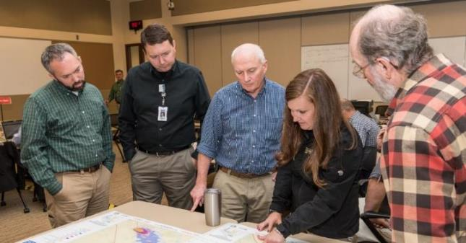
Measure/Assess
Consequence Management Response Team (CMRT)
Notes:
Consequence Management Response Team (CMRT)
Overview:
CMRT consists of technical and management personnel that provide support with radiation sampling and monitoring as well as analysis of data collected.
What they provide:
Assessment scientists to assist in creating data products
Geographical Information Systems (GIS) equipment and personnel for creating map products
Health & Safety for supporting the FRMAC responders
Monitoring & Sampling personnel and equipment to support FRMAC field teams.
Laboratory Analysis equipment and personnel
Logistics support for FRMAC teams.
Rough number of responders:
CMRT, like all of the FRMAC components, is scalable. As few as 25, and more than 100 (with augmentation) could support a response.
When they get there:
CMRT is activated in several phases.
Phase I deploys within 4 hours
Phase II can deploy within 12 hours
Augmentation would follow as needed.
How they fit into the BIG picture:
CMRT folds into FRMAC operations.
Where to find more information:
http://nnsa.energy.gov/aboutus/ourprograms/emergencyoperationscounterterrorism/respondingtoemergencies/consequencemanagem-1

Slide 14
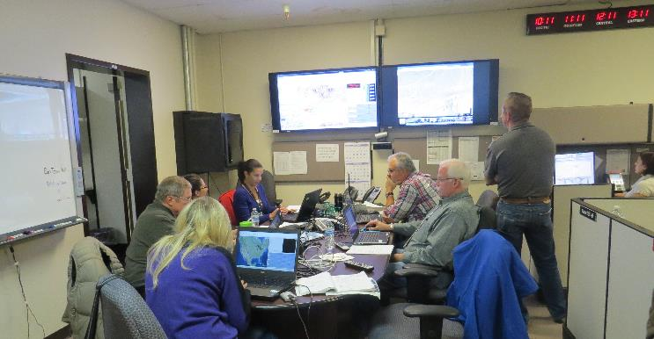
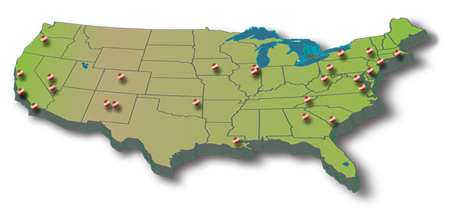
Assess
Consequence Management Home Team (CMHT)
Scientific Support
Atmospheric Modeling
Assessment Scientists
Health & Safety
Aerial Measurements
Laboratory Methods
Communications Support
Bridge Lines & Coordinators
Data Management
Product Support
GIS Specialists
Product development and interpretation
Logistics Support
Personnel
Field Samples & Off-Site Laboratory support
Notes:
Consequence Management Home Team (CMHT)
Overview:
CMHT assists other NNSA field assets in the support of federal, state, tribal, and local response organizations with modeling, radiological operations planning, field monitoring techniques, and the analysis, interpretation and distribution of radiological data.
CMHT folds into FRMAC operations.
What they provide:
Conference line to coordinate communications
Technical guidance
Data and GIS map products that give meaning to the current and projected radiological conditions
Atmospheric plume and deposition modeling (via NARAC)
Event status, logistics, and contact information to authorized personnel
Rough number of responders:
CMHT can be scaled to the response. There can be as few as two or three team members and, in a large response, up to around one hundred (with support from across the country).
When they get there:
CMHT is a remote response asset. They are available in the first hours of the response.
How they fit into the BIG picture:
CMHT supports all of the various components of the response. This includes headquarters, the FRMAC responders in the field, all of the other federal agencies, and the state and locals, among others. They provide access to data and create products. They also provide a central bridge line for coordinating communications with responders that may be in many locations.
Where to find more information:
http://nnsa.energy.gov/aboutus/ourprograms/emergencyoperationscounterterrorism/respondingtoemergencies/consequencemanagem-1

Slide 15
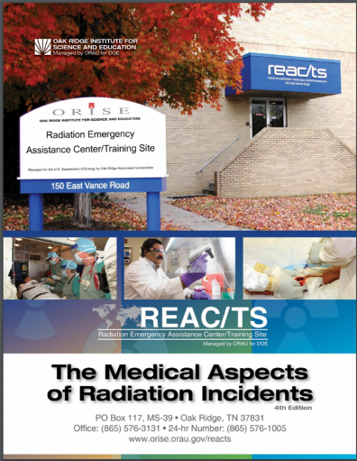
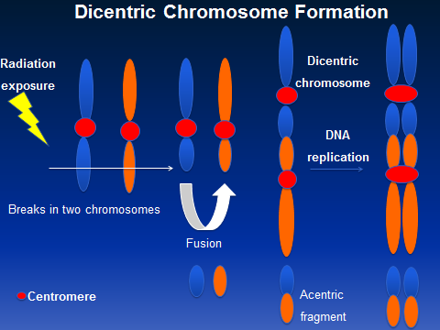
Medical Management
Cytogenetic Biodosimetry Laboratory (CBL)
Notes:
Radiation Emergency Assistance Center/Training Site (REAC/TS)
Overview:
REAC/TS’s mission is to maintain 24 hour response operations to provide assistance and/or deploy personnel and equipment for provision of direct medical care in support of a radiological emergency. In addition, they provide consultative services over the telephone or via email (reacts@orau.gov). The team supports federal, state, and local government organizations
What they provide:
Advice and possible medical care in cases of human radiation exposure.
Facilitating and creating a network of available equipment and staff specializing in human radiopathology.
Operating the REAC/TS Cytogenetic Biodosimetry Laboratory (REAC/TS CBL)
Assisting in the development of medical emergency plans to address large-scale radiation incidents.
Assisting in the preparation of relevant documents and guidelines.
Maintaining a stockpile and registry of internal dose countermeasures.
Maintaining a radiation accident registry pertaining to the medical response and treatment of victims.
Rough number of responders:
The responders to the scene could be less than five people and expand as needed.
When they get there:
REAC/TS can be onsite during the first day of the response.
How they fit into the BIG picture:
REAC/TS folds into FRMAC operations.
Where to find more information:
http://nnsa.energy.gov/aboutus/ourprograms/emergencyoperationscounterterrorism/respondingtoemergencies/consequencemanagem-3

Slide 16
Support & Coordination Elements
Federal Radiological Monitoring & Assessment Center (FRMAC)
Interagency Modeling and Atmospheric Assessment Center (IMAAC)
Advisory Team for Environment, Food & Health (A-Team)
Nuclear/Radiological Incident Task Force (NRITF)
Notes:
The Federal Radiological Monitoring and Assessment Center (FRMAC) is responsible for coordinating all federal ground and aviation-based environmental radiological monitoring, sampling, assessment, and product dissemination for nuclear/radiological incident response. The FRMAC is a DOE-managed interagency asset that is available on request to respond to nuclear/radiological incidents. DOE leads the FRMAC for the initial response, then transitions leadership to the EPA when the continued response shifts predominantly to remediation and/or recovery. The FRMAC is established at or near the incident location in coordination with FEMA, the federal agency with primary authority, other federal agencies, and state and local governments. The FRMAC normally includes representation from DOE, EPA, DOC (through the NOAA), DOD (specialized assets such as the Air Force Radiation Assessment Team and the Armed Forces Radiobiology Research Institute), HHS (Centers for Disease Control and Prevention [CDC]), and other federal agencies, as needed. The FRMAC will be activated on request of the Federal Agency with Primary Authority for Federal Response (Table 1), when requested by state or local authorities with primary responsibility for the response to the incident, or any time a Stafford Act declaration is made, which requires a radiological response. EPA, USCG, DOD, and DOE On-Scene Coordinators under the National Oil and Hazardous Substances Pollution Contingency Plan may request a FRMAC activation through their headquarters response coordination structure. When the FRMAC activates, DOE coordinates all federal environmental and agricultural radiological monitoring and assessment activities, including assessment product and data distribution, for the initial phases of the response, regardless of the primary authority, through the DOE Consequence Management Home Team or the deployed FRMAC.
The IMAAC is an interagency coordination element responsible for production, coordination, and dissemination of federal atmospheric dispersion modeling and hazard predictions for an airborne portion of a hazardous material release. The IMAAC provides the single federal consensus on atmospheric predictions of hazardous material concentration to all levels of the Incident Command and national response organizations. This is achieved through a partnership between DHS, DOC (NOAA), DOD, DOE (NNSA), EPA, HHS, and the NRC. Through plume modeling analysis, the IMAAC provides emergency responders with predictions of hazards associated with atmospheric releases to aid in the decision making process to protect the public and environment. The NARAC is the primary provider of the modeling for nuclear/radiological incidents for the IMAAC.
Advisory Team for Environment, Food, and Health The Advisory Team (A-Team) for Environment, Food, and Health includes representatives from the EPA, USDA, HHS (FDA), the CDC, and other federal agencies as needed. The A-Team, supported by the Federal Radiological Preparedness Coordinating Committee, develops coordinated advice and recommendations on environmental, food, health, and animal health matters for the Incident Command/Unified Command, the Joint Field Office, the UCG, the federal agency with primary authority, and/or state and local governments, as appropriate. The A-Team uses information provided by the IMAAC, FRMAC, and other relevant sources. The ATeam makes protective action recommendations not decisions; provides coordinated technical and scientific advice through the state and federal agency with primary authority; and bases its recommendations on science and best practices. The A-Team is a coordinated asset that must be officially requested before it becomes activated. This advisory team is activated whenever the FRMAC is activated or its assistance can be activated via a telephone call to one of the core federal agencies’ Emergency Operations Center (HHS, USDA, or EPA). The call can be from any local, state, federal, or tribal entity. The A-Team provides federal advice in matters related to— • Environmental assessments (field monitoring) required for developing recommendations with advice from state and local governments and/or the FRMAC. • Protective Action Guides and their application to the emergency. • Protective Action Recommendations using data and assessment from FRMAC. • Measures to prevent or minimize contamination of milk, food, and water. • Recommendations for minimizing losses of agricultural resources from contamination. • Recommendations regarding the health; management and disposition of livestock, poultry, pets, and other animals; and the disposition of contaminated foods, especially perishable commodities (e.g., meat in processing plants). • Availability of food, animal feed, and water supply inspection programs to ensure wholesomeness. • Relocation, reentry, and other radiation protection measures. • Recommendations for recovery, return, and remediation issues. • Health and safety advice or information for the public and for workers. • Estimated effects of radioactive releases on human health and the environment; and • Other matters, as requested by the Incident Command or the federal agency with primary authority. The NRITF is an interagency group that convenes within the National Response Coordination Center to provide standardized nuclear/radiological subject matter expertise in support of national level incident planning and Whole Community core capability delivery. The mission of the NRITF is to recommend answers to executive decision points in this annex regarding technical insight, consequence management support, and other radiological and nuclear critical considerations as needed to inform response/recovery operations and future planning. 37 The task force is scalable, based on the size, scale, and type of incident, and comprised of but not limited to the following entities who will provide support during a nuclear/radiological incident: • A-Team • DOC/NOAA • DOD • DOE/NNSA • DOL • EPA • FEMA • HHS-ASPR • NRC • USDA Other federal agencies, organizations (e.g., private companies or nongovernmental organizations), and liaisons, may support the NRITF on an ad hoc basis depending on the shifting needs surrounding the nuclear/radiological incident. The NRITF will include a recovery liaison staffed by FEMA or a Recovery Support Function coordinating, supporting, or primary agency. The task force does not take the place of any ESF, Recovery Support Function, or federal agency; rather it augments capabilities to focus on specific priorities defined by leadership. It is recognized that a number of interagency organizations already exist to provide nuclear/radiological subject matter expertise in order to fulfill a mandate by the appropriate authorities or specified agency requirements. The NRITF will ensure to not duplicate efforts, but rather conduct its primary mission within the National Response Coordination Center complementary to other nuclear/radiological subject matter expert organizations. The NRITF can be activated, based on the scale and need, in two ways. When the Lead Federal Agency for a nuclear/radiological incident requests the NRITF be activated or, the FEMA Administrator, or his or her delegate activates the NRCC in anticipation of or in response to a nuclear/radiological incident activates the NRITF.

Slide 17
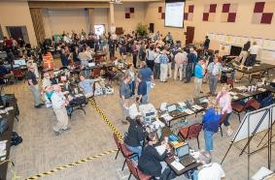

Asset Response Timeline
6-12
0-6
12 – 24
24 – 48
CMRT
EPA
HRF
Advisory Team
FRMAC Established
AMS
CMAC
REAC/TS
CERFP
State/Local
RAP
CST
CMHT - | Consequence Management Home Team
NARAC - | National Atmospheric Release Advisory Center
REAC/TS - | Radiation Emergency Assistance Center/Training Site
RAP - | Radiological Assistance Program
CST - | Civil Support Team
AMS - | Aerial Measuring System
CMAC - | Consequence Management Advance Command
CMRT - | Consequence Management Response Team
CERFP - | CBRNE Enhanced Response Force Package
HRF - | Homeland Response Force
CMHT
NARAC
Remote A-Team
REAC/TS
Notes:
Give general overview of timeline
Define the teams at each level (names and a general description of each)
CMHT
Consequence Management Home Team – staffed by technical and logistics personnel from DOE. Responsible for deploying other DOE CM assets to support a FRMAC and/or RAP. Responds within 1 – 2 hours after notification and capable of providing:
Radiation dose assessment
Atmospheric modeling via NARAC (who will be described in more detail shortly)
Map product support
Aerial data reachback support
Connectivity with other federal home teams
Advisory Team for the Environment, Food, and Health (A-Team)
Combination of federal agencies who authored several regulatory and guidance documents
FDA
USDA
CDC
EPA
Can provide recommendations to the states and locals for their decision making processes
CMHT can reachback to the A-Team to connect responders with additional guidance until the on-site team arrives or in the case there are not enough A-Team staffers to support every operations center involved in a response
REAC/TS
Radiation Emergency Assistance Center/Training Site – group out of Oak Ridge, TN who serve as medical advisors during radiological emergencies. REAC/TS members are trained physicians, nurses, and other medical professionals who can provide guidance related to prophylactic medications available to potential victims of contamination and treatment for overly exposed individuals.
RAP – Radiological Assistance Program (will be covered later)
CST
Civil Support Teams – National Guard teams who receive specialized training in WMD response. These are state assets which can be called upon to support at the request of a governor. Can work with FRMAC teams if allowed.
CMRT I/II
Consequence Response Teams I and II – these are DOE response teams deployed from Las Vegas, NV and are the on-site version of the CMHT. They maintain a full complement of field team support and equipment as well as laboratory analysis and sample collection resources. Phase I
25 personnel (management team, field team members (up to 5 teams), GIS, assessment scientists, and database specialists. With a few thousand pounds of equipment. Wheels up within 4 hours of request. This team is on recall 24/7/365.
Phase II
38 personnel (augmentation of the above mentioned staff plus lab analysis and hotline support)
20,000 lbs of equipment
Can be recalled and wheels up within 12 hours.
CERFP and HRF
DoD support assets which boasts a number of field assets as well as additional command control staffers
EPA
Environmental Protection Agency – responsible for radiation support as well as other hazards during the event (consider Fukushima: near the plant there were several other large production companies along the coast whose materials were at risk. Chemical and other fuels potentially could have been carried away in flood waters creating additional hazards.)

Slide 18
Data and Technical Products

Slide 19
GOALS
Model
Predictions
Measure
Ground truth
Refined decision making
Map
Scale and scope
Early decision making
Situational awareness of the radiological environment

Slide 20
Model
Standard plots sets
Plume hazard areas
Affected population numbers
Expected health effects
Protective action guide levels
Geographical info
Form
One page summaries
Detailed consequence reports
Briefing products

Slide 21
Ground Truth
Data Flow
RadResponder Network
https://www.radresponder.net/
Mobile app
Email to: cmht@nnsa.doe.gov
Fax to CMHT at 702-794-1039
Call in data on CMHT bridge line
Radiological Response Data Portal
FRMAC Radiological Assessment & Monitoring System (RAMS)
AMS Reachback
Data Collection
State, regional, local responders
PRND for CM
REPP states
Fixed radiation monitors (i.e., facility monitoring, RADNET)
Volunteers (i.e., SAFECAST)
Inter-agency responders (DOE, EPA, DoD, etc.)
Notes:
national standard and Whole Community solution for the management of radiological data.
collaboration between Federal Emergency Management Agency (FEMA), Department of Energy (DOE) / National Nuclear Security Administration (NNSA), and the Environmental Protection Agency (EPA)
flexible architecture enables organizations to rapidly and securely record, share and aggregate large quantities of data while managing their equipment, personnel, interagency partnerships, and multijurisdictional event space.
Can be accessed on smartphones, tablets, and via the web

Slide 22
Assessment
Methodologies developed by interagency
DOE/NNSA
US NRC
US EPA
USDA
US FDA
CDC
Documented in peer-reviewed manuals
Codified in TurboFRMAC

Slide 23
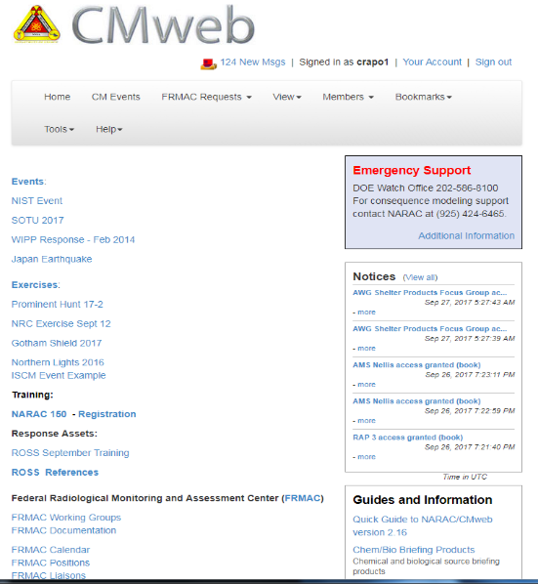
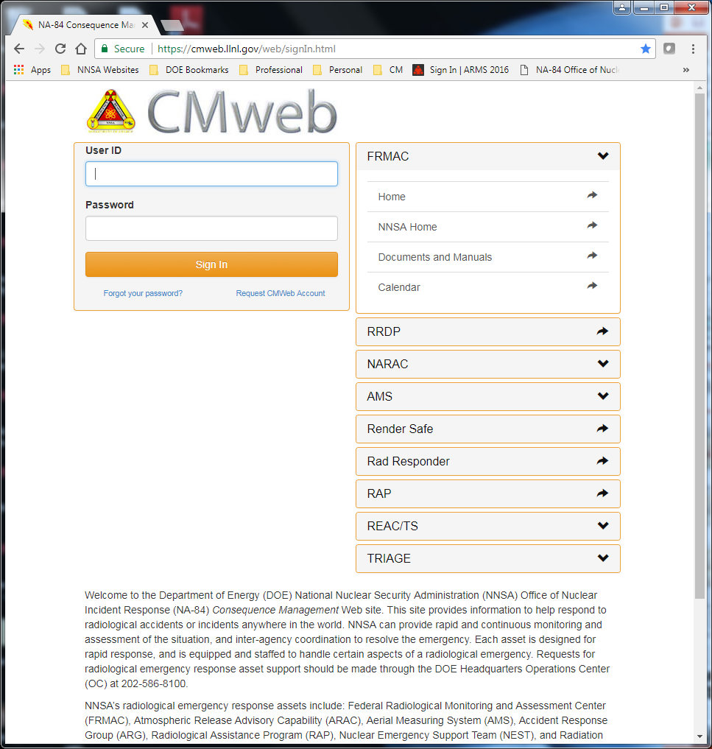
Distribution of Products
Notes:
Data ownership:
DOE will collect the data
The state/local organizations are ultimate owners and have say about sharing on the local level
Markings/Classification
In most cases CM responses are unclassified
In the rare cases where an upgrade of classification must be made considerations must be given about how to protect the data

Slide 24
How to Request Assistance
DOE Watch Office: 202-586-8100 (Primary)
Radiological Assistance Program Regional Offices:
Region 0 (Washington, DC): 1-800-405-1140
Region 1 (Brookhaven, NY): 1-631-344-2200
Region 2 (Oak Ridge, TN): 1-865-576-1005
Region 3 (Savannah River, GA): 1-803-725-3333
Region 4 (Albuquerque, NM): 1-505-845-4667
Region 5 (Chicago, IL): 1-630-252-4800
Region 6 (Idaho Falls, ID): 1-208-526-1515
Region 7 (Livermore, CA): 1-925-422-7595
Region 8 (Richland, WA): 1-509-373-3800
NARAC Operations: 1-925-424-6465
Notes:
All paths lead to FRMAC, there is no “right” or “wrong” way here

Slide 25
Additional Questions
Daniel Blumenthal
CM Program Manager
Daniel.Blumenthal@nnsa.doe.gov
Chris Van Horn
RAP Program Manager
Chris.Vanhorn@nnsa.doe.gov
Lonnie Swindell
NRAT Program Manager
robert.swindell@nnsa.doe.gov

Slide 26
QUESTIONS?

