Slide 1
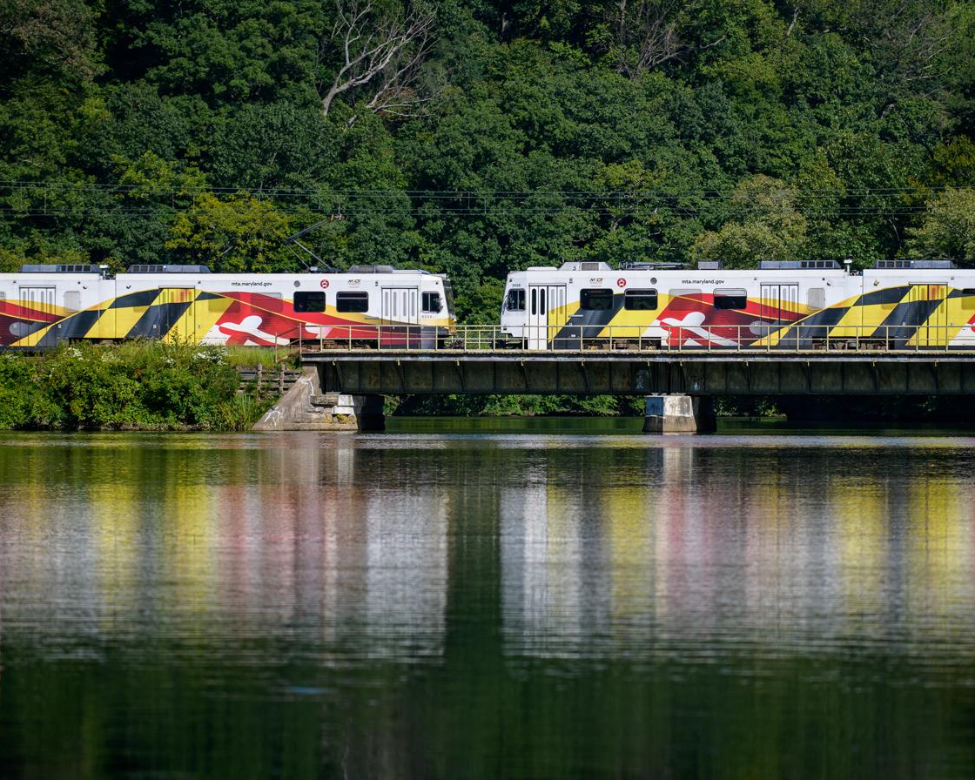
MDOT's Role: Building EV Charging Infrastructure
Joe McAndrew
Assistant Secretary
July 8, 2025

Slide 2
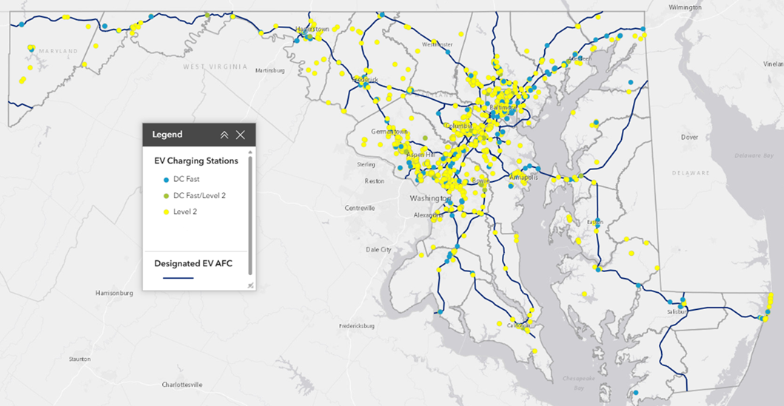
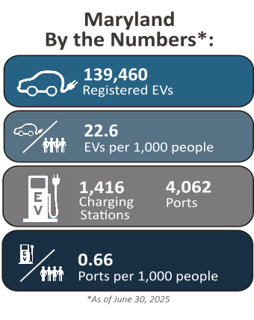
Lay of the Land
Existing Charging Stations
Notes:
Snapshot of where we are
2,623 new EV registrations in June, bringing us to almost 140,000 registered EVs in the State
Over 1,400 public charging stations supporting these EVs, which is roughly 0.66 ports per 1,000 Marylanders
As you may already know, Direct Current Fast Chargers provide high powered charging that provide about 180-240 miles of range per hour of charging. These are most suitable along highways or designated EV Alternative Fuel Corridors for quick charging, as you can see by the blue dots.
Level 2 chargers provides about 10-20 miles of range per hour of charging and can typically fully charge a vehicle in 4-10 hours. These are most suitable in communities.

Slide 3
Federal Programs
Program | Amount | Description
National EV Infrastructure (NEVI) Program | $63 Million | Federal formula program to deploy publicly available charging infrastructure first along designated Alternative Fuel Corridors and then in communities
EV Charger Reliability & Accessibility Accelerator | $4.36 Million | Federal discretionary grant program using NEVI set-aside funds to repair and/or replace existing broken public chargers
Clean Corridor Coalition | $80 Million | Multi-state coalition led by New Jersey and alongside Delaware, Connecticut, and Maryland Department of Environment to deploy charging depots for medium- and heavy-duty (MHD) clean trucks traveling along the I-95 corridor. Funded by the Climate Pollution Reduction Grant
Charging Ahead Partnership | $18.6 Million | Multi-state project led by MDOT and alongside Pennsylvania and New Jersey to deploy charging depots for MHD clean trucks traveling along the I-81 and I-78 corridors. Funded by the Charging and Fueling Infrastructure Grant
Carbon Reduction Program | $94.4 Million | Federally funded program to support projects that reduce transportation emissions, including the adoption of EVs and deployment of EV charging infrastructure
Notes:
NEVI Round 1 will fund 130 new DC fast charging ports at 22 sites. The first site in Grantsville broke ground last month, with others following soon. All sites will be operational by spring 2026.
MDOT’s EVC-RAA grant award will fund the replacement of about 44 broken charging ports across the state to increase charging reliability.
Through the Clean Corridor Coalition and in partnership with MDE, MDOT will deploy 8 truck charging depots along I-95. The coalition will release an RFI this summer to inform program design.
The Charging Ahead Partnership will deploy 6 charging depots supporting freight trucks traveling along I-81 and I-78 in partnering states.
In Round 1 of CRP, MDOT awarded funds to support local governments and modal partners deploying 164 new Level 2 chargers, 17 DC fast chargers, and 114 fleet EVs.

Slide 4
State Initiatives
Initiatives | Description
Maryland EV Tax Credit | Individuals and businesses purchasing new qualifying zero-emission plug-in electric or fuel cell EVs are eligible to receive a one-time excise tax credit, up to $3,000, administered by the Motor Vehicle Administration. The FY2025 budget for this program was $8.25M. Since 2010, this incentive has increasingly been oversubscribed, with funds depleting well before the end of each fiscal year.
Zero Emission Electric Vehicle Infrastructure Council (ZEEVIC) | Established in 2011, legislatively mandated council with public and private representatives responsible for developing policies, recommendations, and incentives to promote ZEV adoption and awareness.
Maryland EV | Consumer-facing resource hub to facilitate education and information exchange surrounding zero emission vehicles and infrastructure in Maryland.
Maryland EV Dashboard | Public platform that provides the latest EV registration and publicly available charging station data (updated monthly), as well as an EV Charger Siting Tool to support project planning.
Notes:
Maryland EV tax credit program uses Strategic Energy Investment Funds (SEIF) from MEA

Slide 5
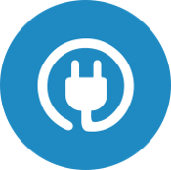

Zero Emission Vehicle Infrastructure Plan (ZEVIP)
Plan to support the growth of light-, medium-, and heavy-duty zero emission vehicles (ZEVs)
Suitability for deploying publicly available infrastructure
Multi-agency strategy to accelerate buildout through 2045
Actions and recommendations targeting:
EV sales
EV charger deployment and reliability
Utility grid integration
Public engagement and communications
Anticipated release in Fall 2025
Notes:
2024 Climate Executive Order by Governor Moore – calls for MDOT’s development of ZEVIP, to include Maryland’s NEVI Plan, and a multi-agency strategy
New statewide plan to strategize suitable ZEV infrastructure deployment in the state to meet the projected growth across all vehicle classes from now through 2045 and recommend comprehensive key actions to move the needle
This first edition of ZEVIP focuses specifically on supporting public chargers for light-duty EVs, while MDE develops the Trucking Needs Assessment in tandem
Will include a publicly available suitability tool to guide infrastructure investments
Recently ran a successful survey to inform ZEVIP development using feedback gathered from over 1,480 Marylanders
MDOT will publish ZEVIP this fall

Slide 6
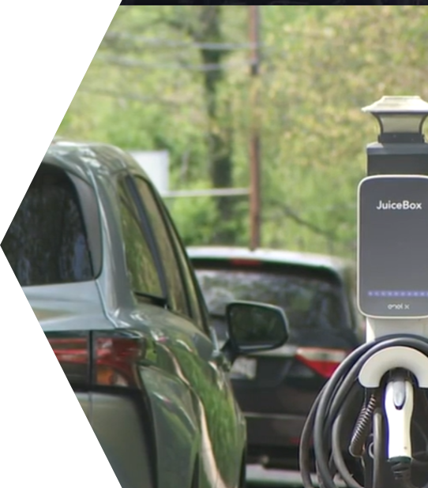
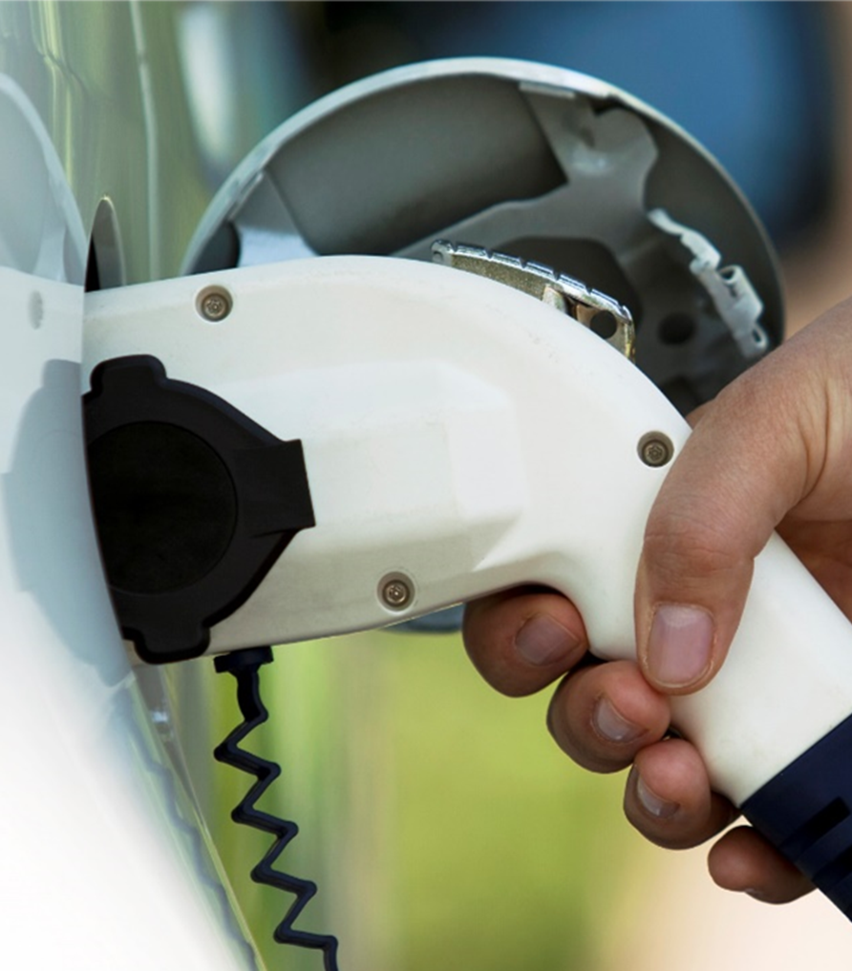
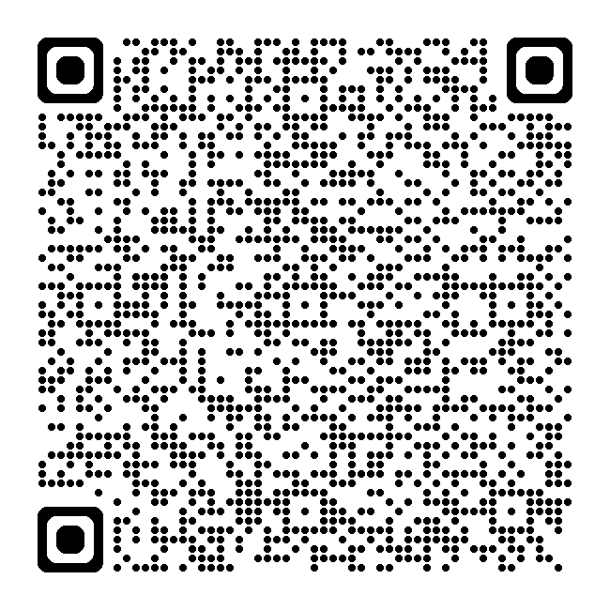
Workgroup Feedback Opportunity: Meet with MDOT
Schedule a meeting with our ZEVIP team
Notes:
From mid July through early August, MDOT is inviting workgroup members to schedule one-on-ones with us to provide your feedback. You can book a session with us using the link on the slide.

