Slide 1
Maryland’s Phase III
Watershed Implementation Plan for the Chesapeake Bay TMDL
Water Quality Trading Advisory Committee
MDA Headquarters
March 26, 2018
Greg Busch
gregory.busch@maryland.gov
MDE Integrated Water Planning Program

Slide 2
Chesapeake Bay TMDL Basics
Established by EPA in 2010
  Load caps for nitrogen, phosphorus and sediment
  Six bay states and DC
Accountability Framework
  Develop Watershed Implementation Plans
  Set two-year milestones
  Monitor progress
  EPA consequences for inadequate progress
Bay TMDL Progress is measured
  Using computer models
  Evaluating milestones
  Assessing water quality data
  The TMDL is designed to ensure that all pollution control measures needed to fully restore the Bay and its tidal rivers are in place by 2025
2

Slide 3
Bay TMDL and 3-Phase Planning Process
2010 Chesapeake Bay TMDL established
General plan with strategies to meet at least 60% by 2017
Phase I WIP
2010
2025
More detail on strategies, extensive local engagement, local plans and growth
Phase II WIP
2012
2017
2025
Detailed plan with local goals to meet 100% by 2025
Phase III WIP
2017
2025
3

Slide 4
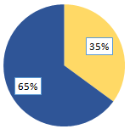
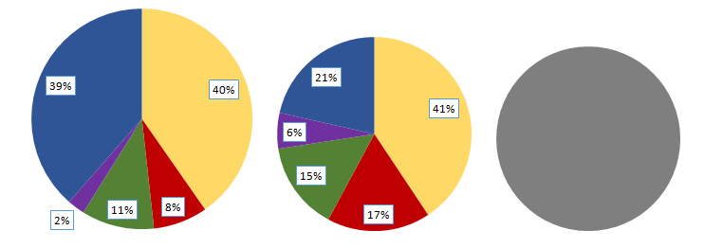
Maryland’s Progress: Nitrogen
Where did the reductions come from?
1985
83.6 M lbs
2017
56.0 M lbs
2025 WIP3 Target
45.3 M lbs
All numbers are edge-of-tide nitrogen loads based on the Phase 6 Chesapeake Bay Watershed Model
4

Slide 5
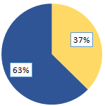
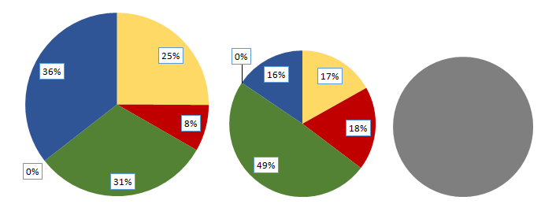
Maryland’s Progress: Phosphorus
Where did the reductions come from?
1985
7.42 M lbs
2017
3.79 M lbs
2025 WIP3 Target
3.60 M lbs
All numbers are edge-of-tide phosphorus loads based on the Phase 6 Chesapeake Bay Watershed Model
5

Slide 6
Developed Sector Highlights
Cost effective wastewater upgrades already implemented and continuing
  95% of municipal wastewater flow will be upgraded to enhanced nutrient removal technology
Stormwater focus on water quality improvement
  90% of impervious land covered by NPDES stormwater permits
    Retrofit older “untreated” development with stormwater controls
  Environmental Site Design for new development
Focus on correcting failing septic systems to ensure public health
6

Slide 7
Why a New Cleanup Plan Now?
Models have been improved (new Phase 6)
  More monitoring data
  Improved land cover
  Conowingo
  Updated BMP efficiencies
Updated models approved December 2017
Approve new state planning targets in May 2018
7

Slide 8
Reaching our 2025 targets
Overall health of Bay continues to improve
Robust Funding Programs (BRF, Trust Fund, Stormwater, MACS)
Wastewater & agriculture have taken significant pollution reduction actions
Reductions in air source contributions
Next generation stormwater permits
Trading program
2025 targets will be require additional effort from Maryland
All states in Bay watershed must do their part
8

Slide 9
Building Blocks of Phase III WIP
WIP Phase II
  County plans
  Soil conservation district implementation strategies
Wastewater permits
MS4
  Financial Assurance Plans
  TMDL Implementation Plans
Funding
  BRF, Trust Fund, stormwater, MACS
  2015 UMD EFC Report
    MD Chesapeake Bay Restoration Financing Strategy
Water quality trading

Slide 10
Phase III WIP Gap Analysis - Preview
Reductions achieved
Planned reductions
Remaining gap
?
Achieved under Phase II WIP
Based on regulations in place and current funding
Gap Analysis:
How large?
How to achieve?
10

Slide 11
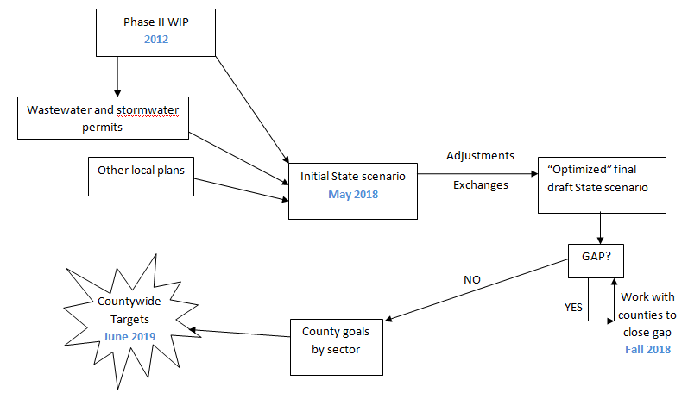
Phase III WIP Planning
11

Slide 12
Phase III WIP Considerations
Identify pollution reduction already being done
What can be accomplished by 2025?
Identify any gaps
Strategies to fill any gaps
Funding needs for implementation
Pace of implementation beyond 2025
Account for growth
Conowingo
Climate change
Local engagement and goals
12

Slide 13
Phase III WIP Schedule
Spring 2018: Maryland review Draft Planning Targets
May-June 2018: Five Phase III WIP regional meetings
Summer 2018: Technical webinars
March 2019: Draft WIP complete
June 2019: Final WIP complete
13

Slide 14
Conclusions
Overall health of Bay continues to improve
2025 targets are achievable, but will require more effort
Conducting gap analysis now
Regional meetings in May and June
More about the Phase III WIP at the next WQTAC meeting
  What would you like to hear more about?
WIP Outreach Coordinator:
Kathy Stecker
kathy.stecker@maryland.gov 410-537-3864
14

