Slide 1
Local Water Quality: Trading to Meet the MS4 Responsibility for Nutrient & Sediment Reductions to the Chesapeake Bay
Presentation to
Maryland’s Trading Advisory Committee
March 21, 2016

Slide 2
Overview
MS4s address multiple local and Bay WLAs.
Local WQ: Local WQ requirements are met when sufficient progress is made towards all WLAs during a permit period.
Pace: The pace of progress must be balanced among local and Bay WLAs.
Priorities: Only Bay WLAs have a firm 2025 deadline.
Balance: The 10/10 policy in the Trading Manual is the proposed balance.

Slide 3

Local Waters
Defined at the scale managed under the Section 303 of the Clean Water Act
Same scale used to:
Set Water Quality Standards (WQS)
Assess Attainment of WQS
List Impairments
Set Waste Load Allocations (WLAs) under a TMDL
Grouped by Tidal and Non-Tidal
A Question of Scale

Slide 4
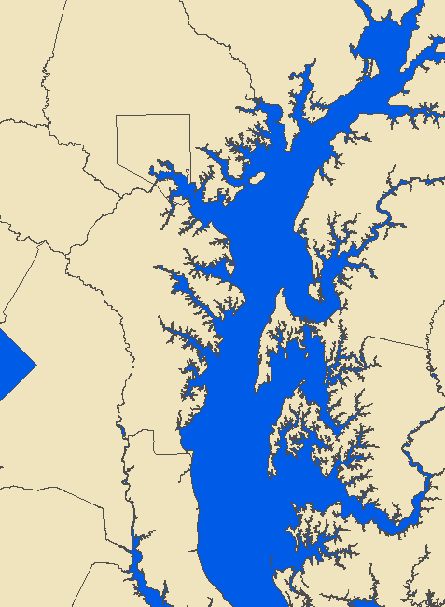
Tidal River Segments
Local:
Western Shore
Tidal Segments
Bush
CB1
Gunpowder
Middle
Back
Patapsco
CB2
Magothy
CB3
Not Local:
Main Bay Tidal Segments
Severn
South
Rhode
West
CB4
Patuxent

Slide 5
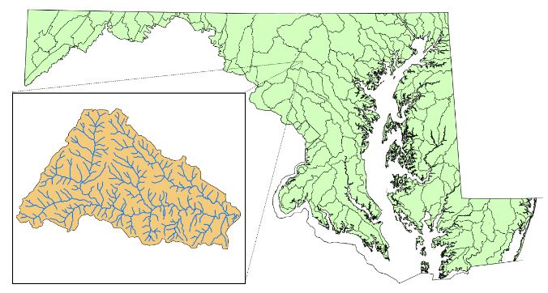
Non-Tidal Waters
Non-tidal Streams & Rivers are generally defined at the Maryland 8-digit watershed scale

Slide 6
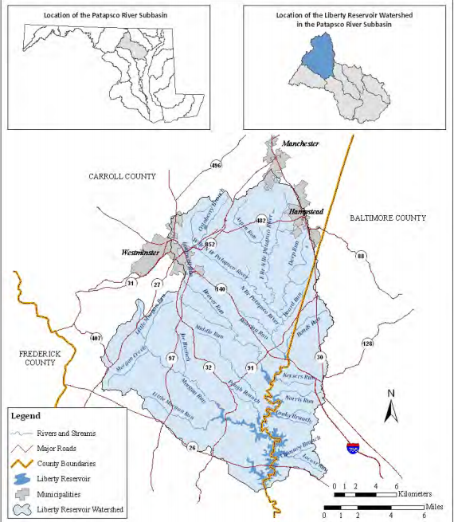
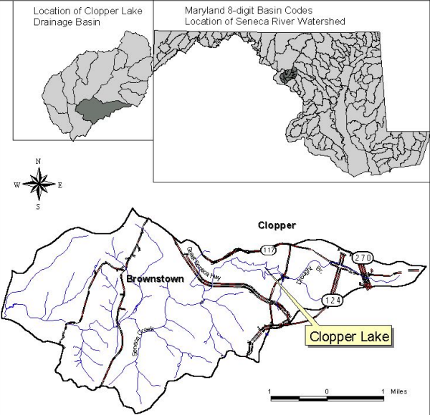
Non-Tidal Waters
Impoundments: Large and Small
Liberty Reservoir:
Maryland 8-digit watershed
Clopper Lake:
Smaller than Maryland 8-digit waterhsed

Slide 7
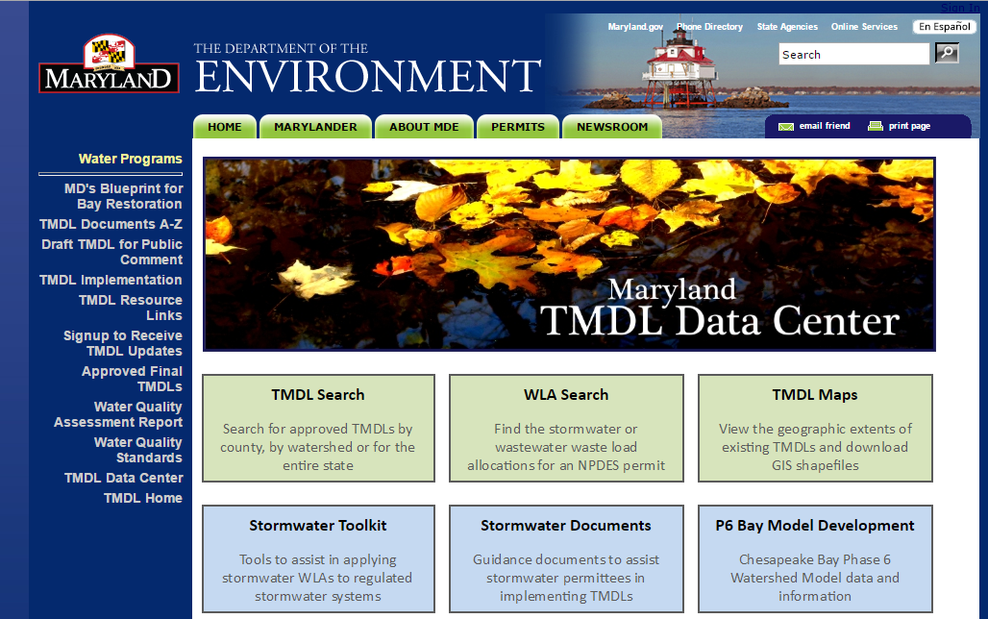
Identifying Local Waters with MS4 WLAs

Slide 8

EPA Local WQ Issue
“A credit generated in one watershed should not be used to offset a load, either existing or proposed, in another watershed unless there is a clear demonstration that the resulting discharges will not cause or contribute to a failure to comply with any applicable water quality standard (WQS).” - EPA Local WQ Tech Memo.
A Question of Permit Consistency
Notes:
At Issue:
We are talking about reducing “existing “ loads via a restoration provision in an MS4 permit
We are talking about MS4 permits complying with applicable water quality standards.

Slide 9
MS4 Permit Consistency with TMDL WLAs
If progress is required toward all WLAs in the MS4 permit, then it is consistent with the WLAs.
If progress is being made toward all WLAs, then the local water quality issue is a question of pace.
A Question of Pace
Notes:
Is progress being made fast enough?

Slide 10

Ensuring Pace Toward MS4 WLAs
"the permit requires that the County submit restoration plans and a final date for meeting stormwater WLAs approved by EPA."
(Phase I MS4 final determination language)
A Question of How
Notes:
The Restoration plans include estimated deadlines for addressing local WLAs.

Slide 11

Pace of Progress Towards MS4 WLAs
TMDLs generally do not include deadlines for meeting respective WLAs. One exception to this rule is the Chesapeake Bay TMDL, which… must be met by 2025.
(Phase I MS4 final determination language)
A Question of Priorities
Notes:
The issue of making progress fast enough depends on the allocation of limited resources and is a matter of priorities.
The 2025 Bay restoration priority is a significant factor in weighing the priorities.

Slide 12

Balancing Pace Toward MS4 WLAs
Trading Manual Proposal:
Credits can be acquired at any time during the permit term to meet up to 10 Percent [half] of the MS4 jurisdiction's [20%] restoration requirement. (Draft Maryland Trading Manual )
A Question of Balance
Notes:
The 10/10 policy is, in part, a proposal about striking a balance between local WQ and Bay WQ.

Slide 13

Balancing Pace Toward MS4 WLAs
First 10% SW restoration ensures progress toward local WQ.
Second 10% via trading is primarily for Bay WQ, but prioritizes purchase of local credits.
About 90% of expenditures will be for the first 10% due to higher cost per pound reduced.
A Question of Simplicity
Notes:
Simplicity: Given the priority of meeting the Bay WLA by 2025, focusing the first 10% on local WQ should suffice to meet the local WQ objective particularly given that roughly 90% of the expenditures will be implemented locally. Prioritizing the purchase credits locally should be viewed as desirable, but non-mandatory, enhancement. This will simplify the complexity of the policy and increase the likelihood of a viable trading market.

Slide 14
In Summary
MS4s address multiple local and Bay WLAs.
Local WQ: Local WQ requirements are met when sufficient progress is made towards all WLAs during a permit period.
Pace: The pace of progress must be balanced among local and Bay WLAs.
Priorities: Only Bay WLAs have a firm 2025 deadline.
Balance: The 10/10 policy is the proposed balance.

Slide 15
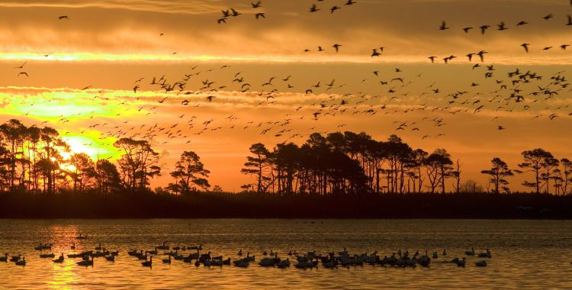
End

