Slide 1
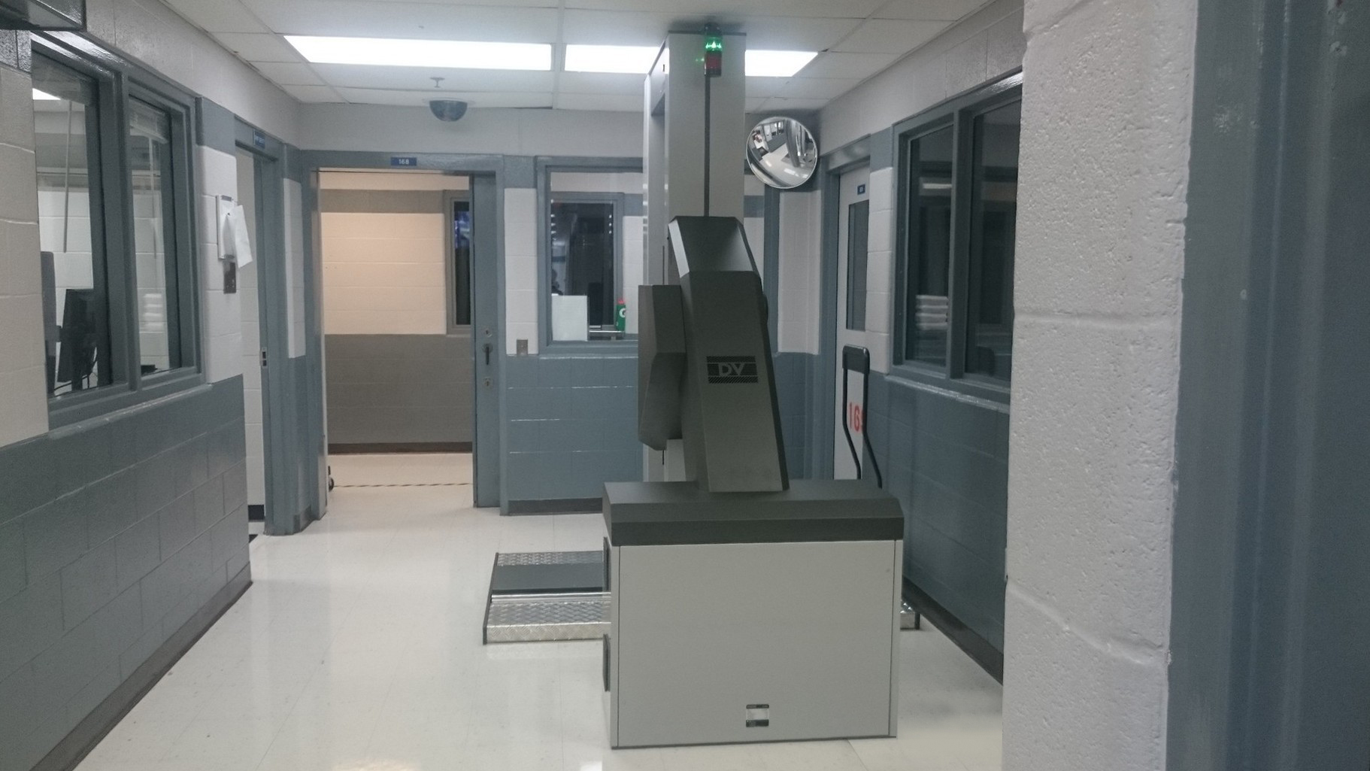
Scott Ortolani
Chief Operating Officer
ADANI Systems, Inc.
September 19, 2018
CUSTOMER FOCUSED SOLUTIONS
CONPASS DV:
RADIATION SAFETY & EASYDATA2

Slide 2

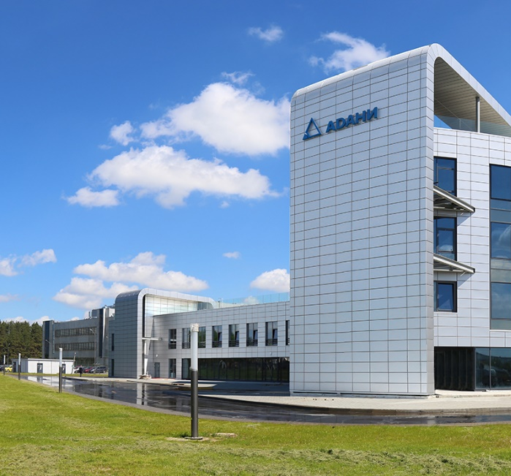
Who We Are
ADANI a world leader in the design, manufacture, of digital X-ray slot-scanning technology for medical and security applications.
Certified by ISO 9001:2008, ISO 13485:2003 guaranteeing international quality standards.
All products meet applicable industrial standards and fully comply with ANSI 43.17-2009 and INTERTEK ETL requirements.

Slide 3
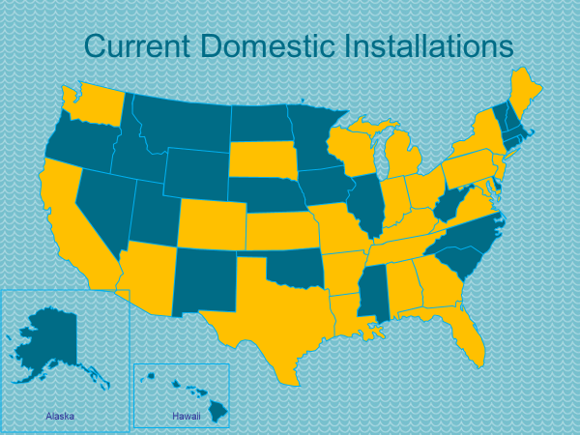
Who We Are
ADANI SYSTEMS, Inc.
Success Story
We have successfully installed and currently support more than 600 units in the US and Latin America

Slide 4


X-RAY SECURITY SCREENING SYSTEMS
REFERENCES
Over 2100 CONPASS INSTALLATIONS in 58 countries of the world including:
UAE
1-st CONPASS
KSA
Heathrow Airport
Minsk Airport
Bahrain Airport
Oslo Airport
Nairobi Airport
Islamabad Airport
19 airports in Russia
CATOCA diamond mine
(ANGOLA), 1999
4 seaports in Russia
500 installations in USA
www.adanisystems.com
2016

Slide 5
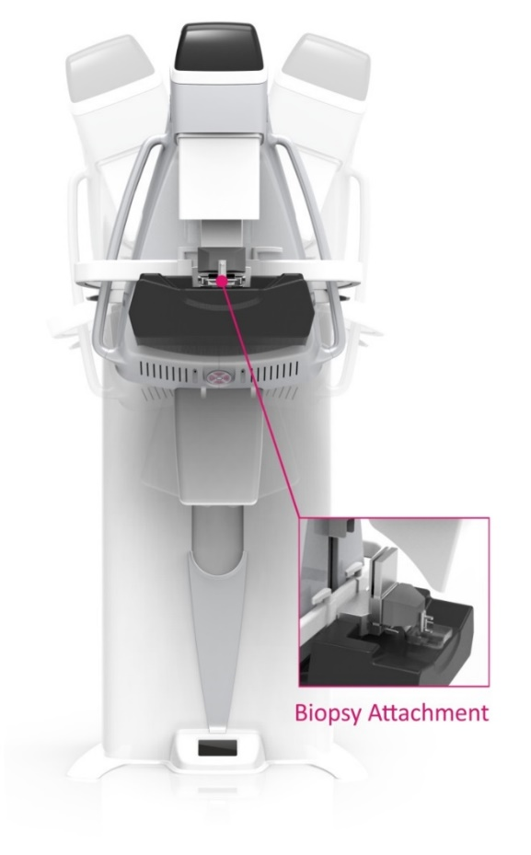
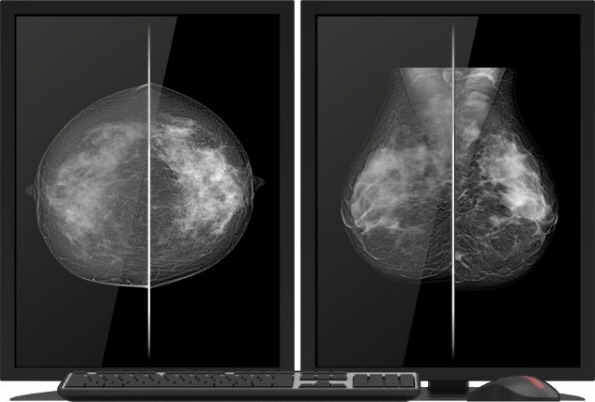
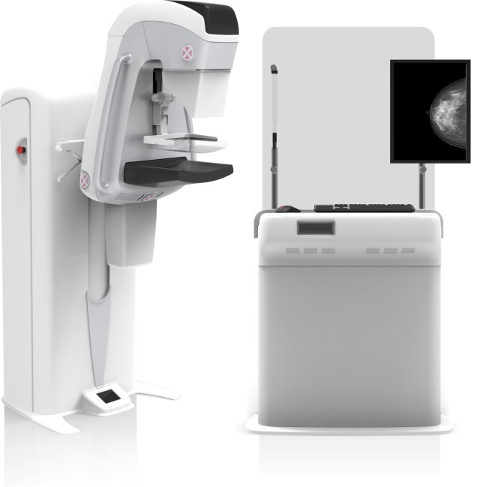
MEDICAL X-RAY SYSTEMS
FULL-FIELD DIGITAL MAMMOGRAPHY SYSTEM
MAMMOSCAN
www.adanisystems.com

Slide 6
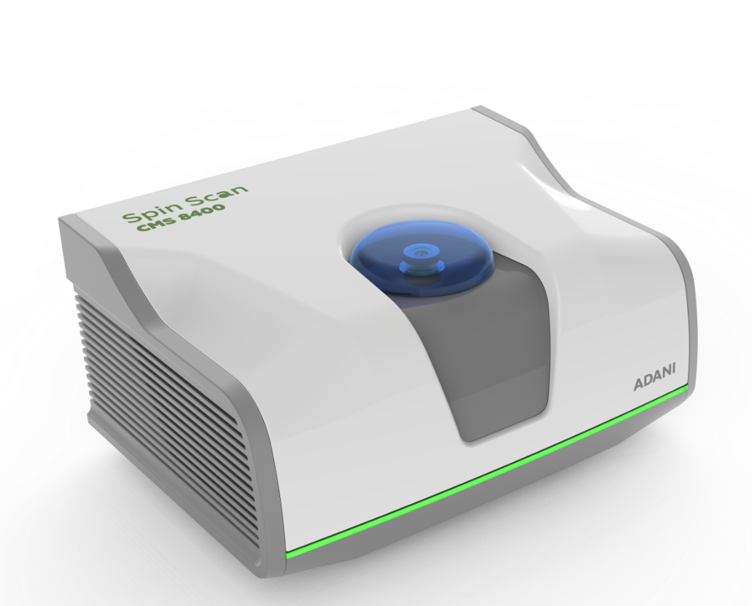
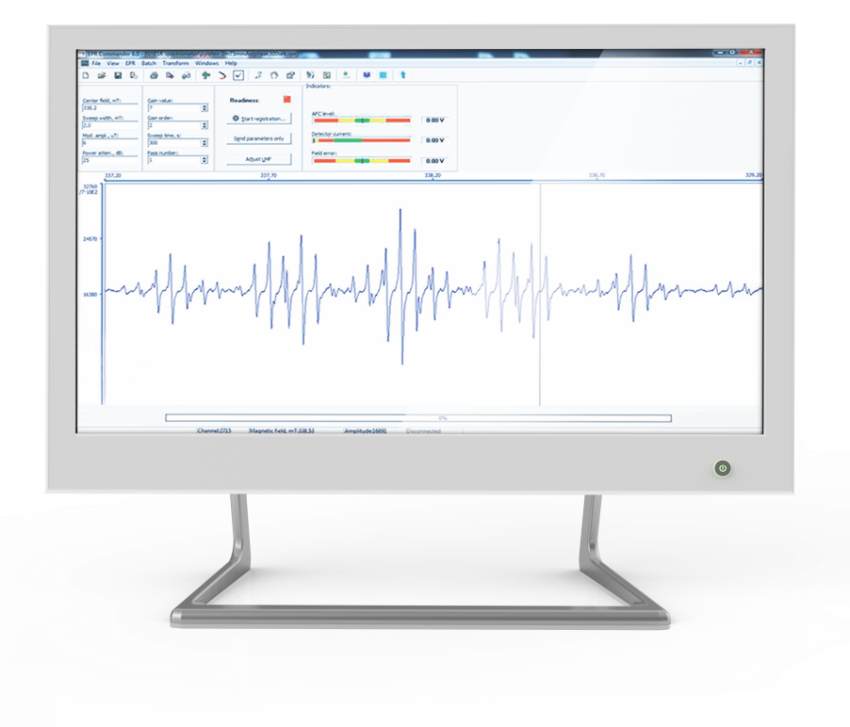
ADANI ANALYTICAL INSTRUMENTS
BENCH TOP EPR SPECTROMETER FOR SCIENTIFIC RESEACH, EDUCATION AND INDUSTRIAL APPLICATION
ADANI CMS 8400
www.adanisystems.com

Slide 7
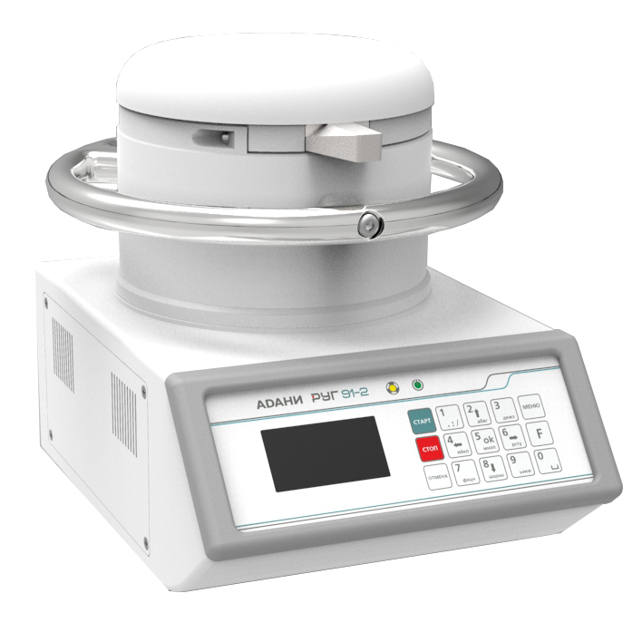
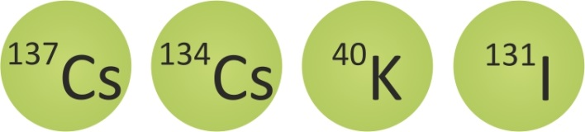
ADANI ANALYTICAL INSTRUMENTS
BENCH TOP GAMMA-RAY SPECTROMETER FOR RADIOLOGICAL
FOOD SCREENING
ADANI RUG 91-2
www.adanisystems.com

Slide 8
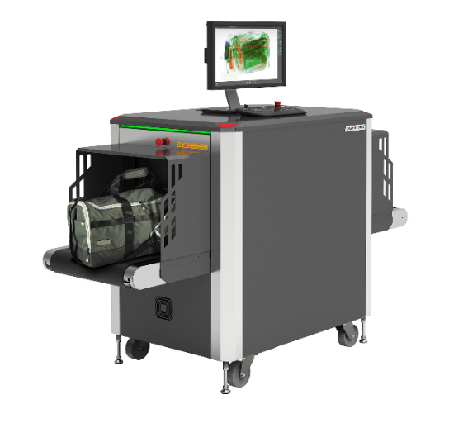
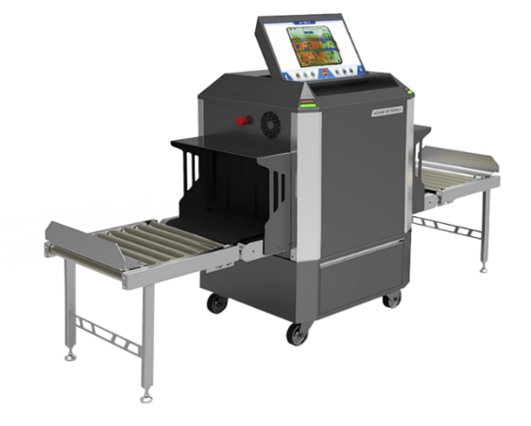
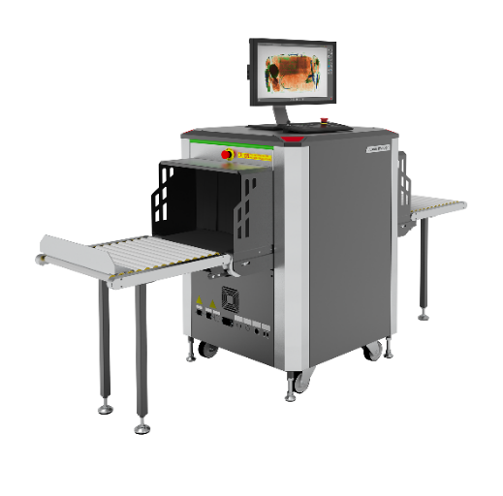
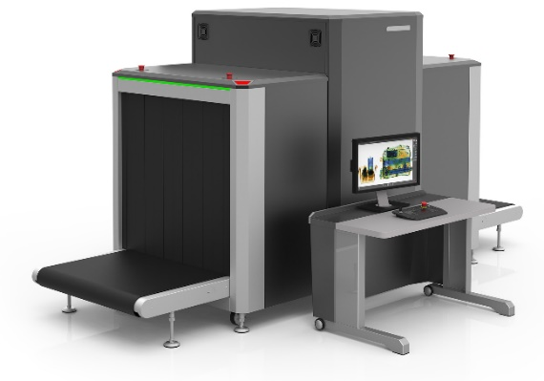
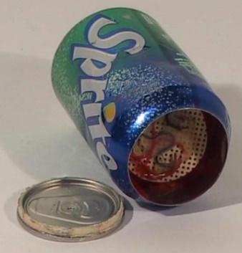

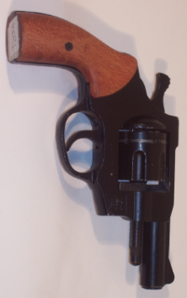
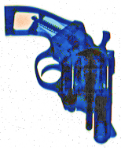
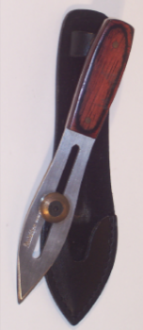
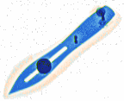
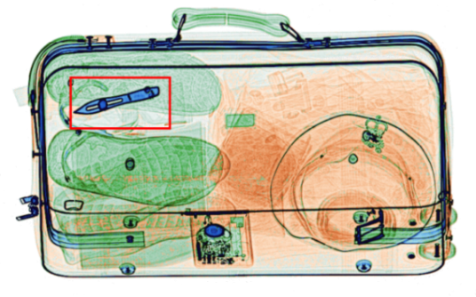
PARCEL, BAGGAGE AND CARGO X-RAY INSPECTION SYSTEMS
BV 5030CA
BV 5030
BV 6045
BV 100100

Slide 9
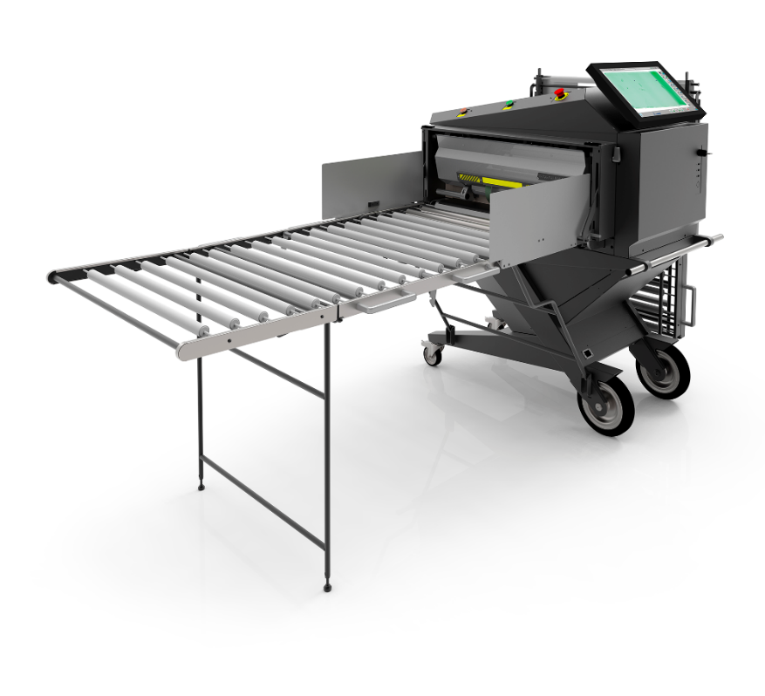
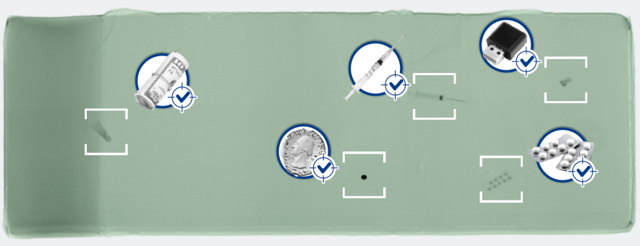
BV M.A.X.
BV M.A.X. is a compact mobile conveyor type X-ray screening system for fast, effective and contact-free inspection of mattresses and inmates' personal property.
Due to the compact design and special wheels the
BV M.A.X. can be easily relocated and deployed wherever security inspection is needed.
This movable and highly versatile tool is the first system designed specifically to address the problem of contraband hidden in mattresses. It is created to eliminate the need to fold mattresses to fit into conventional X-ray inspection systems. BV M.A.X. has also full baggage scanner functionality able to inspect mail and personal property.

Slide 10
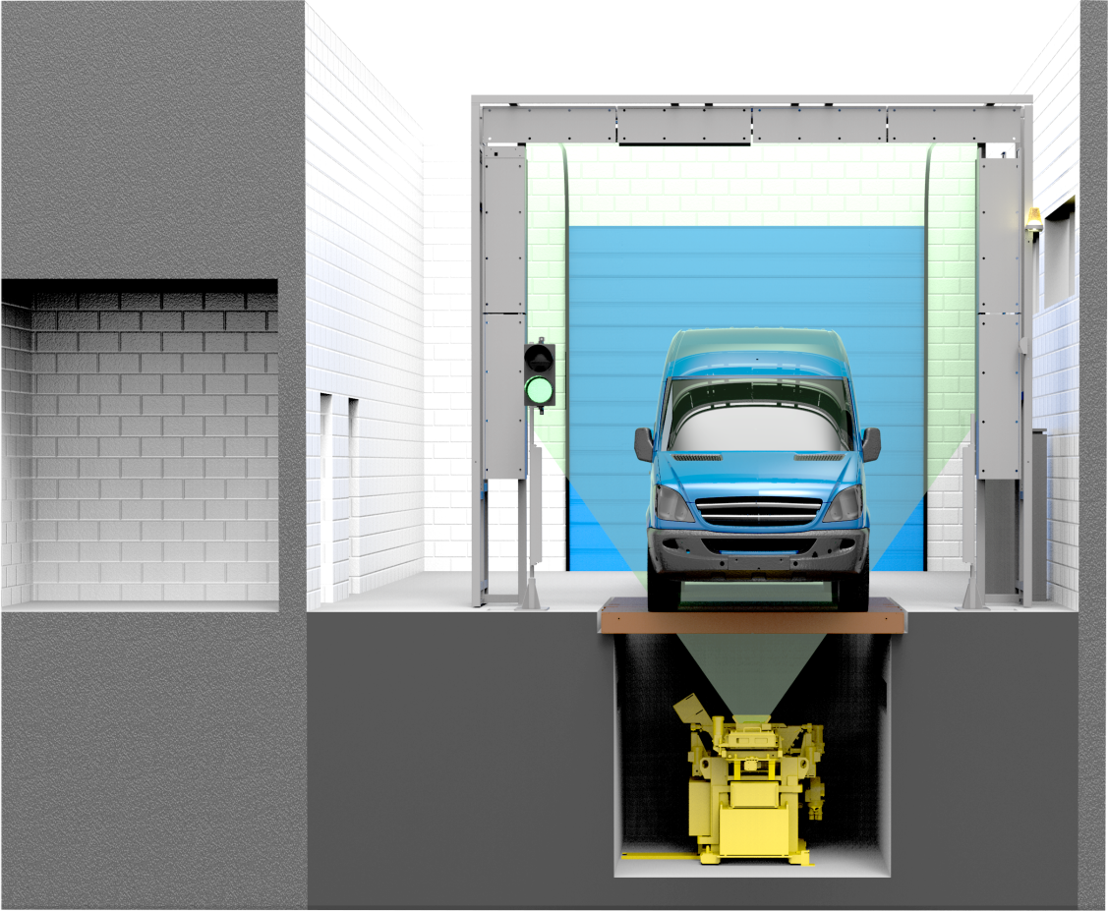
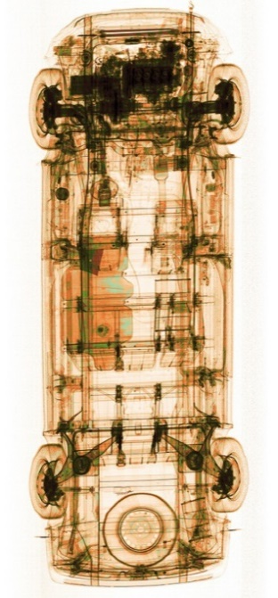
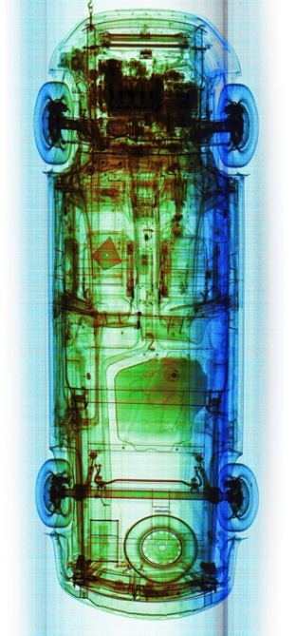
SECURITY X-RAY SCREENING SYSTEMS
DRIVE-THROUGH PORTAL PASSENGER VEHICLE AND VAN INSPECTION
DTP 7500/200S
www.adanisystems.com

Slide 11
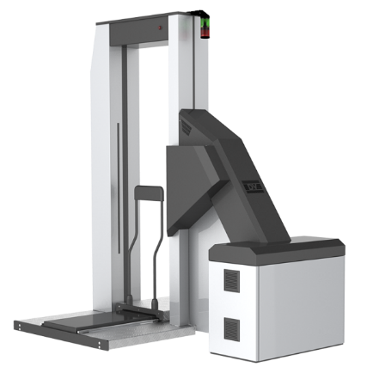
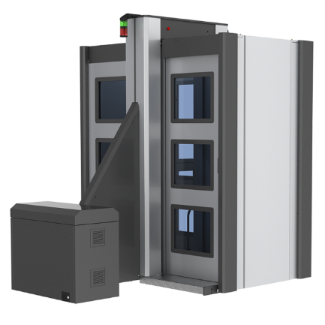
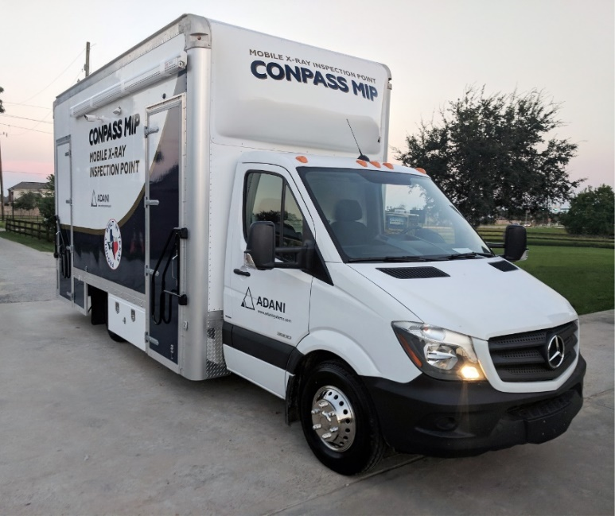
CONPASS PRODUCTS
CONPASS DV (DUAL VIEW)
CONPASS X-RAY PROTECTIVE CABIN
CONPASS MIP

Slide 12
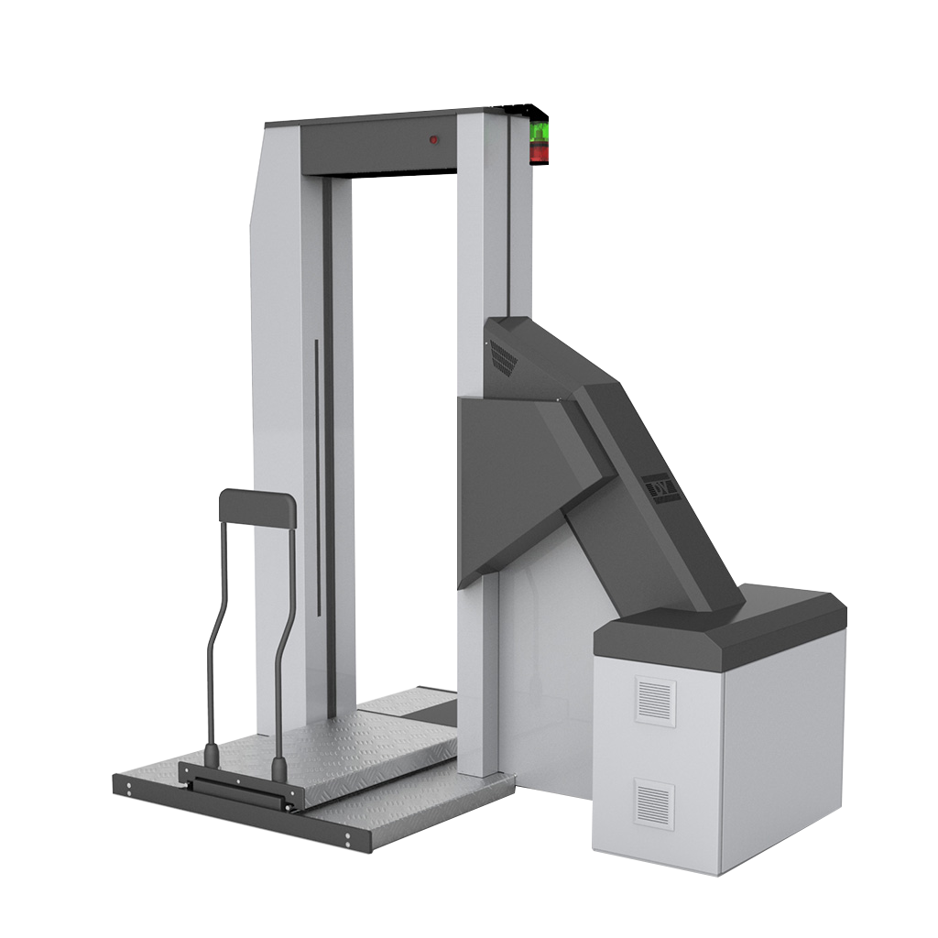
CONPASS DV WHOLE BODY IMAGING SYSTEM
CONPASS DV
DUAL-VIEW TRANSMISSION X-RAY
ITEMS IMAGED:
Narcotics
Pills & Medication
Cell Phones
Sim Cards & Flash Cards
Money
Razors & Needles
Syringes
Weapons
Explosives (Including Liquid)
Detonators
Knives & Blades

Slide 13
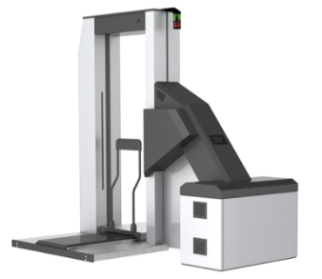
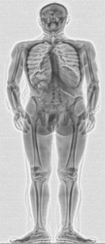
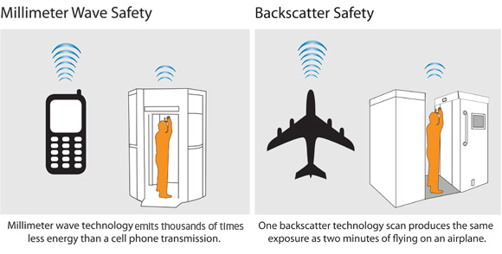
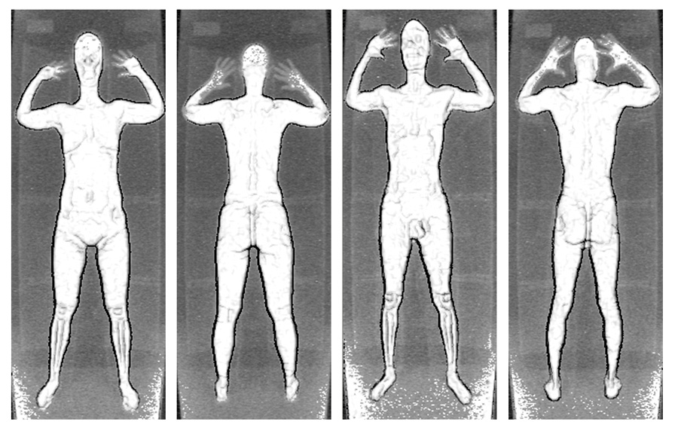
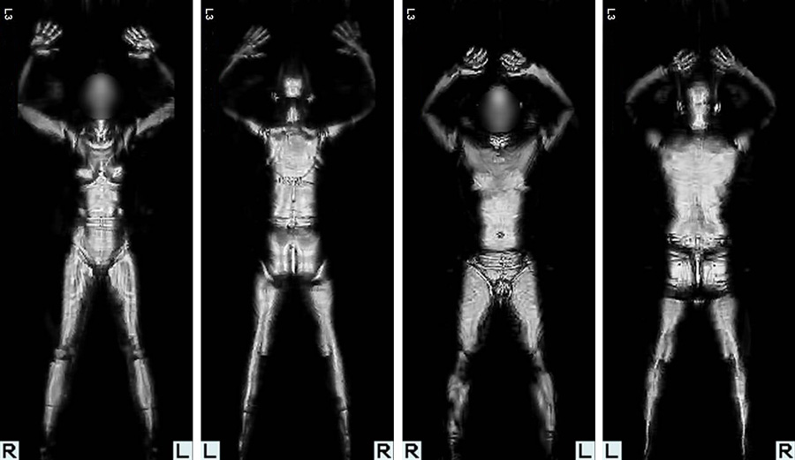
ACTIVE BODY SEARCH TECHNOLOGIES
TRANSMISSIOM X-RAY
X-Rays are penetrating the body
BACKSCATTER X-RAY
X-ray detects the radiation that reflects from the target
BOMBS IN CAVITIES
Millimiter wave radiation is reflected from the body
www.adanisystems.com

Slide 14
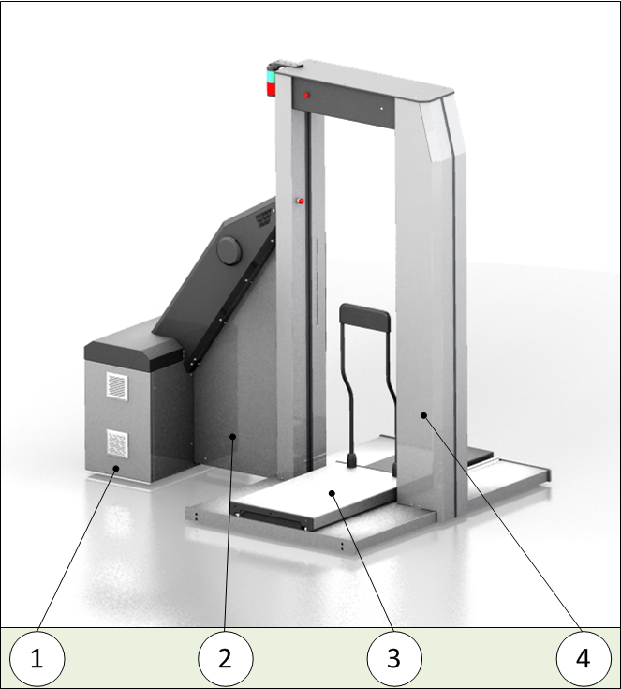
CONPASS DV
CONPASS DV
MAJOR ASSEMBLIES OF THE SCANNER
(without the operator’s workstation)
Enclosure;
Generator cabinet;
Moveable platform;
Gantry.

Slide 15
CONPASS DV
2 INDEPENDENT VIEWS
2 X-Rays sources positioned on the different levels from the ground provides 2 independent views of the object
SMALL FOOTPRINT
2500 mm
OPTIMAL GEOMETRY
2nd view is specially dedicated for inspection of abdomen area, while 1st view provides the full body image.
HIGH RESOLUTION
Due to higher spatial resolution and higher penetration, dual-view system provides better detectability of internally concealed small objects
2260 mm
2000 mm

Slide 16
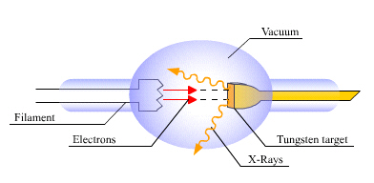
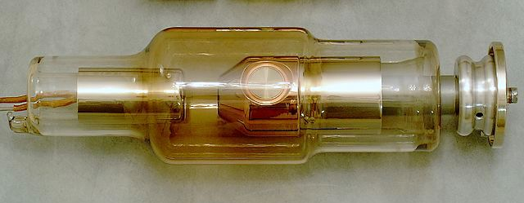
X-RAY SECURITY SCREENING SYSTEMS
X-RAY PRODUCTION
In CONPASS X-rays are created in a vacuum tube.
High voltage (150-200 kV) is applied between anode and cathode.
Electrons emitted by a heated filament are accelerated by high voltage
and strike the target to produce X-rays.
X-rays are only available when the system is TURNED ON.
Remove the X-ray source power – no X-rays are produced
cathode
anode
2016
www.adanisystems.com

Slide 17
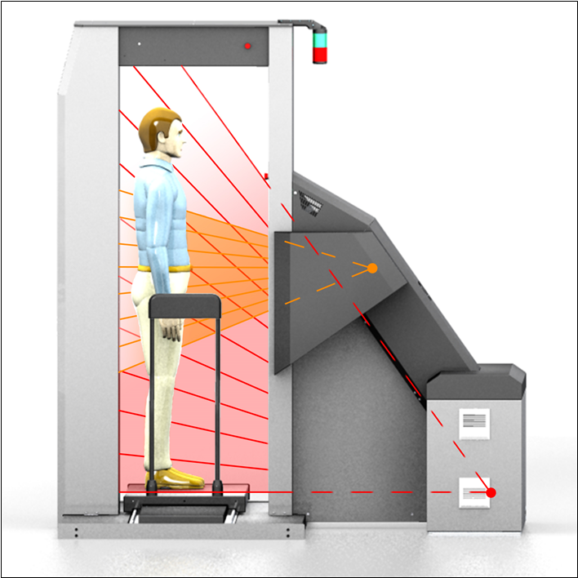
X-RAY SECURITY SCREENING SYSTEMS
Operation
Shutter is a device that controls X-ray emission to the Portal when X-ray source is powered on.
Shutter is opened when scanning is started and is closed when scanning is stopped.
Shutter is automatically closes in case of any fault or emergency event.
If Shutter fails, the system shuts down automatically.
Path of X-Rays (during scanning)
2016
www.adanisystems.com

Slide 18
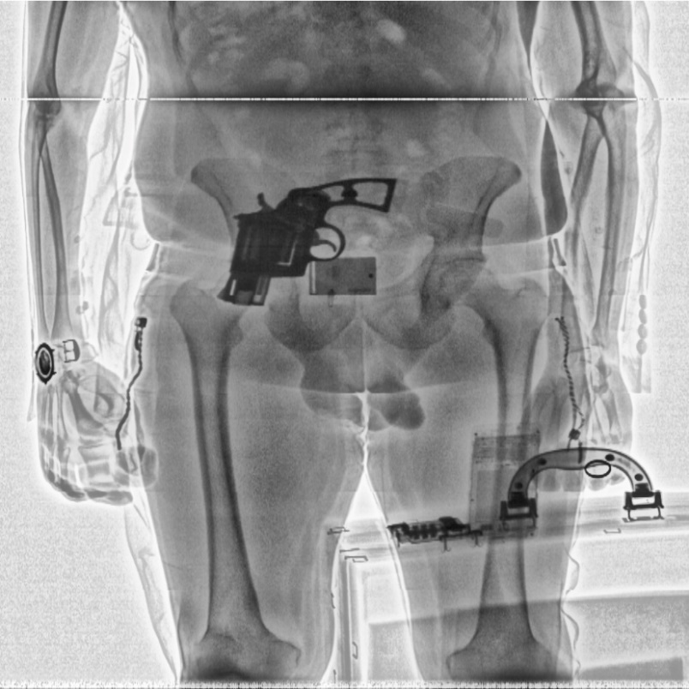
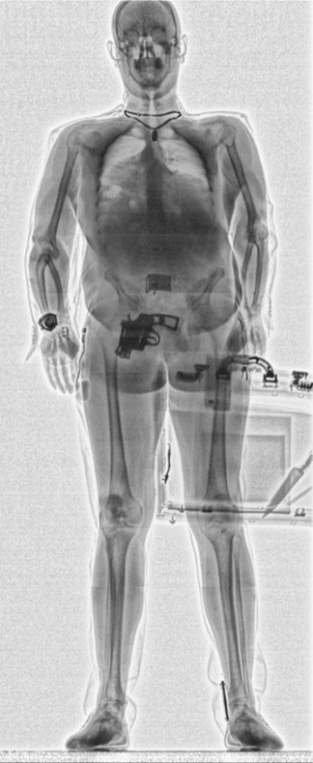
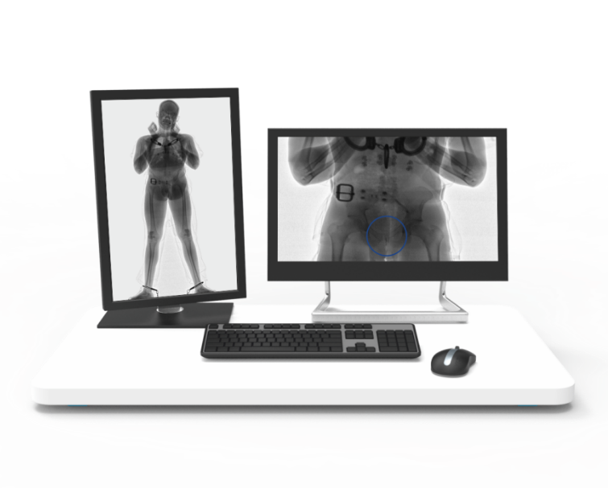
CONPASS DV
DUAL GENERATOR
DUAL IMAGE
DUAL EFFECTIVNESS
Work station for CONPASS

Slide 19
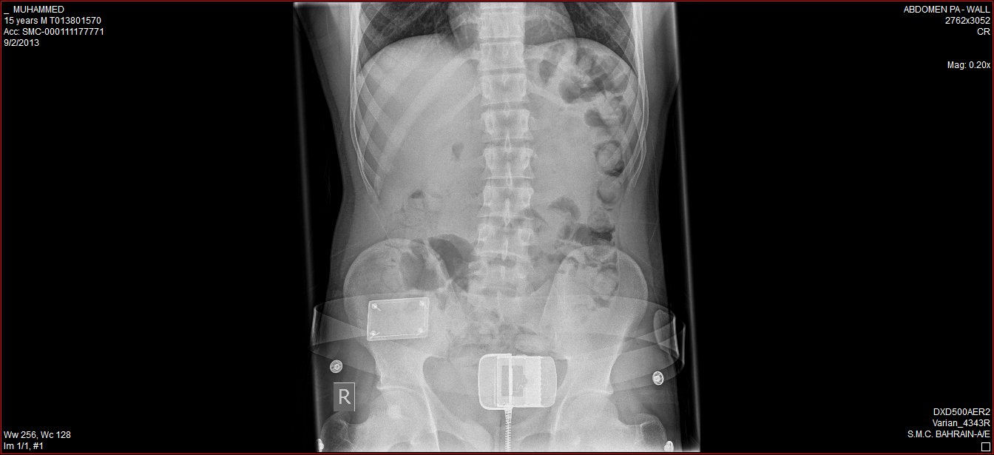
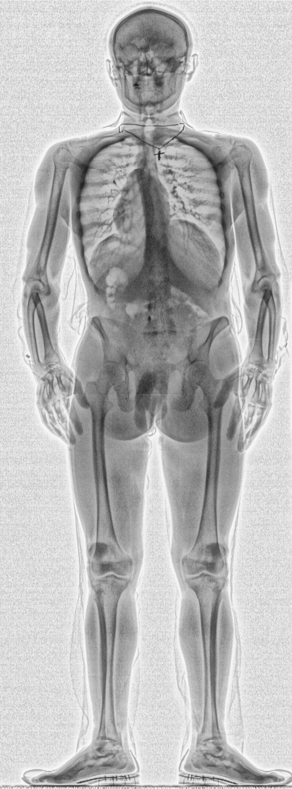
CONPASS DV IMAGE QUALITY
The CONPASS DV provides the best image quality versus dose available among transmission X-ray body scanners.
The second projection significantly enhances detection capability. Especially for swallowed drugs detection.
Image obtained on
Medical X-ray system
X-ray radiation dose – 150 µSv
Image obtained on the
CONPASS DV (torso view)
X-ray radiation dose – 2 µSv

Slide 20
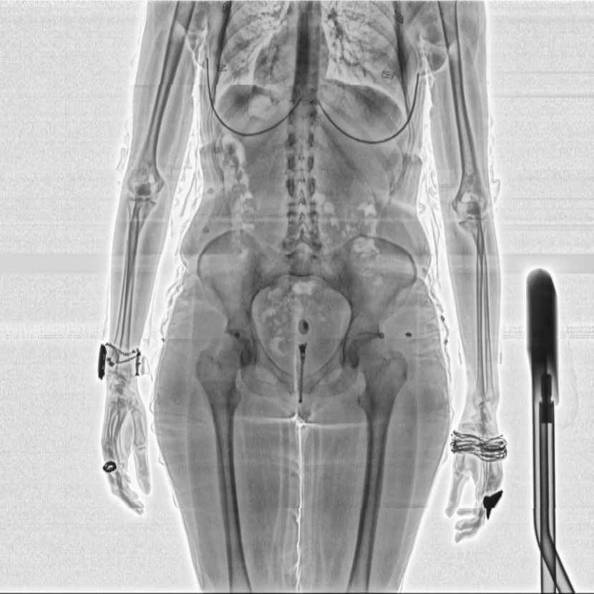
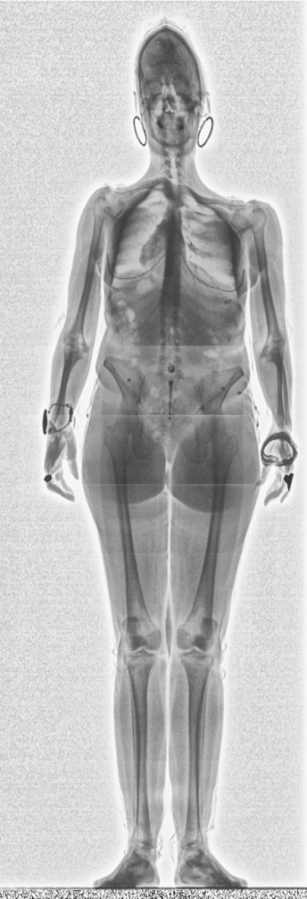
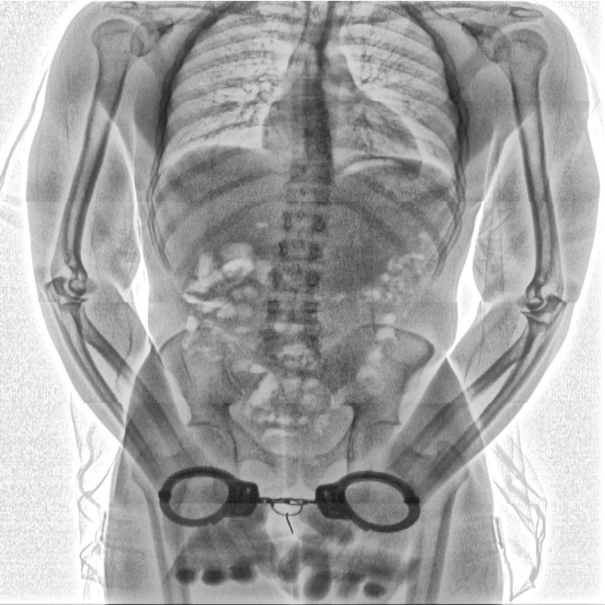
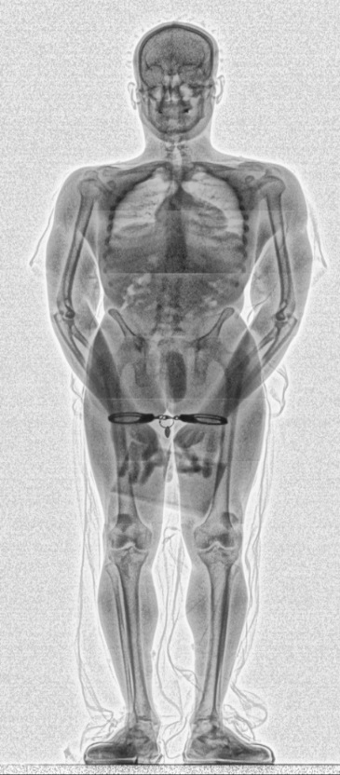
CONPASS DV X-RAY IMAGES
www.adanisystems.us

Slide 21
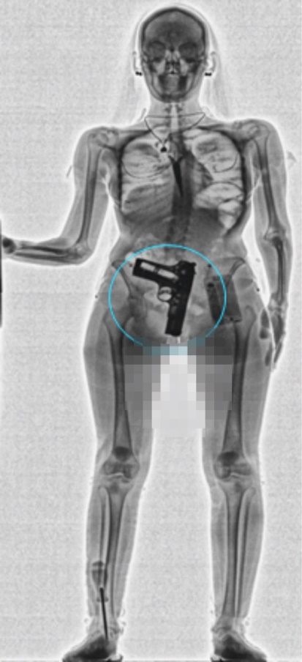
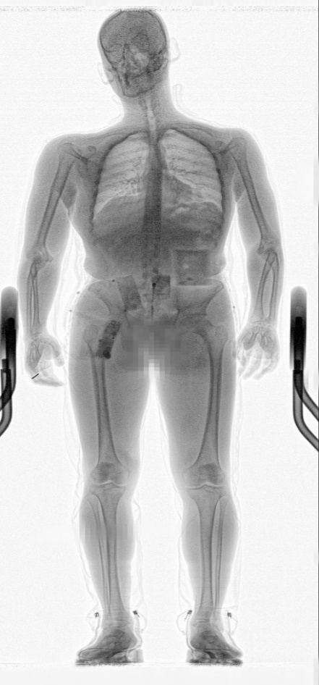
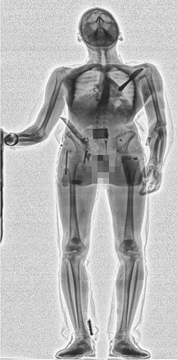







CONPASS DV X-RAY IMAGES
WEAPONS
IED
CERAMIC KNIVES
SWALLOWED DRUGS
PRECIOUS STONES

Slide 22


RADIATION SAFETY
General-use system ≤ 0,25µSv per screening
Limited-use system ≤ 10 µSv per screening
40 CONPASS SCREENINGS GIVE NEGLIGIBLE ANNUAL DOSE
1000 CONPASS SCREENINGS
ARE ALLOWED ANNUALLY PER INDIVIDUAL
Effective dose to individual ≤ 250 µSv per year
Effective dose to operator ≤ 1 mSv per year

Slide 23

X-RAY SECURITY SCREENING SYSTEMS
BACKGROUND RADIATION
Other
EVERYONE IS EXPOSED TO IONIZING RADIATION FOUND NORMALLY IN NATURE
Cosmic Rays
Terrestrial
Gas Radon
Man-made sources like Consumer products
(TV, tobacco, smoke detectors, nuclear plants etc.) and Medical sources contribute to annual dose as much as 18%.
Food
Consumer products
Medical
The background radiation level is about 3 mSv (300 mrem) per year.
2016
www.adanisystems.com

Slide 24




RADIATION SAFETY
The average annual radiation dose per person per year is approximately 2400 μSv
 | 250μSv | Travel and power stations
 | 300μSv | Cosmic rays
 | 400μSv | Food and drink
 | 800μSv | Terrestrial radiation

Slide 25
RADIATION SAFETY
Medical radiation sources and doses
Typical doses during X-ray examinations
Scans | Dose
Bone | 4600μSv
Thyriod | 2600μSv
Lung | 2600μSv
Liver | 1700μSv
Kidney | 1400μSv
Soft tumors | 40000μSv
X-rays
X-rays (conventional)
Chest | 20μSv
Leg or foot | 20μSv
Dental | 5-10μSv
Skull | 70μSv
Barium metal | 2500μSv
Intestine | 3000μSv
Mammography | 400μSv
X-rays (computerized)
Routine head | 2600μSv
Routine abdomen | 13000μSv

Slide 26

X-RAY SECURITY SCREENING SYSTEMS
WHAT IS “SAFE” DOSE LEVEL?
International Commission On Radiation Protection (ICRP) for those who work with radiation and for general public has established the limits in the table above.
Different federal and local governments, companies, and organizations may set different acceptable levels, via policy or law.
  It is the responsibility of the operator of x-ray equipment to be familiar with and comply with the policies and laws governing the use of x-ray equipment.
Adhere to ALARA principle in all situations - “As Low As Reasonably Achievable”.
2016
www.adanisystems.com

Slide 27
X-RAY SECURITY SCREENING SYSTEMS
LIMITATION OF ACCUMULATED DOSE TO SCANNED PERSONS
Annual accumulated dose for a person to be inspected shall not exceed 250 μSv from one facility. In the Table below permissible number of screenings is shown.
Dose per screening | Maximum number of screenings
 | daily | weekly | quarterly | yearly
0.25 μSv | 2 | 19 | 250 | 1000
0.5 μSv | 1 | 9 | 125 | 500
1.0 μSv | - | 4 | 62 | 250
1.5 μSv | - | 3 | 41 | 166
2.0 μSv | - | 2 | 31 | 125
2016
www.adanisystems.com

Slide 28


RADIATION SAFETY
ANSI Compliance
ADANI CONPASS typical X-Ray emission is 0.25 μSv per scan.
CONPASS scanner is fully comply with American National Standard ANSI 43.17-2009 “Radiation Safety for Personnel Security Using X-Ray or Gamma Radiation”.
A personnel screening system that delivers a reference effective dose equal or less than 0.25 μSv (25 μRem) is classified as general-use system that does not require administrative control.
System guarantees a high degree of radiation safety due to the extremely low doses delivered and engineering controls incorporated in the system.
ANSI 43.17.2009

Slide 29

X-RAY SECURITY SCREENING SYSTEMS
SHIELDING
6 mm Pb
CONPASS has built-in shielding to minimize radiation leakage:
2 mm lead on collimator sides,
6 mm lead beam stopper behind vertical part of detector,
X-ray source lead shielding.
2 mm Pb
2016
www.adanisystems.com

Slide 30


X-RAY SECURITY SCREENING SYSTEMS
CONPASS RADIATION CONTROL INSTRUMENTS
Built in dosimeter
Monitors the individual dose rate. Located in the direct path of the X-ray beam.
Built in dose measurement software
Records the personal data of the inspected people, calculates the total amount of scans and stores the captured data on the PC or uploads to networked storage.
2016
www.adanisystems.com

Slide 31

RADIATION SAFETY
CONPASS DV RADIATION SAFETY ZONE
4 cans of water (test object)
Radiation was measured in 6 different
scanning modes:
Main and optional projections enabled. Generators are on at max modes (160kV; 1.2мА)
Main and optional projections enabled. Generators are on at min modes (160kV; 0.2мА)
Only main projection is enabled. Generator is on at max mode (160kV; 1.2мА)
Only main projection is enabled. Generator is on at min mode (160kV; 0.2мА)
Only optional projection is enabled. Generator is on at max mode (160kV; 1.2мА)
Only optional projection is enabled. Generator is on at min mode (160kV; 0.2мА)

Slide 32


RADIATION SAFETY
CONPASS DV RADIATION SAFETY ZONE
6 different scanning modes:
Main projection active, generator = 160kv, 1.2mA
Optional projection active, generator = 160kv, 1.2mA
Main projection active, generator = 160kv, 0.2mA
Optional projection active, generator = 160kv, 0.2mA
1
2
Radiation zone by maximum points for 0.1 µSv/h

Slide 33







X-RAY SECURITY SCREENING SYSTEMS
RECOMMENDED INSTRUMENTS
Radiation leakage through shielding, dose rate at operator’s workplace, and the dose rate at the border of exclusion zone are best controlled by portable dosimeters like AT1121 and Victoreen 451P-DE-SI-RYR
Dose to humans per inspection can be controlled by using an ionizing chamber (10 L volume) and electrometer like Unidos E.
Other instruments with similar parameters can also be used
AT1121
Victoreen 451P-DE-SI-RYR
Unidos E
2016
www.adanisystems.com

Slide 34


EASYDATA2
NEW FEATURES
NEW INTERFACE
Separate fields of the person being registered added
name,
surname,
passport number or ID

Slide 35



EASYDATA2
Added color indication for more visual representation of search results in the accounts database
GREEN: a single person with this parameter value is found in the database, only one person will be displayed in the drop-down list.
YELLOW: several persons with this parameter value were found in the database, the data of several persons will be displayed in the drop-down list.
RED: no matches found, no options in the drop-down list.

Slide 36
EASYDATA2
Dose Limiting Rules
SCAN RESTRICTION WHEN ANNUAL LIMIT IS REACHED
ANNUAL
INDIVIDUALLIMIT
Calculation of accumulated dose is based on the centralized database, which keeps dose per each scan of each individual;
Current accumulated dose is a sum of doses per each scan of individual during the past 365 days ending the current date;
Scanning is not permitted as soon as current accumulated dose reaches 250 microSv
Scanning can be performed as soon as current accumulated dose becomes less than 250 microSv
Mock scan is available to prevent awareness of 250 microSv limit reaching.
250
microSv
MOCK SCAN
ENABLED

Slide 37


EASYDATA2
MOCK SCAN
MOCK SCANNING is an imitation of the scanning process without the use of X-rays.
Thus all the scanner parts (platform, signal lights, curtains) except of the x-ray generator function as they should while productive scanning. If mock scan takes place, the actual image is not captured, but replaced with the last actual image belonging to scanned person from appropriate database account.
250
microSv

Slide 38

X-RAY SECURITY SCREENING SYSTEMS
THANK YOU!
www.adanisystems.com
2016

