Slide 1
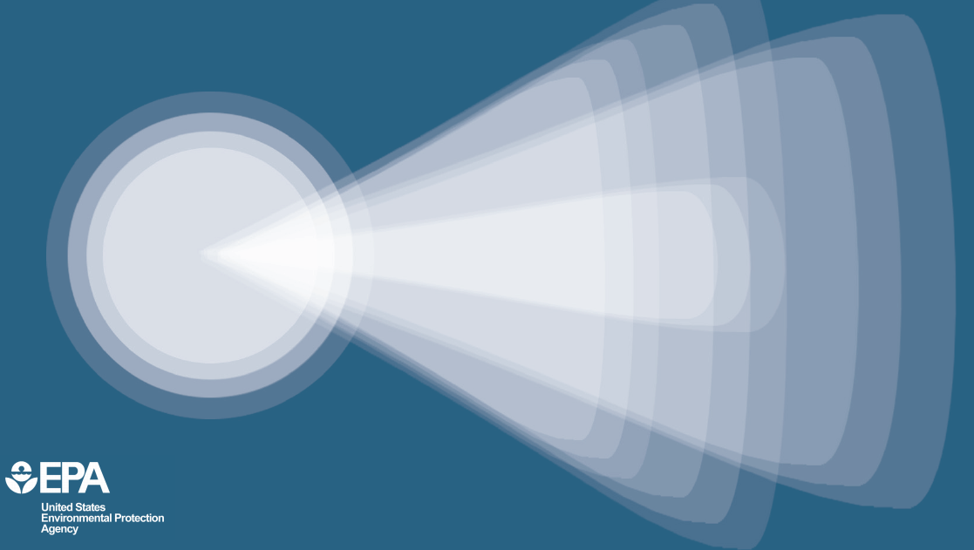
2017 PAG Manual
Notes:
I hope you’re all prepared and excited to learn more about EPA’s updated, 2017 Protective Action Guide Manual – or as we often shorten it, the PAG Manual. This manual updates and supersedes the guidelines presented in the 1992 and interim 2013 PAG manuals.

Slide 2
What is a Protective Action Guide (PAG)?
A dose guideline that triggers public safety measures
Based on avoiding additional dose for a given situation
Examples include evacuation, sheltering-in-place, food embargo or alternative water, relocation
Non-regulatory guidance crafted by interagency group of radiation emergency experts
Notes:
We are all here today to learn about EPA’s revised, 2017, protective action guide Manual – or PAG Manual for short.
The Protective Action Guide Manual contains dose guidelines under several different scenarios that would trigger public safety measures to minimize or prevent radiation exposure during an emergency. Each Protective Action Guide in the manual serves as “health-based tipping point” to assists officials in deciding when it is necessary for people to evacuate, stay inside, issue a food or water advisory, or take other immediate steps to safeguard health during a radiological emergency.
The PAG manual features non-regulatory guidance for state, local and tribal governments responding to a radiological emergency. PAGs are not legally binding regulation, they are not radiation limits, and do not supersede any environmental laws or regulations. PAGs also do not establish an acceptable level of risk for normal, non-emergency conditions, nor do they represent the boundary between safe and unsafe conditions.
PAGs are also not meant to be applied as strict numeric criteria, but rather as guidelines to be considered in the context of incident-specific factors.

Slide 3
Who Uses PAGs
State & Local
Tribal
Industry
Developed by Federal Agencies
Implemented by
Local emergency response officials
State radiation and emergency management groups
Tribal governments
Industry
Supported by the federal Advisory Team for Environment, Food and Health
EPA, CDC, FDA, USDA
Notes:
PAGs are used by several different parties. They are developed by federal agencies based on the best scientific information available.
In terms of implementation, state, local and tribal governments have the main responsibility for taking measures to protect life and health – this includes the decision to implement protective actions when needed. The good news is that PAGs have already been worked in to all state and many tribal and local emergency plans in some form or another
PAGs are also in place around certain types of industrial facilities. For example, around all nuclear power plants, and in most radioactive material use facilities, plans are in place to implement the PAGs if needed.
But state, local and tribal governments don’t have to go at it alone. When it comes to implementing the guidance during an emergency, there is a federal group of radiation experts that can support state and local governments… This group is the Advisory Team for Environment, Food and Health (sometimes referred to as the A-Team)! Their mission is to provide radiation safety recommendations to decision-makers at all levels of government, following a radioactive release. The Advisory Team is comprised of expert radiation representatives from the Environmental Protection Agency, the Centers for Disease Control and Prevention, the Food and Drug Administration, the U.S. Department of Agriculture.

Slide 4
Why PAGs?
Nuclear Power Plant Incidents
Three Mile Island (1979)
Chernobyl (1986)
Fukushima (2011)
Terrorism
Radiological Dispersal Device (RDD), also known as “dirty bomb”
Improvised Nuclear Device (IND)
Release from a contaminated site
Nuclear weapon
Waste management
Notes:
The PAG manual was developed to help emergency planners make timely and effective decisions for dose avoidance.
Emergency planners should be prepared to apply PAGs to a wide scope of facilities and circumstances; and to project doses that may trigger the need for protective actions from a release of radioactive material.
Historical radiological incidents like Three Mile Island, Chernobyl, and Fukushima all demonstrated the need for guidance. These events were important turning points for improvements in preparing and responding to radiological emergencies. There are also other events, such as an RDD, IND, or nuclear weapon detonation, that we have a responsibility to plan and prepare for, should an event happen in the future.
All of these events require some type of protective action or actions be put in place immediately following the release of radiological materials to best protect the public.
Past history, paired with unpredictable, and still theoretical future events make advanced planning critical, but also challenging. The PAGs are an important tool that can help emergency responders put in place scientifically defensible, protective measures to most adequately protect the public during or after a radiological emergency.

Slide 5
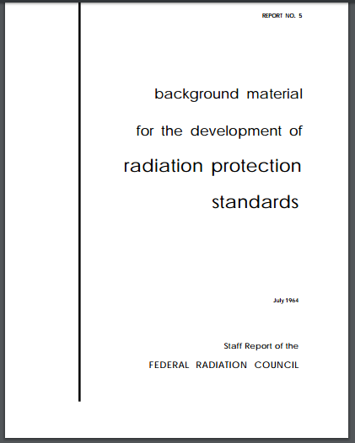
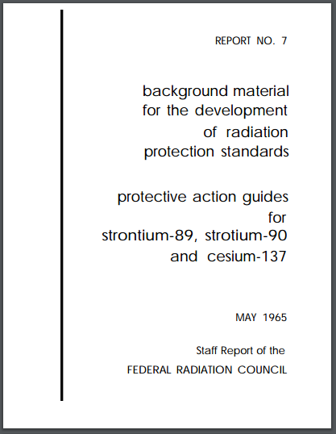
Origins of PAGs
In 1964, the Federal Radiation Council (FRC) addressed the concept of PAGs through Report No. 5
In 1965, Report No. 7 provided guidance for actions to environmental contamination of radionuclides strontium (Sr)-89, Sr-90, and cesium (Cs)-137
1960s fallout guidance refined in 1975 and 1980
Notes:
PAGs are not new! In the 1960s the Federal Radiation Council developed guidance at which implementation of protective actions may be appropriate. The council also provided general guidance for the protection of the public against exposure resulting from the accidental release of radioactive materials in the environment. These guidance measures specifically provided a numerical value for an Iodine-131 PAG.
The Council later provided guidance for situations involving contamination of the environment by additional radionuclides.

Slide 6
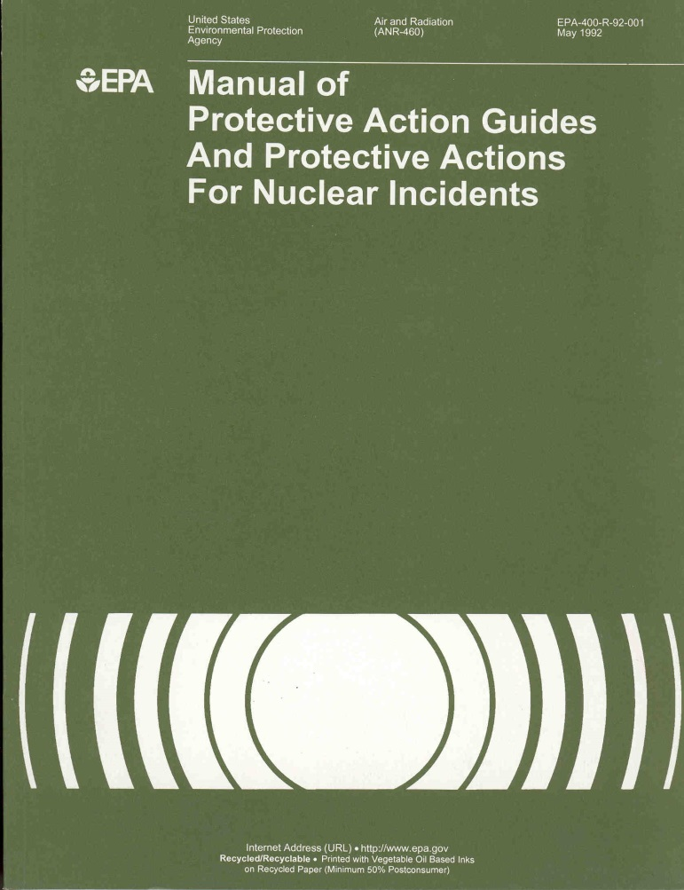
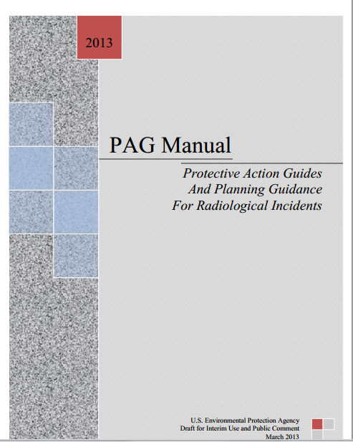
Timeline
1992
2013
(proposed)
2017
Notes:
There have been several versions of the PAG manual since those initial guidance documents issued in the 1960’s – with each new manual building on the ideas presented in the previous one and including new advancements in the scientific understanding of radiation dose and risk to human health.
In order to fully understand the changes in the 2017 PAG manual, and how many advancements have been made, it’s important to understand what was included in the 1992 PAG manual – the last final PAG manual released by EPA.

Slide 7
1992 PAG Manual
Guidance for action in nuclear emergencies
Early, intermediate phases
Promised late phase (recovery) and water PAGs
Still okay to use!
Notes:
The 1992 PAG manual provided emergency management officials at the federal, state, and local levels with the technical basis to plan responses to radiological emergencies. It was written to accommodate the “worst release” scenario deemed likely at the time– and at that time the “worst release” scenario was considered to be a major accident at a commercial nuclear power plant, that would result in significant off-site release of radioactive material.
The manual included PAG levels for only the early and intermediate phases following a radiological emergency and only promised late phase PAGs as well as drinking water PAGs.
I think that we can all agree that a lot has changed in terms of the needs from state, local and tribal governments since 1992. The good news is, there is nothing wrong with this PAG Manual, it’s just a bit outdated.

Slide 8
2017 PAG Manual
Broadened range of scenarios
Updated guidance on radioactive contamination in food
Clarified guidance for administration of potassium iodide (KI)
Provides guidance on reentry, late phase cleanup and waste disposal considerations
Includes additional language on using Federal Radiological Monitoring and Assessment Center (FRMAC) derived value tables
Includes drinking water PAG
Notes:
Focus of this talk -- the new PAG Manual that was issued in January of 2017!
As part of a response to comment effort, members of the public, state, and local emergency response and health organizations along with industry associations, and national and international radiation protection organizations provided more than 5,000 comments on the full PAG manual. We used those comments to make updates in the 2017 PAG Manual. Significant changes from previous PAG manuals were made, based on those comments.
The 2016 PAG Manual now applies to a broader range of radiological emergencies – we already talked about many of these during our interactive experience.
In regard to food guidance, emergency planners are referred to current guidance on radioactive contamination in food from the U.S. Food and Drug Administration (FDA). In the 2017 PAG manual, the EPA adopts the FDA guidance issued in 1998. I should note that this is a significant update from the 1992 version of the PAG Manual. However, for the most part, prior to the 2017 PAG manual release, most everyone had already incorporated this guidance.
In the 2017 PAG manual, EPA has adopted the latest guidance from FDA on the administration of a potassium iodide – abbreviated KI.
The Manual also contains brief planning guides on reentry for members of the public and workers who would support the recovery of an affected area.
As for cleanup and waste disposal considerations, the 2017 Manual provides additional guidance for planning a cleanup process as well as considerations for planning the disposal of radioactive waste.
For projecting doses, the 2017 PAG Manual points users to the Federal Radiological Monitoring and Assessment Center (FRMAC) Manuals. The FRMAC Manual’s dosimetry is based on the International Commission on Radiological Protection’s Publication 60 (ICRP 60) series.
And of course, as many of you may already know, the 2017 PAG includes a drinking water component. This is the first time a drinking water PAG has been included in issued PAG manuals.

Slide 9
PAGs for Different Stages of a Response
1
Early Phase
2
Intermediate Phase
3
Late Phase
Notes:
We all know that after a radiological emergency, the situation AND the best available information may change quickly. To most adequately respond to any given incident, planners divide each incident into Early, Intermediate and Late Phases and apply different PAGs as the emergency response progresses.
We will go into each of these phases, and the protective actions recommended included in the 2017 PAG manual for each phase in much more detail in the following slides, but I first wanted to be sure to introduce each of the phases so that you could become more familiar with what we are talking about; especially if these classifications are unfamiliar.
The Early Phase is the beginning of a radiological incident. It is absolutely crucial during this period to implement some type of immediate protective actions for protection of the public. These actions must be based primarily on the status of the radiological incident and the prognosis for worsening conditions. When available, predictions of radiological conditions in the environment or actual environmental measurements may be used. This phase may last from hours to days.
The Intermediate Phase is the period beginning after the sources and releases of radiological material have been brought under control. During this phase reliable environmental measurements are often available for use as a basis for decisions on protective actions. This phase may overlap the early phase and late phase and may last from weeks to months.
Finally, the Late Phase is the period that begins only once recovery actions have brought radiation levels in the environment to acceptable values. It ending when all recovery actions have been completed. This phase may extend from months to years. A PAG level, or dose to avoid, is not appropriate for long-term cleanup.
The phases cannot be represented by precise periods of time – and may even overlap – but to view them in terms of activities, rather than time spans, can provide a useful framework for emergency response planning.
We saw this happening (and still happening) in Japan after Fukushima. The country went through early and intermediate phases of their response in 2011. And they are still in late phase so many years after the initial accident.

Slide 10
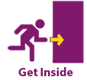
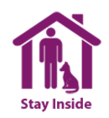
2017 PAGs for Early Phase
Implement PAGs immediately following an incident
May be preceded by precautionary actions during the period
This phase may last from hours to days
Decision examples:
Evacuation/shelter: 1-5 rem (10-50 mSv)
Supplementary protective action: 5 rem (50 mSv) child thyroid dose
Emergency worker exposure limits: 5, 10, 25+ rem (50, 100, 250+ mSv)
Notes:
In the early phase of a radiological emergency, there may be little or no data on actual releases to the environment and responders may have to rely on crude estimates of airborne releases.
Decision time frames are short during the early phase and preparation is critical to make prudent decisions when data are lacking or insufficient. However, this is also the key time frame where it is absolutely necessary to implement protective actions immediately to protect workers and the public.
Decisions to implement PAGs for the early phase are based on the current status of the radiological incident and the prognosis of worsening conditions. Depending on the conditions, this phase may last from hours to days.
In the early phase, sheltering-in-place and evacuation are the principal protective actions. These actions are meant to avoid inhalation of gases or particulates in an atmospheric plume and to minimize external radiation exposures.
Decision examples based on the 2017 PAG that may be necessary to protect public health during the early phase may include:
Evacuation and shelter in place, which is recommended if 1-5 rem (10-50 mSv) is projected over four days. A decision to evacuate weighs avoid dose against feasibility, and risk associated with the evacuation itself. There are several planning considerations included in the PAG Manual about whether to advise evacuation, or shelter in place.
Supplementary protective action, can be taken if radioactive iodine is released. KI should be considered as a supplementary protective action if the projected child thyroid dose exceeds 5 rem (50 mSv) – note that this threshold is lower than the 1992 guidance. Remember that some communities do not use KI and some do, it is okay if your community does not use it.
Emergency worker exposure limits, are imposed if doses of 5/10/25 rem/yr. (50/100/250 mSv) are expected to be incurred over the response duration. Recommended limits of exposure for emergency workers remain unchanged from the 1992 PAG Manual. The higher limits are based on task (e.g., protecting large populations or critical infrastructure or lifesaving) and are clearly situation dependent.

Slide 11
Comparison of 1992 and 2017 Evacuation and Shelter
1992
Evacuation/Shelter 1-5 rem (10-50 mSv)
thyroid/skin 5, 50 x higher
2017
Evacuation/Shelter 1-5 rem (10-50 mSv)
No organ dose specified
Notes:
Again, one of the purposes of today’s presentation is to really hammer in some important information that was updated in the 2017 PAG manual. To do this, I’m going to start to introduce some comparison slides that highlight the differences between the 1992 PAG manual and the revised, newly issued 2017 PAG manual.
The following is a side-by-side comparison of the changes made to PAG early phase response guidelines for evacuation and shelter:
For the sheltering-in-place or evacuation of the public, the protective action guide range of 1-5 rem remained unchanged; however, in the 2017 PAG, there is no specific organ dose recommended.

Slide 12
2017 PAGs for Early Phase – Potassium Iodide
FDA updated its guidance on the use of KI in 2001 and 2002
Supplementary protective action = not all communities use it
Simple approach recommends use at the lowest intervention threshold
The one-year old age group dose is expected to be limiting
KI administration recommended at 5 rem (50 mSv) projected child thyroid dose from exposure to radioactive iodine
KI
Notes:
We touched on this very briefly already, but it is worth mentioning again. Potassium iodide – abbreviated as KI and also called “stable iodine,” is used to partially block uptake of radionuclides by the thyroid. KI can be used as a type of supplementary protective action during an early phase response when radioactive iodine is released in the environment.
In the 2017 PAG manual, EPA adopts the FDA guidance issued in 2001. This FDA guidance recommended lowering the projected thyroid dose at which the administration of KI is warranted. The PAG manual not only lists KI as a “supplemental” PAG, it recommends a simplified approach where the new guideline, 5 rem, child thyroid, is recommended for the entire population and is set at a level that is protective of the most vulnerable member of the population - children. If a community uses KI, everyone can be advised to take KI if the child thyroid dose projection exceeds 5 rem.
This change was made in part because of child thyroid cancer studies following the Chernobyl incident. This change is consistent with the idea of conservatism built into the PAG levels when they were set. It results in an appropriate level of dose avoidance for the whole community, including all age groups, for an emergency. Dosages, however, are still complicated.

Slide 13
Comparison of 1992 and 2017 KI
1992
KI 25 rem (250 mSv) thyroid dose (adult)
2017
KI threshold 5 rem (50 mSv) thyroid dose (child)
Notes:
For communities that use it, (KI) should be considered as a supplementary protective action if projected child thyroid dose exceeds 5 mrem (50 millisieverts). This PAG is lower than the 1992 guidance. The lower dose, which the FDA adopted in 2001, is for protection of children based on studies of Chernobyl exposure data.
BUT don’t mix the lack of organ dose based Evac/Shelter (if you keep it, which you can, use ADULT thyroid projection) with the recommendation to project child thyroid dose for KI – these are distinct and neither must be used.

Slide 14
2017 PAGs for Intermediate Phase
Starts after source and release brought under control
This phase may last from weeks to months
Decision examples:
Relocate population: ≥ 2 rem (20mSv) projected dose in the first year; 0.5 rem (5 mSv)/year projected in subsequent years
Food interdiction: Most limiting of 0.5 rem (5 mSv) whole body or 5 rem (50 mSv) to most exposed organ or tissue
Drinking water: Two tiered approach (100 mrem (1 mSv) projected dose for sensitive populations; 500 mrem (5 mSv) for general population)
Notes:
Moving on. The intermediate phase starts after the source and releases of the radiological materials have been brought under control. At that time, the source and releases may not have necessarily ceased, but are no longer growing. Reliable environmental measurements are typically available during an intermediate phase response, for use as a reference when making important decisions on protective actions.
Intermediate phase protective actions are intended to reduce or avoid dose to the public, to control worker exposures, to control the spread of radioactive contamination, and to prepare for late phase cleanup operations. The intermediate phase of a radiological response may last for weeks or months.
During the intermediate phase, several decision-based PAG actions may occur. Commonly we talk about 3, which I show on this slide.
Relocation of the public, is recommended at a dose of greater than or equal to 2 rem (20 mSv) PAG projected dose for the first year and 0.5 rem (5mSv) per any subsequent year. In this phase, with federal support from FRMAC, scientists can run dose calculations with RESRAD-RDD or Turbo FRMAC; and the user can choose sensitive age groups, or enter lower guidelines, if desired. Additionally, local decision makers can adapt the guidelines with incident specific considerations and implement variations as needed. Emergency managers may recommend simple dose reduction techniques if < 2 rem (20 mSv) projected dose in the first year.
Food and drinking water exposure calculations are considered separately from the relocation PAG projection. PAG level set at 0.5 rem (5 mSv)/year projected whole body dose, or 5 rem (50 mSv)/year to any individual organ or tissue.
Drinking water, PAG levels are set at 100 mrem for sensitive populations and 500 mrem for the general population.
Note that the drinking water PAG is a new feature in the 2017 PAG manual, and I know a lot of folks are very interested in the topic. I’d like to touch on a few additional drinking water related points in the next few slides.

Slide 15
Why is there a need for a PAG when there are regulations for drinking water?
Lifetime Protection –
The Safe Drinking Water Act (SDWA) sets Maximum Contaminant Levels (MCLs) for radioactive materials in drinking water based on lifetime exposure criteria (which assumes 70 years of continued exposure to contaminants)
Emergency Conditions –
Prioritize potentially scarce water resources for those at most risk
Return to compliance with SDWA levels as soon as practical
Notes:
Under the Safe Drinking Water Act (or SDWA), EPA established a dose-based Maximum Contaminant Level (or MCL) for radioactive material based on lifetime exposure criteria, which assume 70 years of continued exposure to contaminants in drinking water. The MCLs were developed into the Radionuclides Rule and the rule only applies to a particular class of public water systems regulated. Those systems are Community Water Systems. CWSs are those water systems who supply water to residents year-round, such as a large city or town where people use the water in their homes.
During the development of the drinking water PAG the Agency determined that it is not appropriate to base response measures during short-term emergency incidents on lifetime exposure criteria. We know that MCL’s are meant to protect a person over their lifetime.
Let me give you a scenario – A radiological emergency contaminates a drinking water source. The drinking water results are above the MCL. Would you know at what point above the MCL that you would need to start providing alternative source of water for protection of public health?
While the SDWA framework is appropriate for normal operations, it does not provide the necessary tools to assist emergency responders with determining the need for an immediate protective action (such as ‘do not drink orders’) when a MCL is exceeded. The goal is to prioritize potentially limited water resources for those most at risk in a disaster response.
Regardless of the cause of an incident, EPA expects that any drinking water system impacted during a radiation incident will take action to return to compliance with the Safe Drinking Water Act levels as soon as practical.

Slide 16
What about compliance with Drinking Water Regulation?
The drinking water PAG is a non-regulatory guidance for emergency situations only
Public water systems must comply with EPA’s regulations for Radionuclides
PAGs do not affect public water systems’ compliance under the Safe Drinking Water Act (SDWA)
Responsible parties for drinking water systems impacted by a radiological incident are expected to take action and return to compliance under the SDWA Maximum Contaminant Levels (MCLs) as soon as practicable
Notes:
All of the guidance in the Protective Action Guide Manual is exactly that… guidance for state and local and utilities to use for emergency situations only. Again, let me repeat myself because this is important: PAGs are use for emergency situations only. And they are EPA’s recommendations only; they are not required by the EPA.
While the drinking water PAG is a non-regulatory guidance for emergency situations only – as I said earlier – drinking water facilities are expected to take action and return to compliance under the SDWA Maximum Contaminant Levels (MCLs) as soon as practicable – certainly within the first year after an incident.
I say this with a bit of caution because some Community Water Systems (CWSs) may be on reduced monitoring and not have adequate treatment installed based on their historical monitoring data and proximity of their water source to a nuclear power facility. But again, that would be regulatory decisions under the SDWA and not related to the PAGs.

Slide 17
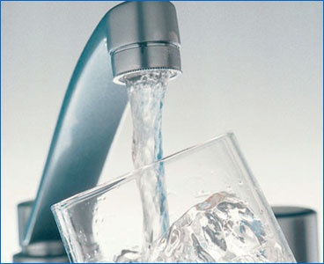
What is the Drinking Water PAG ?
EPA recommends a two-tier drinking water PAG for use during the intermediate phase of a nationally significant radiation incident:
100 mrem
projected dose for pregnant or nursing women, and children age 15 and under
500 mrem
projected dose for the general population (anyone over age 15)
Guidance only provides recommendations; does not confer any legally binding terms upon the public, states, or any other federal agency
Applies during intermediate phase of a nationally significant radiation contamination incident
Does not affect or change current enforceable drinking water standards
Notes:
Now we are going to focus on the drinking water PAG. This is new guidance to the PAG manual. We received more than 60,000 public comments when this approach was proposed in 2016. EPA recommends a two-tiered drinking water guide for use during an emergency: 100 millirem for pregnant and nursing women and children and 500 millirem for anyone over the age of 15. These are doses that we want to avoid – not doses that we want the public to get.
Emergency responders and radiation experts have the ability to take radiation readings and project a dose and if we are “predicting” that children, pregnant and nursing women will get 100 mrem from drinking water in the first year after an incident, EPA is recommending that steps be taken to limit that exposure. If we predict that anyone over age 15 will receive 500 mrem in one year, then EPA also recommends that steps be taken to limit that exposure.
So what do 100 mrem and 500 mrem mean? Are 100 and 500 mrem a lot?
To give you some perspective, let me quickly talk about the most common radiation sources we encounter in our everyday life and how much radiation we get from these sources. Sources of radiation are around us, all the time. Some sources are natural and others are man-made.
Natural background radiation comes from the ground, soil, water, outerspace, and is also emitted by all living things.
Man-made sources of radiation comes from medical procedures such as X-rays.
The average person in the US will receive a dose of 620 mrem per year from background and man-made source.
Studies have shown that in an emergency situation if a person receives between 5,000 to 10,000 mrem there are no immediate health effects and the competing risks from emergency actions need to be weighed against those minimal risks.
Remember the water PAG uses 100 mrem and 500 mrem as thresholds. Now compare those values to 10,000 mrem, it doesn’t sound so bad now, does it? Especially when we consider that there is no known immediate health effects at 10,000 mrem
Children are typically more susceptible to the effects of radiation because they are growing so quickly. For example since there is rapid cell division happening in children, there is more of a chance that DNA will be damaged as compared to adults. At that time, there is a greater opportunity to do damage to cells that could lead to cancer later in life.

Slide 18
How was the DW PAG developed ?
Drinking water PAG was developed taking into consideration the risks associated with ingesting drinking water contaminated with radioactive materials and assuming an exposure period not exceeding 1 year.
PAG levels result in projected risks which generally fall within the range of risks for lifetime exposure under the EPA’s National Primary Drinking Water Regulations for Radionuclides (40 CFR Part 141.66).
Drinking water PAGs provide levels of protection consistent with current PAGs for other media in the intermediate phase
Notes:
All Protective Action Guides are created the same way with the same goals
Prevent immediate health effects
Balance protection with other important factors and ensure that actions result in more benefit than harm
Reduce risk of chronic (or long term) effects
The drinking water PAG was developed taking into consideration the risks associated with ingesting drinking water contaminated with radioactive materials and assuming an exposure period not exceeding 1 year.
PAG levels result in projected risks which generally fall within the range of risks for lifetime exposure under the EPA’s National Primary Drinking Water Regulations for Radionuclides, which are codified in 40 CFR Part 141.66 titled “MCLs for Radionuclides”. We strike a balance between risks and actions needed. Drinking water PAGs provide levels of protection consistent with current PAGs for other media in the intermediate phase

Slide 19
Interpreting the Two-Tier Water PAG
Authorities have flexibility on how to apply the PAG
May use prudent measures by applying 100 mrem as a target for the whole population or implement both targets simultaneously
For example, authorities may make bottled water available to children, pregnant women and nursing women, and instruct the rest of the population to use a public drinking water supply that will not exceed 500 mrem
PAGs are intended as guidance only; local authorities should take into account local circumstances (e.g., incident scope and community needs) when implementing any course of action to protect the public
Notes:
Recommending a drinking water PAG and implementing a drinking water PAG are two different things, which is one of the reasons that they are non-regulatory and the reason we stress that states and locals have a lot of flexibility in how they implement the guidance in the PAG Manual.
For public acceptability and ease of application – the states or locals may apply 100 mrem (originally targeted for children and pregnant and nursing women) for the whole population served by the water system. Or, authorities may make bottled water available to children, pregnant women and nursing women, and instruct the rest of the population to use a public drinking water supply that will not exceed 500 mrem
As stated above, the PAGs are intended as guidance only, and local authorities should take into account local circumstances (like the scope of the incident, the community needs, risk of dehydration if it is extremely hot outside, ability to quickly bring in alternative water) when implementing any course of action to protect the public.

Slide 20
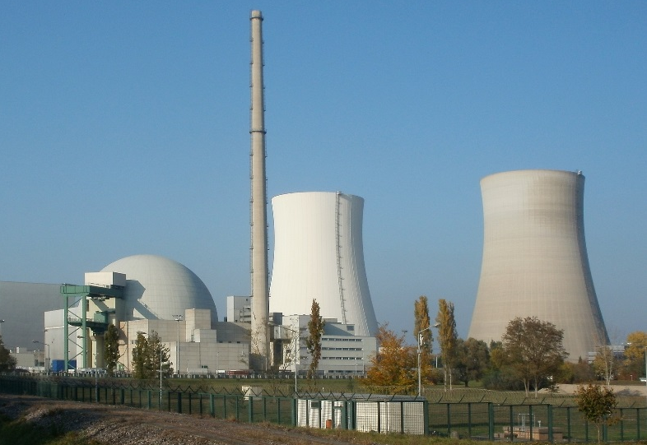
Key Terms & Concepts
Measuring Radiation in Drinking Water
Picocuries per liter (pCi/L), & Becquerel per Liter (Bq/L)
Gross Alpha or Beta (Screening levels for mixed contaminants)
Isotope Specific (Targeted analysis)
Notes:
The protective action guidance is given in millirem but we typically measure radiation in water in picocuries per liter. So how do we get from a concentration of picocuries per liter to millirem?

Slide 21
Understanding Derived Response Levels
DRLs are concentrations of radioactive materials in drinking water that correspond to EPA recommended PAGs of 100 mrem and 500 mrem
DRLs are essential because a PAG identifies a radiation dose rather than a quantity of radioactive materials that can be measured directly in drinking water
Notes:
We use Derived Response Levels (or DRLs) to determine the concentrations of radioactive materials in drinking water that correspond to EPA recommended PAGs of 100 mrem and 500 mrem
Figuring out how a concentration of a radioactive material relates to a dose is not easy and its done on a case by case basis, because every type of radioactive material is different.
The numbers you see in this chart are not derived from the same methodology as EPA uses for equivalent concentrations of beta/photon emitters measured in pCi/L that correspond to the MCL of 4 mrem. Keep in mind, as we discussed earlier, the MCLs were developed based on lifetime exposure.
For the PAGs, we focused on establishing dose levels that would protect the most sensitive populations. Remembering that dose is related to things like age, so sometimes several calculations are needed to determine the correct derived response level for the incident. To help, in the PAG manual we included a chart that assumes a constant level of radioactive materials in water over the course of a year… so it does not account for decay over time. What does it mean when we say not account for decay over time? Simply put, the term ‘decay’ in here refers to all radionuclide will transforms into a different atom, it’s a natural process and this different atom is called decay product. The atoms keep transforming to new decay products until they reach a stable state and are no longer radioactive. This decay process helps reducing the radionuclide concentration in water, but we do NOT account in our calculation so we can make our calculation conservative. Not accounting decay product is a very unrealistic assumption, but it help makes sure the DRLs are conservative estimate considering all of the uncertainty.
Again, for PAG calculations, we used the assumption of no decay, which makes the PAG levels very conservative.
For this chart, we ran calculations for Strontium and Yttrium-90, Cesium 137 and Iodine-131, which are of particular interest for major radiological incident scenarios where drinking water sources might be contaminated . We ran calculations for 8 different age groups and selected the most conservative value as the Derived Response Level– for example the 1-year-old who drinks formula might be the most susceptible for Iodine 131.
If no site-specific DRLs developed for a specific emergency, EPA recommends using these Derived Response Levels to allow for the direct comparison between radioactive material concentration in drinking water and dose.
Dose conversion factors, calculation methodologies as well as other comprehensive information regarding DRL development can be located through the PAG Manual. But know that the Advisory Team for Environment, Food and Health can help with drinking water guidance during an emergency.

Slide 22
Practical Considerations
EPA drinking water PAG is a non-regulatory guidance to assist emergency management officials when making response plans
Options available to local jurisdictions for providing an alternate source of drinking water could include:
Bottled water
Altering the source water (such as switching to ground water)
Interconnection between systems
Combination of all of these actions
Radioactive material concentrations present in a water supply decline at rates determined by the half-lives of individual nuclides
May decline by dilution with uncontaminated water or increase with rainfall
Notes:
It is important to remember the bottled water is not the only option for providing clean, safe water for the public.
Options available to local jurisdictions for providing an alternate source of drinking water could include:
Bottled water
Altering the source water (such as switching to ground water)
Interconnection between systems or a
Combination of all of these actions
Remember, all radioactive material will decay naturally, and this will reduce the concentration in water.
And even adding uncontaminated water or rainfall can reduce the concertation of radioactive material in water.

Slide 23
Planning: Key for Drinking Water Action
The PAG Manual describes actions that local authorities can take to protect the public if a radiological incident occurs
Does not constitute a complete handbook for emergency response, but describes considerations that can be included in comprehensive emergency planning at the state, local, and utility level
Actions that public authorities could take during a radiological incident include:
Water monitoring
Mitigation measures to protect water supply
Preventative action may be taken in advance of an anticipated release
May include temporary closure of water system intake valves to prevent entry of contaminant plume
Emergency response plans should consider whether sufficient storage capacity is available to support the community’s fire suppression and sanitation needs while intake valves are closed
Notes:
You need to plan for a radiological emergency. And no state representative or water utility can do it alone.
Here is a question for everyone, in the chat box – name two people or organizations that you should contact to start planning on how your organization or facility will protect public drinking water during a radiological emergency. Let me repeat the question – name two people or organizations that you should contact to start planning on how your organization or facility will protect public drinking water during a radiological emergency.
While you are doing that – Here are some planning considerations for you to think about with those other people or organizations:
How are you going to monitor the water during an emergency
Are you planning to use the PAGs or another level as that in which to provide alternative drinking water?
There are preventive actions that may be taken in advance of an anticipated release including temporarily closing of water system intake valves to prevent entry of contaminant plume. But emergency response plans should consider whether sufficient storage capacity is available to support the community’s fire suppression and sanitation needs while intake valves are closed.

Slide 24
Comparison of 1992 and 2017 Relocation
1992
Relocate population
≥ 2 rem (20 mSv) first year (projected dose)
0.5 rem (5 mSv) any subsequent year
5 rem (50 mSv) over 50 yrs.
2017
Relocate population
≥ 2 rem (20 mSv) first year (projected dose)
0.5 rem (5 mSv) any subsequent year
Removed 50-year Relocation PAG
Notes:
This slide format should look a little familiar to you. We’re now going to talk about some of the important revisions to intermediate phase PAG levels in the 2017 and 1992 PAG manuals.
Remember relocation means moving out for potentially a long time, maybe until cleanup is complete.
The Relocation of the public PAG was adjusted to remove the 1992 provision about 5 rem over 50 years. The interagency PAGs Subcommittee found that there might be confusion between it and long-term cleanup goals… or that it might be misunderstood that relocation might have to last as long as 50 years!

Slide 25
Comparison of 1992 and 2017 FDA Food PAGs
1992
1982 FDA guidance
NCRP 39 methodology
Preventive PAG 0.5 rem (5 mSv) whole body and 1.5 rem (15 mSv) thyroid
Emergency PAG 10 times higher, depends on impact
Dose only, no activity levels provided
2017
1998 FDA guide, by reference
ICRP 56 & NRPB methods
One set of PAGs
0.5 rem (5 mSv) whole body dose, or
5 rem (50 mSv) to most exposed organ or tissue
Dose and derived intervention levels (DILs) provided
Notes:
On your screen now you will see a comparison of the FDA Food PAGs - This is not really new news, all organizations that use FDA PAGs had already implemented this update long ago, however we are covering it now on this slide for completeness, since it is a change from the 1992 PAG manual.
FDA provided Dose and Derived Intervention Levels (DILs), which is a concentration derived from the intervention level of dose at which introduction of protective measures should be considered. FDA always says that in a real event, incident-specific factors will be used to develop DILs appropriate for the situation. Note also that if FRMAC is generating Intervention Levels for any of the “non-FDA” radionuclides not explicitly address in FDA’s 1998 guidance, then FDA’s guidance is to use the ICRP 60 series to assess these radionuclides.
<<Host does not need to say the acronyms below, they are just here FYI>>
NCRP = National Council on Radiation Protection
ICRP = International Commission on Radiological Protection
NRPB = National Radiological Protection Board (UK)

Slide 26
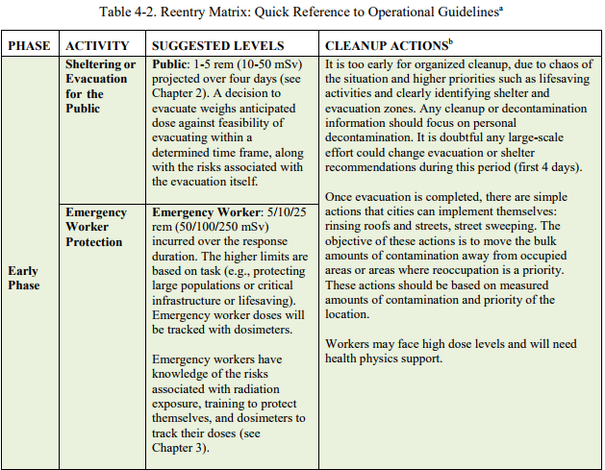
PAGs for Early & Intermediate Phase – Reentry Matrix
Notes:
Another important highlight is the “Re-entry Matrix Following a Radiological Incident or Accident” found on pgs. 50 – 52 of the 2017 PAG manual. The very first section of this matrix is shown on your screen – but trust me, there is much more to see if you open the PAG manual.
During the early and intermediate phases of a radiological emergency, individuals will need to enter the relocation area to collect their belongings, maintain or repair critical infrastructure, and to work on preliminary recovery activities. The Reentry Matrix provides a quick reference for public and worker dose guidelines and considerations for decontamination ongoing during this phase.
Operational guidelines include detailed numeric guidance, specific discussions about applicable dose-based limits, timeframes and pathways of exposure related to reentry tasks. The term reentry is used for emergency workers and members of the public going into radiologically contaminated areas, temporarily, under controlled conditions. As part of the U.S. response to the Japanese Fukushima accident, scientists performed dose calculations to ensure that passengers and workers on train trips through contaminated areas do not exceed doses typically received from cosmic radiation during an international flight. DOE’s Argonne National Laboratory scientists used the RESRAD-RDD tool and hand calculations to approximate doses from the NPP radionuclides.
I bring this table up, because it’s important to know that it is available as a resource. You don’t need to memorize it, but knowing that it is available will help you with reentry decisions in your next drill or exercise.

Slide 27
2017 PAGs for Late Phase – Cleanup Process
Begins when strategic focus shifts to reducing longer-term exposure and improving living conditions
Additional planning time for stakeholder involvement
Response may extend from months to years
Cleanup process should be based on the societal objectives for expected land use
Numeric PAG level not applicable for long-term cleanup
Notes:
Late phase clean up begins sometime during the intermediate phase and proceeds concurrently with intermediate phase protection action activities. I mentioned earlier in the presentation that often, response phases overlap, and that is true here. The transition to the late phase really is marked by a change in the approach. Response strategies during the late phase are driven by strategies that focus on reducing longer-term exposure and improving interim living conditions rather than by urgency which drives the early and intermediate phase approaches.
During the late phase of a radiological incident, decision-makers will have more time and information allowing for better data collection, more complex modeling, stakeholder involvement, and options analysis. Community members will influence decisions such as if and when to allow people to return home to contaminated areas. There will be populations, who were not relocated or evacuated, living in contaminated areas where efforts to reduce exposures will be ongoing.
This should not come as a shock – the late phase can last for many months to years. During this phase there are no applicable numeric PAG levels for long-term cleanup.
For instance, around Fukushima, which happened in 2011 the Japanese are still in the late phase conducing waste management.

Slide 28
2017 PAGs for Late Phase – Waste Management
Waste may overwhelm existing radioactive waste disposal capacity in the U.S.
Primary responsibility for waste management decisions falls to state and local officials.
Safely managing and disposing of radioactive waste will require advance planning at all levels of government and careful coordination with stakeholders at all stages of the decision-making process.
Notes:
If a large-scale radiological incident were to occur in the United States, the complexity of radiological waste disposal has the potential to be huge but would ultimately depend on the magnitude of the release and the decisions related to site cleanup, both of which will determine the amount and types of waste requiring disposal.
States hold primary responsibility to identify and provide waste management options, including disposal capacity; in the event of a terrorist attack, the federal government can offer a range of assistance to states to identify and implement waste management options.
Stakeholder involvement groups presents opportunities to involve members of the community in providing sound, cost-effective waste staging and disposal recommendations that will protect human health and the environment.
The new waste management discussion includes some possible solutions to a situation involving more radioactive waste than all of our US repositories could handle. It was co-authored by experts from DoD, DOE, EPA and others who would have a role in supporting states dealing with such an incident.

Slide 29
Interactive Quiz - Application of PAGs
What PAGs are:
Represent a projected dose to individuals that triggers protective action.
General guidance to officials to make safety decisions.
Used to minimize risk from an ongoing, radiological incident or an incident that has already occurred.
What PAGs are NOT:
Legally binding regulations or standards.
Able to supersede any environmental laws.
Imply an acceptable level of exposure.
Strict numeric criteria.
Not related to CERCLA or Superfund.
Notes:
Focus on avoided dose: Radiation emergency experts have protocols to make estimates of a projected public dose downwind for the first hours or days, and that is compared to PAGs.
The forward looking projection sometimes is hard to not compare to regulatory ‘safe’ levels – they are apples and oranges. The goal of using PAGs is to avoid the projected dose, by taking an action to take the source or the person away.
It is important to note that PAGs are not meant to be applied as strict numeric criteria, but rather as guidelines to be considered in the context of incident-specific factors.
Not for radioactively contaminated sites
Releases, incidents, or accidents
Public protection is the focus
Guidance, not regulatory
Not related to CERCLA or Superfund
Avoided dose ≠ safe limit to allow
Also note that several states have their own adaptations to PAGs

Slide 30
Next Steps
The latest version of the PAG Manual is available for download at EPA’s website: https://www.epa.gov/radiation/protective-action-guides-pags
You can also find the PAG Manual outreach presentation (with speaker notes!) on the PAGs web page
If you would like to view the PAG FAQ’s Click Here.
If you have further Questions, click on “Contact Us” to ask a question, provide feedback, or report a problem
Thank you for your attention!
Notes:
We are going to make these slides and speaker notes available to you all, and will work your questions into FAQs.
Go check out the new FAQs we’ve posted on the link here (you can click the link right now right in Adobe Connect), and feel free to type your comments or questions into the Chat box. We have a few minutes for questions today, so I’d like to take the opportunity to ask for anyone with questions to unmute yourself and speak up over the phone line, or type your question in the chat box.

Slide 31
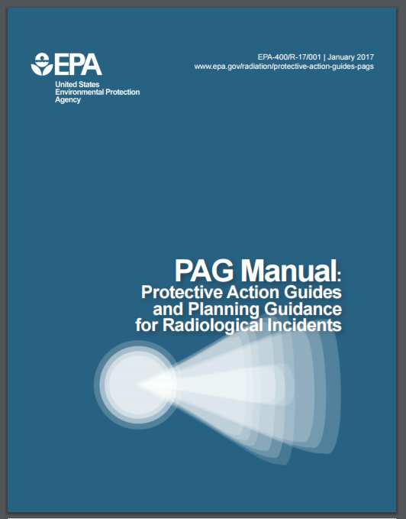
Next Steps
The latest version of the PAG Manual is available for download at EPA’s website: https://www.epa.gov/radiation/protective-action-guides-pags
You can also find the PAG Manual outreach presentation (with speaker notes!) on the PAGs web page
If you would like to view the PAG FAQ’s Click Here.
If you have further Questions, click on “Contact Us” to ask a question, provide feedback, or report a problem
Thank you for your attention!
Notes:
We are going to make these slides and speaker notes available to you all, and will work your questions into FAQs.
Go check out the new FAQs we’ve posted on the link here (you can click the link right now right in Adobe Connect), and feel free to type your comments or questions into the Chat box.

