Slide 1
Maryland’s Draft Phase III WIP for the Chesapeake Bay
Spring 2019
WIP Regional Meetings

Slide 2
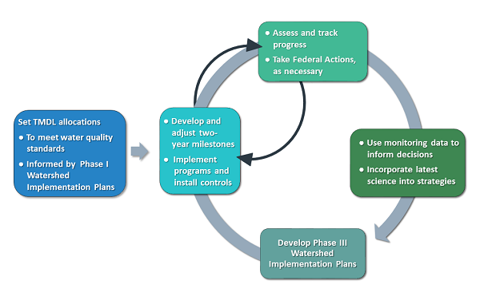
Why a Phase 3 WIP?
Notes:
2009 EO and 2010 TMDL established an adaptive management and accountability framework.
As part of that there are 3 phases of watershed implementation plans to gauge progress and adaptively manage restoration.
There are also 2-year milestones, annual progress evaluations, and a mid-point assessment in 2017.
Phase 3 focuses on getting us from where we r now to our 2025 restoration targets.

Slide 3
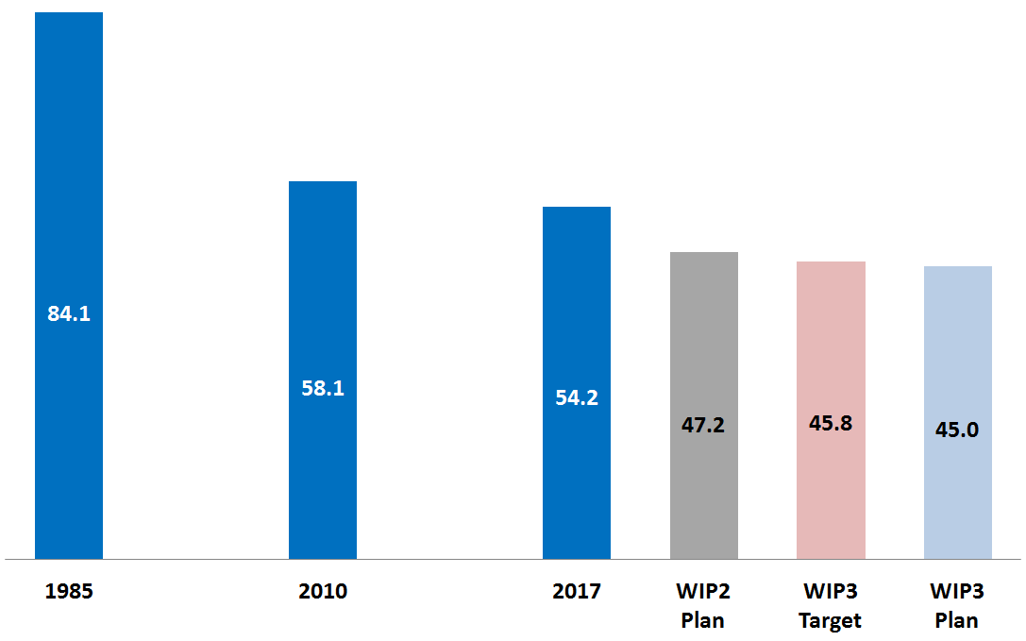
Current Progress and Achieving the WIP
-26 M lbs
-3.9 M lbs
-9.2 M lbs
Million pounds of nitrogen to the bay
The State is on track to meet its phosphorus and sediment goals
Data from: P6 CAST - 2017 Progress
Notes:
Here’s what our progress looks like so far and where we project our Phase III WIP plan will get us by 2025. To date we have achieved an impressive 30-million pound reduction in nitrogen loads.
Phase III another 9.2-million pound reduction that gets us almost a million pounds under our nitrogen target.
We are already on track to achieve our phosphorus and sediment targets.

Slide 4
Principles for Maryland’s WIP
Locally-driven
Based upon robust engagement process, local plans and commitments
Co-benefits
Achievable
Cost effective
Builds on lessons learned in Phase 1 and 2
Balanced
Balance of regulations and incentives
Balance of immediate/near-term actions and longer term sustained efforts across sectors
Notes:
In preparing this plan, we adhered to 3 broad principles.
Locally-Driven
A bottom up approach where we did not start the conversation by assigning local targets but worked with our local partners to document and quantify their plans and commitments. Some partners (like our Ag. and wastewater operators) committed to do more during this process which is why we can do better than our assigned targets.
Encourages local partners to leverage cobenefits – for example green infrastructure projects that can reduce nutrient runoff while also helping with local needs like flood control.
Achievable
Cost-effective in that the highest loading sectors largely responsible for getting us to our targets are also the most cost-effective
Adaptive and builds on what we learned in Phases 1 and 2. In phase 1 and 2 assigned the same percentage reductions across different sectors, which was not achievable for some local jurisdictions.
Balanced
Regulatory controls vary across sectors whereby incentives are needed to ensure progress in some areas.
Recognizes that different sectors have different restoration pace, so balances progress across time scales.

Slide 5
Adhering to WIP Principles
Manage wastewater effectively
Enhance agricultural implementation efforts
Sustain progress in stormwater and septic sectors
Maintain current environmental regulations
Maintain full funding for state programs
Need for continued engagement and success does not end in 2025
Notes:
Here are some of the broad strategies we are using to adhere to these WIP Principles..

Slide 6
Maryland’s Strong Investments
Governor Hogan has invested $5-billion since taking office!
Full funding of Maryland’s key Bay restoration programs
Trust Fund
Program Open Space
Bay Restoration Fund
Maryland Agricultural Cost Share
Federal funds
Farm Bill funding
Drinking Water Revolving Loan Fund
WQ Revolving Fund
EPA Grants (106, CBRAP, CBIG, 319, etc)
Significant local funding
Stormwater restoration
Notes:
It is worth noting Maryland’s strong funding commitment to Bay Restoration.
Governor Hogan has fully funded our Bay Restoration funding programs and made sure those dollars go to their intended purpose.
Governor Hogan has also been a strong leader in pushing for increased federal funding for the Bay Restoration effort.

Slide 7
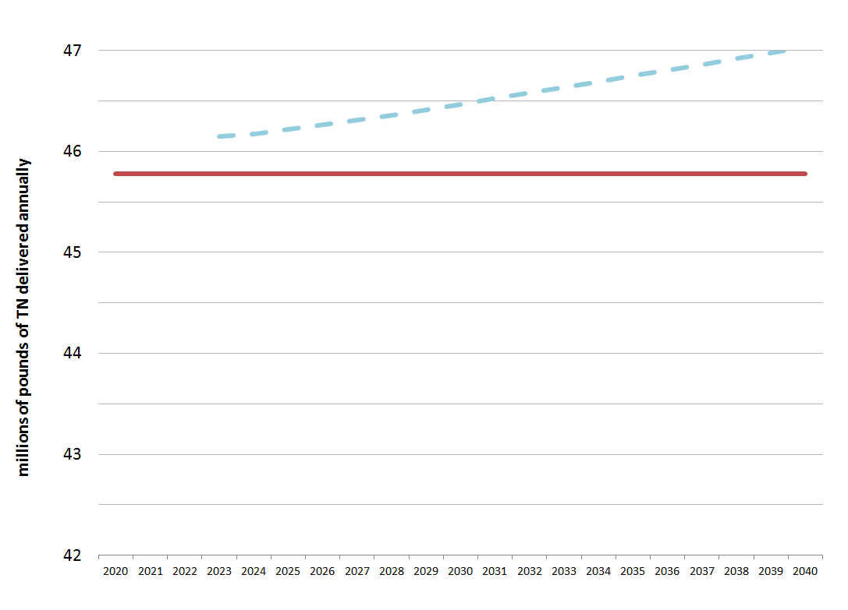
New Phase III WIP Target
Phase II Target: 47.2 M lbs
Phase II
Phase III Target: 45.8 M lbs
Notes:
we were on a path to meet 2025 based on Phase 2 WIP, but mention that factoring in new science, information and apply partnership decision rules we had a gap to close.
Upward trend due to growth.

Slide 8
Biggest Drivers of Pollution Reduction
Bay Restoration Fund (BRF) upgrades to major wastewater treatment plants;
Agricultural pollution reduction practices funded through the Maryland Agricultural Cost Share Program, Bay Restoration Fund, and the Chesapeake & Atlantic Coastal Bays 2010 Trust Fund (Trust Fund);
Atmospheric pollution reductions resulting from the Clean Air Act; and
NPDES Municipal and Separate Storm Sewer System (MS4) Permit requirements (local $, Trust Fund, BRF).
Notes:
These are the Key Drivers in closing the pollution gap

Slide 9
WIP III Wastewater Strategies
Wastewater
Complete significant plant upgrades
4 remaining (plus additional 12 minor plants)
Commit to municipal performance incentives
Achieve aggregate nitrogen performance to 3.25 mg/L reference concentration
Regulations, Enforcement, and Funding Programs for Sewer Overflows
Stimulating Markets and Creating a Restoration Economy
Nutrient trading & Clean Water Commerce
Notes:
Getting in to a little more detail sector by sector, here are the key pollution reduction drivers in the wastewater sector.

Slide 10
WIP III Agriculture Strategies
Key activities out to 2025
BMP implementation
Additional implementation of management practices
Leverage new BMPs
Ag drainage management
Nutrient management compliance
Tracking, reporting and maintaining
Accurate accounting of all conservation practices currently on the ground
Comprehensive Soil Health
Financial assurance
Notes:
Here are some of our key agricultural strategies between now and 2025
For BMP implementation we want to maintain Cover Crops levels, complete additinoal Soil Conservation and Water Quality Plans (800k to 1M), riparian buffers, enhance farmers NM planning.
We also want to make sure we have robust tracking, reporting and maintenance of BMPs n the ground.
Comprehensive soil health: co-benefits like carbon sequestration
Financial assurance we are working to ensure we continue to have adequate funding. This includes boots on the ground and technical assistance delivery to our farmers.

Slide 11
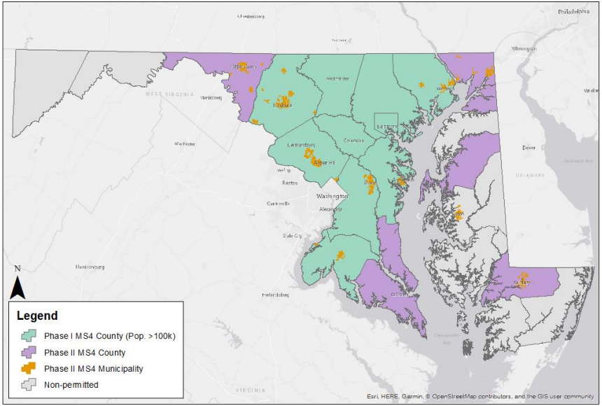
WIP III Stormwater Strategies
Phase I MS4s
Continue pace of restoration to the maximum extent practicable (MEP) during upcoming permit (2% annually for WIP planning).
Phase II MS4s
Restoration of 20% of untreated impervious by 2025
Non-MS4 - Pursue additional resources for rural counties
Focus on local priorities
“Co-benefits”
Flooding
Climate change
Healthy streams
Healthy lakes
Drinking water
Greener communities
Notes:
Phase 1 MEP is a long-term strategy as 70% of the impervous surface was developed with little to no stormwater. For some local jurisdictions, the 20% was not achievable with current local capacity. Working with each local jurisdiction to determine. Expect that this will amount to a 2% retrofit on average and that in the longer term we will get to a 40% retrofit by 2030.
For Phase 2 and since those jurisdictions are not as built out and are anticipated to have more land available for BMPs, we maintained a 20% level of effort.
We need to build more capacity in our rural/NonMS4 jurisdictions and are looking into more boots on the ground and enhanced technical assistance.
The WIP places a strong emphasis on practices with cobenefits so projects achieve multiple desired outcomes.

Slide 12
WIP III Septic Strategies
Continue septic upgrades with priority in critical area
Pursue septic connections
Maintenance of existing and new systems
High-benefit reductions
Local priorities
Public health & drinking water quality
Concentrated areas
Clusters
High-density of individual systems
Bermed infiltration pond (BIPs)
Mobile home parks, campgrounds, marinas
Notes:
Continue septic upgrades with priority in critical area
Pursue septic connections
Maintenance of existing and new systems
Emphasis on public health cobenefits and highest loading areas.

Slide 13
Conservation, Protection & Growth
Phase III Built on 2025 Land Use (BMPs applied to that projection)
Forest Conservation Act
Agricultural Preservation
Priority funding areas
Program Open Space
Critical Area protections
All other zoning and conservation measures
Stormwater environmental site design
Notes:
The Phase III WIP is also accounting for the pollution avoided through MD’s conservation, protection and growth programs.
Out to 2025 this is estimated at about 100K pounds of nitrogen.
It is more cost effective to prevent pollution that clean it up after the fact.

Slide 14
Draft WIP Plan: Nitrogen by Sector
Source Sector | 2017 Progress (M lbs TN/yr) |  | Phase III WIP * (M lbs TN/yr) |  | Change in Load (M lbs TN/yr | Percent)
Agriculture | 22.4 |  | 18.0 |  | -4.4 | | | -20%
Stormwater | 9.4 |  | 9.2 |  | -0.2 | | | -2%
Natural | 8.1 |  | 8.1 |  | 0.0 | | | 0%
Septic | 3.1 |  | 3.1 |  | 0.0 | | | 0%
Wastewater | 11.3 |  | 6.6 |  | -4.7 | | | -41%
Total | 54.2 |  | 45.0 |  | -9.2 | | | -17%
Phase III WIP Target = 45.8
Notes:
The wip is "front loaded" with wwtp and agr nutrient reduction
stormwater and septic will be long term incremental strategies and that.
N reductions are extremely difficult with SW bmps and current science suggests that septic systems only contribution N (no P or Sed).

Slide 15
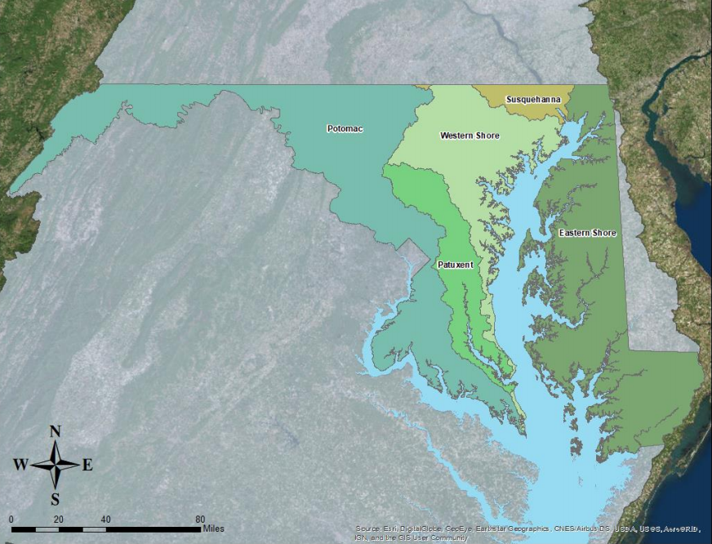
Draft WIP III Plan: Nitrogen by Basin
Western Shore Basin
-5.3 M lbs (-31%)
Susquehanna River Basin
-0.1 M lbs (-8%)
Potomac River Basin
-0.7 M lbs (-4%)
Eastern Shore Basin
-3.1 M lbs (-17%)
The Patuxent Basin wastewater loads appear to increase because 2025 plant performance is projected at 3.25 mg/L for WIP planning. Looking at aggregate 2017 performance in the basin, the significant plants performed well below 3.0 mg/L. Projecting based on current performance would result in a Phase III WIP load reduction of 0.2 M pounds
Patuxent River Basin
0.1 M lbs (2%) *
Notes:
We also have 5 major basin targets that our WIP 3 is striving to achieve.
Here is how our WIP 3 strategies shake out in terms of nitrogen reductions in our major basins.
Note that the Patuxent loads appear to go up because they are currently operating at lower concentrations than we used for our WIP projections. However, we anticipate a 200K reduction from this projection if basin WWTPs continue to operate at current levels.

Slide 16
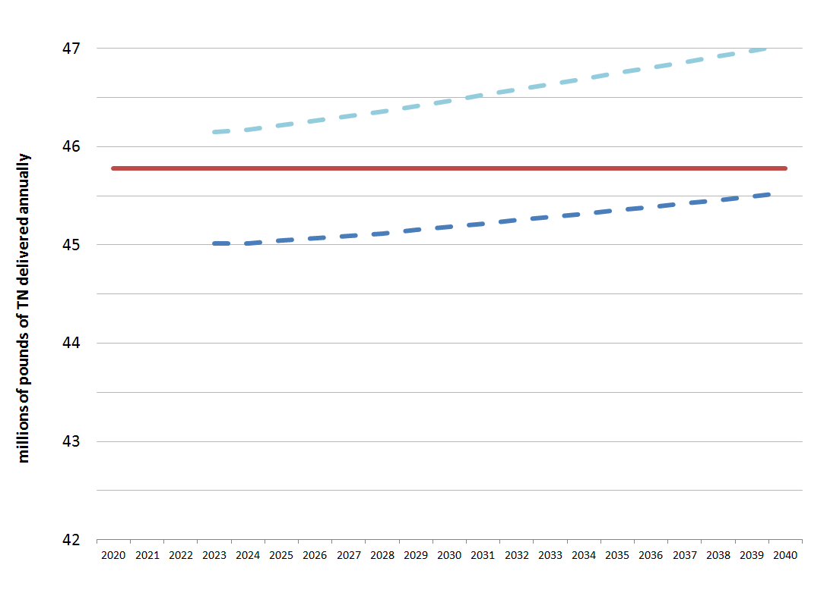
Achieving the Phase III WIP Target
Phase II Target: 47.2 M lbs
Phase II
Phase III Target: 45.8 M lbs
Phase III Projected load
0.8 M lbs below target
Notes:
This slides brings it all together in terms of:
1 – where we were with Phase 2
2 – the Phase 3 pollution gap from phase 2 that resulted from the new science and modeling tools that came out of the midpoint assessment.
3 – and where we project our Phase 3 plan will get us.

Slide 17
Phase III WIP Challenges/Opportunities
Factoring in Climate Change Impacts to Bay Restoration
Accounting for Conowingo
Ensuring Local Jurisdiction Capacity
BMP verification and maintenance
Technical assistance delivery
Notes:
The Phase 3 WIP does not incorporate anticipated increases in loads from climate change. EPA is currently asking states to account for climate in 2022/2023 milestones or a WIP addendum. Current estimates anticipate a further 2-million pound nitrogen reduction.
Conowingo is being addressed through a separate collaborative WIP among all the jurisdictions, as well as through MD-specific actions in our water quality certification for Conowingo and a sediment characterization and beneficial reuse pilot.
Capacity is necessary for Phase 1, 2, non-MS4 and SCDs.
Will also use the Adaptive management process highlighted earlier and working through the milestones and progress evaluations process to make sure we stay on track and address WIP challenges moving forward.

Slide 18
Planned Continuing Engagement
April-May 2019 Informational Meetings
MACO and MML
MAMSA
County Health Directors
Local Government (trajectories)
Conservation Districts
NGOs
Regional Workshops and Webinars
Notes:
Reiterate that engagement will be critical to the adaptive process and ensuring we meet WIP targets. Here are some example groups we have planned for continued engagement.

Slide 19
Thanks for Your Involvement!
Maryland’s Phase III WIP
Locally-driven
Achievable
Balanced
Public Meetings:
April 29 (1-3 PM) Hagerstown Community College
May 3 (9:30-11:30 AM) Chesapeake College
May 6 (1-3 PM) Harford Community College
May 17 (1-3 PM) Webinar
Public Comment (Through June 7)
Website: bit.ly/mdwip3
E-mail: MDE.ChesapeakeWIP@maryland.gov

