Slide 1

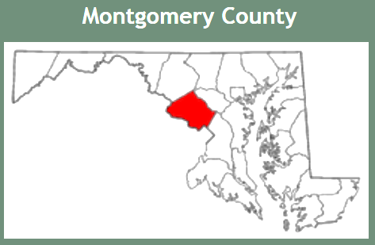
Radon Testing and Mitigation Program in MCPS
Notes:
Radon has developed into a major environmental health concern for communities and schools around the county. Initially recognized as a problem in the 60’s and 70’s, the government started to develop programs in the 80’s to address the public health impact of the naturally occurring substance. Montgomery county public schools, the fourteenth largest school system in the US has tried to stay ahead of the curve and started monitoring and remediation in the mid 80’s. We now operate a very large testing and remediation program and we’d like to share the major elements with you

Slide 2
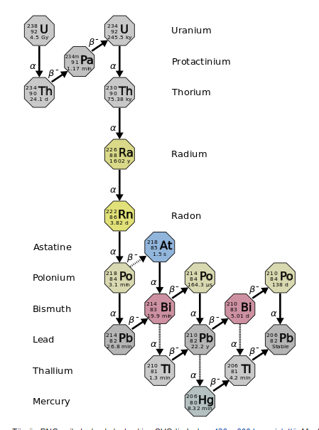
Radon: A Bio
Originates from decay of uranium
Travels through soil
Invisible, odorless, tasteless, colorless, inert, radioactive gas
Enters buildings
Half-life of 3.8 days
Notes:
Just as a reminder: We are dealing with is a naturally occurring radioactive isotope from uranium (238) decay. Regions with relative enrichments of naturally occurring uranium (granites are relatively rich in uranium) are easy predictors for radon but radon’s distribution is also influenced by typical geological processes on the earth’s crust including activity from glaciers, sedimentary processes and groundwater. Radon happens to occur as an inert gas which can easily make its way through soil. It has a relatively short half life. Ironically, it’s some of the daughter products that cause the adverse health affects and not so much radon itself. Radon is more the transport mechanism for the problem

Slide 3
Radon: A Bio
“Radon is a serious national health problem”
American Lung Association
American Medical Association
U.S. EPA
National Academy of Sciences
U.S. Surgeon General
World Health Organization
Notes:
Since the 70’s, many organizations have studied the affects of radon on public health. As the health affects of radon have become known, more and more organizations in America as well as around the world have recognized it as a truly serious public health problem

Slide 4
Radon: Health Effects
Radon is a known human carcinogen
Radon is leading cause of lung cancer among non-smokers and second-leading cause among smokers
No ‘safe’ level of radon exposure
Smoking History
Radon Exposure Radon Health Effects
Genetic Pre-disposition
Notes:
The primary health effect of radon exposure is lung cancer. In fact it is the leading cause of lung cancer among non-smokers and second leading cause among smokers
No safe level of radon exposure has been found
Smoking, exposure and family background all contribute to adverse health effects

Slide 5
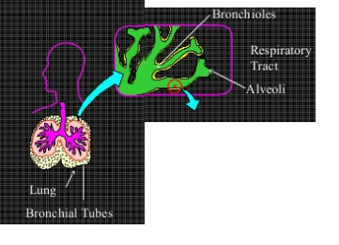
Radon: Health Effects
Radon and radon decay products inhaled. Decay products remain in respiratory track
Po-218 and Po-214 do much of the damage (alpha emitters)
Alpha particles strike lung cells damaging cell DNA
Notes:
As mentioned earlier, the primary damage from radon exposure is from decay of two daughter isotopes—Polonium 218 and 214. Both are alpha emitters. The nature of alpha exposure is generally exposure to a relatively large particle with high momentum inflicting physical and chemical damage to cellular DNA—in the case of Radon—deep in the lungs

Slide 6
Radon: Health Effects
Not sure if children are at greater risk
  Most lung cancer diagnoses are among those older than 40 years
  Evidence of childhood lung cancer associated with indoor radon is mixed
Children are young—many years in front of them during which they will accumulate radon exposure
  Since radon is cumulative risk, it is important to reduce childhood exposure
Notes:
The literature is not clear that children are actually at greater risk. But on general principles, since children are young with many years of life remaining and radon exposure presents cumulative risk—it is important to reduce childhood exposure

Slide 7
District-wide Program History
Montgomery County Public Schools has been testing for radon since the 1980s.
An intensive period of system-wide testing and remediation was accomplished in the late 1980s through the mid-1990s
Since that era, radon prevention measures such as sub-slab vapor barriers, proper sealing, and sub-slab vents have been incorporated into all new construction projects.
L
Notes:
As background, Montgomery County Public Schools has been testing for radon in our schools since the 1980s. An intensive period of system-wide testing and remediation was conducted in the late 1980s through the mid-1990s to ensure that all schools complied with EPA guidance for radon (See EPA Publication EPA 402-R-92-14: Radon Measurement in Schools, Revised Edition)
Since that era, radon prevention measures such as sub-slab vapor barriers, proper sealing, and sub-slab vents have been incorporated into all new construction projects.

Slide 8
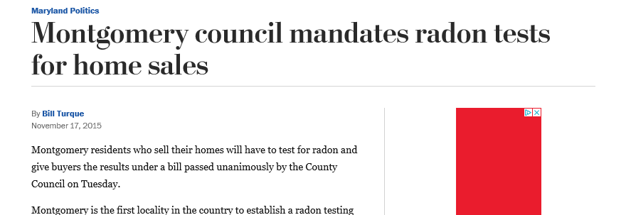
Substantially Revised Program Started Late 2015
New program to comprehensively review our overall radon testing program to strengthen our protocols going forward.
MCPS retested all schools in our district, 2015-2016 L
Notes:
Concerns about elevated levels of radon in our schools were raised after the publication of a summary report of MCPS radon testing. This report showed certain rooms in 28 locations that had elevated radon levels in need of retesting because they registered higher radon levels than the United States Environmental Protection Agency (EPA) recommended action limit of 4.0 picocuries per liter of air (pCi/L).
We revised our program to comprehensively review our overall radon testing program to strengthen our protocols going forward. In addition, out of an abundance of caution, MCPS commenced with retesting all schools in our district as a first step to enhance our overall radon testing and remediation program.

Slide 9
  MCPS is: largest school system in MD also the 14th largest public school system in the nation (17th in 2015) employs 23,000
  Educates 161,546 students (2% increase) from over 157 countries (156,500 in 2015)
  35.1% of our students to receive free & reduced-price meals (FARMS)
  >1M residents of Montgomery County
  L
About MCPS

Slide 10
The Program:
Large number of facilities (currently 244 facilities (206 schools) ~26.2M sq feet)
  ES
  MS
  HS
  Special
  Admin/maintenance/transportation
Selected AARST testing and mitigation protocols for schools and large buildings.
Testing conducted by third party
Notes:
MCPS is large:
Over 26 million square feet
244 facilities
Facilities are frequently being modernized, hvac upgrades, windows replaced, exterior doors replaced, and new additions and buildings

Slide 11
The Testing Program
Relies on short-term testing (activated charcoal)
Testing Rounds:
  Initial
  Follow-up
  Post-mitigation
Test all occupied ground contact rooms/areas and a portion of occupied upper level rooms/areas.
Portables not tested
Notes:
We selected short term testing from AARST rather than protocols that used long term (3-month) testing. The major driver for this was anticipated public concern for fast sample turn around times and a somewhat restricted sampling window during the heating season.
In general terms, the testing protocol relies on as many as three rounds of sampling to bring testing to a conclusion—initial, follow-up and post mitigation.
Hopefully, the initial sampling targets all occupied ground contact rooms and a portion of upper level rooms.
The follow-up round is intended to re-test locations that showed elevated results initially, as well as any locations that were missed or considered compromised during the initial sampling
Post-mitigation is done after the mitigation system has been fully installed and should be conducted at the same time of year as the initial sampling
Portables, or the beloved ‘learning cottages’ are not sampled

Slide 12
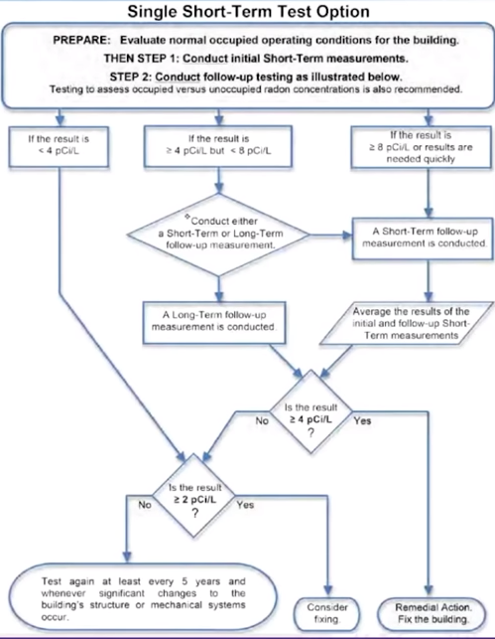
Notes:
This is the AARST short term test protocol.
First, note ‘normal occupied operating conditions’. Closed building conditions during the heating season are considered more of a potential worst case scenario for radon concentrations so testing is conducted from roughly 11/1 till middle of April.
Urgency to the response depends on the results. Retest results are averaged with initial results. If the average is 4 or more-then remediate
At MCPS, if the average is 2 or more, we strongly consider remediating
Retesting is scheduled every 5-years for facilities with no problems and every 2 years for those that had elevated results

Slide 13
Testing Program Challenges
Communication with schools
  Several items including: notice of initial testing, notice of follow-up testing, notice of mitigation work schedule, notice of post mitigation testing, notice of final results
  Each notice needed to be vetted by management
  Translated versions supplied as needed
Ensuring buildings were closed during testing
  Occasional testing delays to make repairs
  Window and doors openings during testing
Missing and compromised samples
No access to rooms
Snow storms
Earthquake
Follow-up sampling
Notes:
We had a number of challenges with our testing program. First, there is communication—notifying schools of the initial test, of follow-up testing, of mitigation work, of post mitigation sampling and then final results. Everything needs to be reviewed by management and schools will often request documents provided in assorted languages. There was an informational piece about radon that we also distributed. The turn-around time for the review process and translations often slowed our ability to quickly communicate with the customers—sometimes leading to customer frustration.
Another challenge was making sure buildings were closed during the test period—windows and doors closed. Sometimes a challenge with hvac problems where we needed to re-schedule testing due to building-wide hvac problems (over-heating)
It was rare to have a building that had no missing or compromised samples (dropped, moved, damaged)
Then of course there were the weird events that we could not avoid including snow storms and earthquakes—both of which can influence radon movement
These misfit scenarios ended up being the targets for follow-up sampling which we tried to combine with follow-up sampling of initial elevated sample locations

Slide 14
Testing Program Successes
Public access to all test results for each tested facility
https://www.montgomeryschoolsmd.org/departments/facilities/maintenance/default.aspx?id=458858
Notes:
Aside from lowering radon levels in our schools, probably one of the big successes for our Radon program has been our dissemination of sample results to the public.

Slide 15
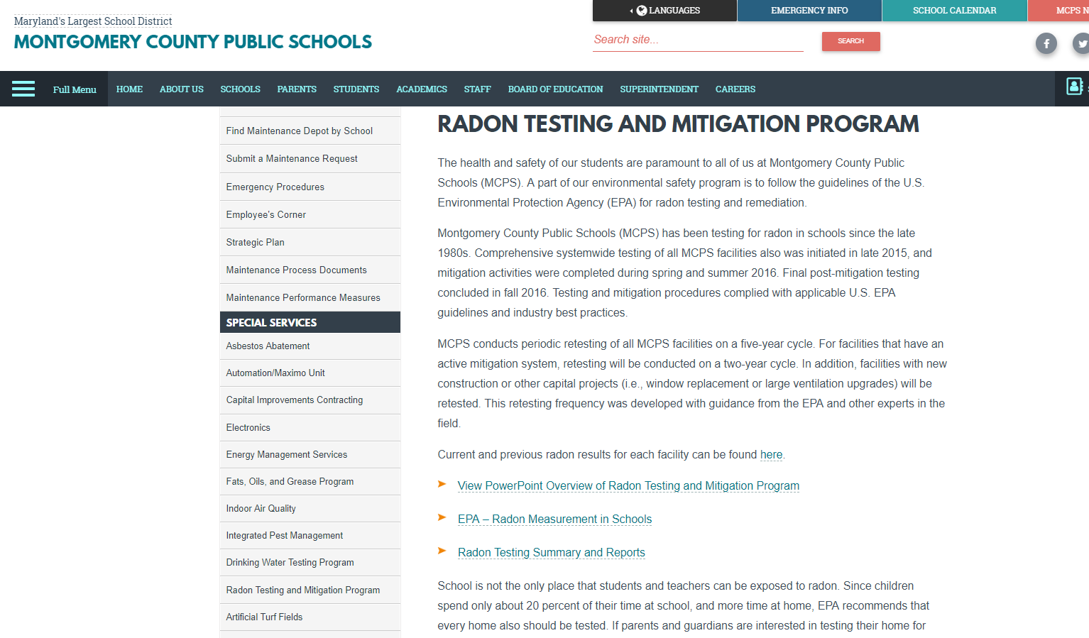

Slide 16
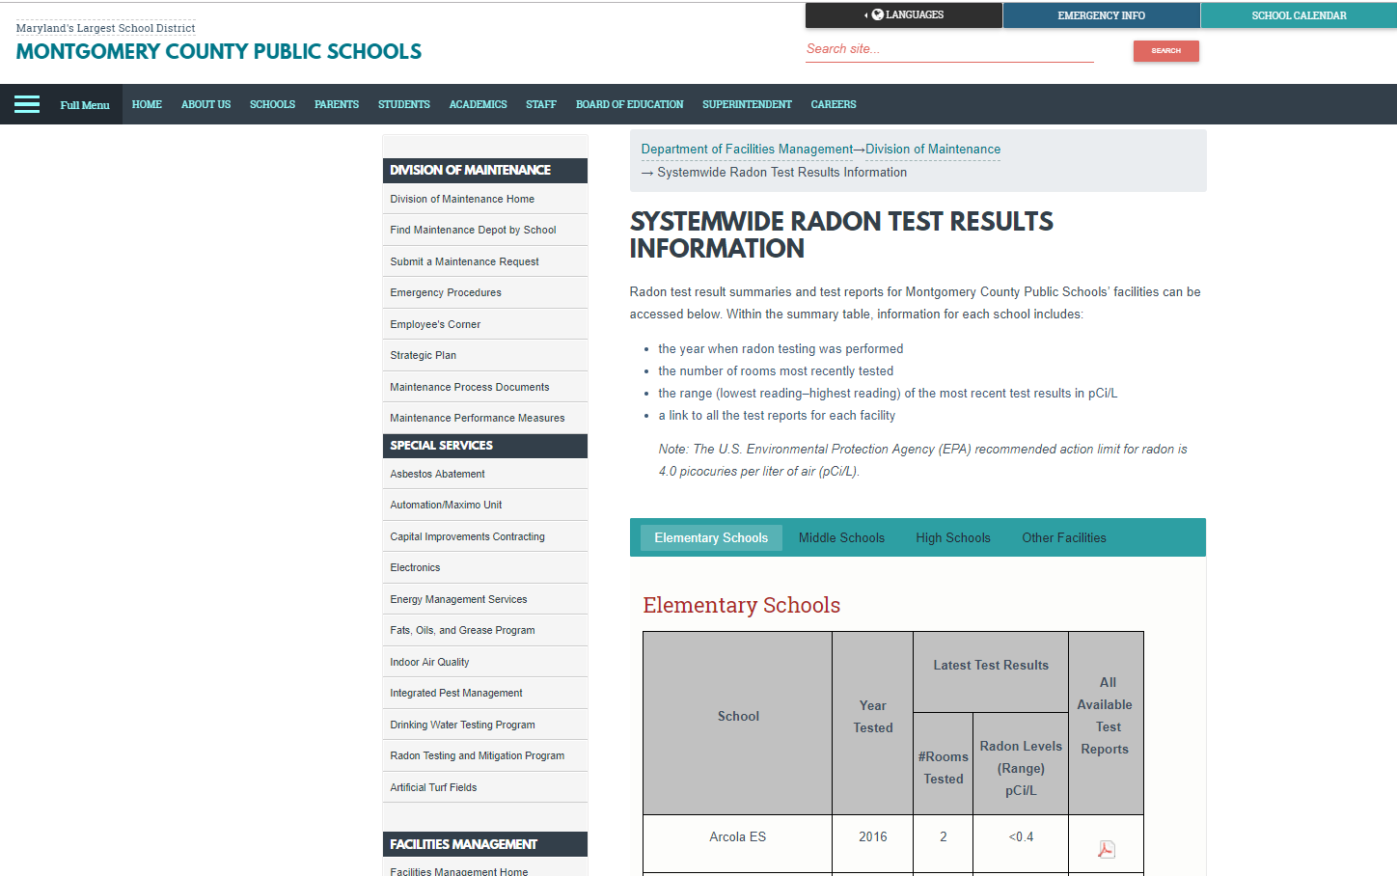

Slide 17
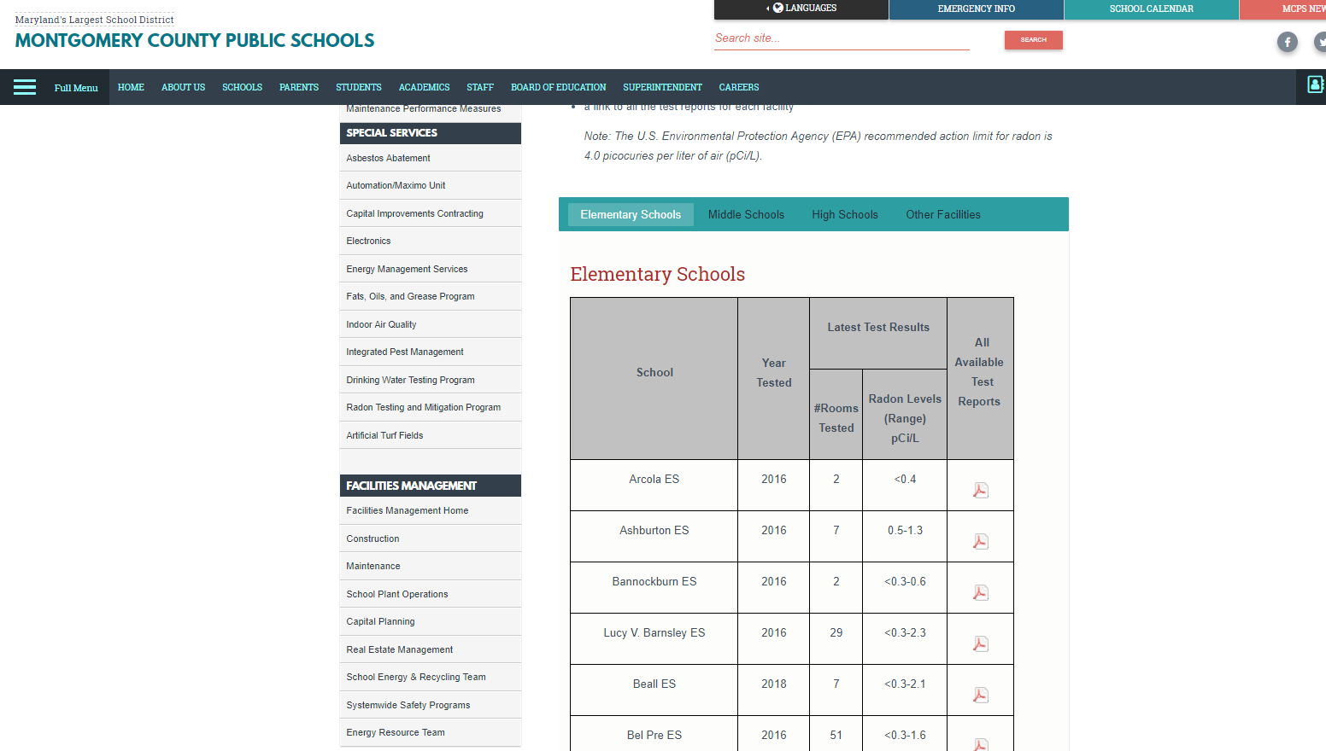

Slide 18
Testing Program Successes
Single point of contact for testing and questions
  Reduces bad information with customers
  Simplifies information search for customers
Testing data loaded into a MS Access database for future use and data work-ups (18500 samples 2016 and 5000 samples 2018)
Notes:
Other points of success for the program include having one person to act as liaison to respond to parents, and staff about testing/ mitigation and regulatory topics. This helps reduce confusion and customer frustration. There is a tendancy for customers to reach for upper management to get answers which can take time. We try to make it easy for the customer. This also can make it easy for management since it minimizes their exposure to unhappy customers!
We have our data dumped into a database. The benefits of this will appear in future years to verify test locations and identify trends

Slide 19
The Mitigation Program
Testing ID’s locations 4.0+
Also look for locations 2.0+
A day to diagnose
Coordinate work with mitigation contractor, electricians, roofers, carpenters
Usually one day to install up to 3-4 systems
Added alarms & labeling on fans
Majority of locations mitigated with sub-slab depressurization systems (SSDS)
Notes:
Initial and follow-up results are averaged and average values 4 or more are targeted for mitigation. Locations with results for 2 or more are scrutinized carefully and we usually prefer to mitigate these locations if there’s is any hint of a potential problem
The mitigation process is relatively easy—about a day for diagnostics of up to about 5 or 6 location. Work is then coordinated and scheduled with other trades. Installation will usually take about a day and includes alarms and labels. The majority of our systems are SSDS’s

Slide 20
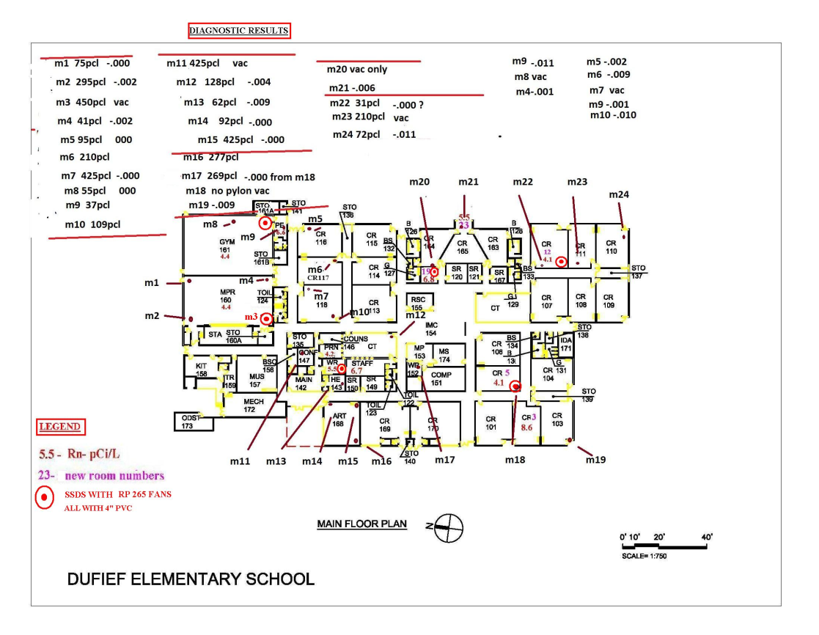
Notes:
This gives you an idea of the sub-slab depressurization systems (SSDS) diagnostics.
The idea is to verify that air will flow under the floor slab to an exist point—which is where the exhaust stack is location this is the sub-slab communication challenge. It’s usually straight forward and almost always important to have access to structural plans to identify footers and crawl spaces
This is a communication map from one of our more challenging schools

Slide 21
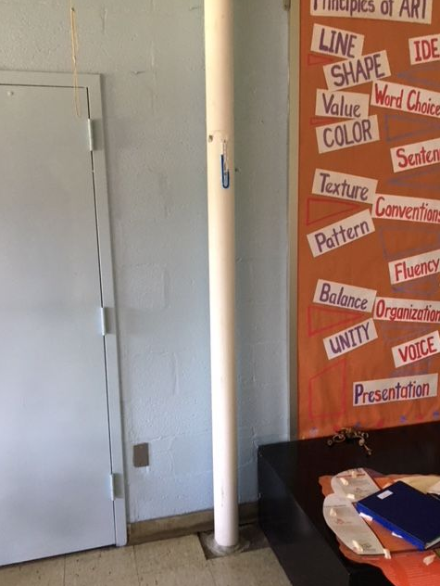
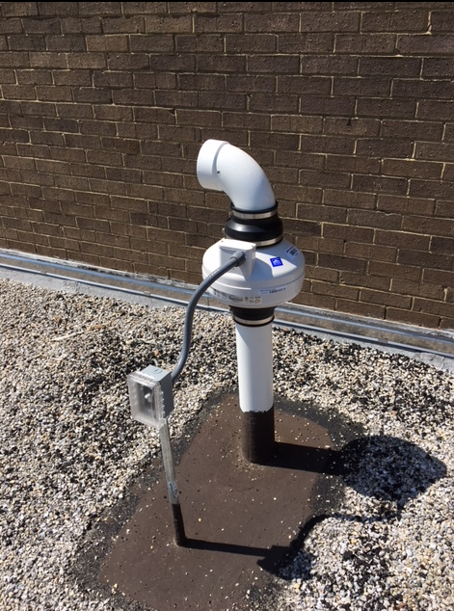

The Mitigation Program
Notes:
A typical exhaust stack. We frequently enclosed these pipes in a finished chase. A simple manometer is seen here which verifies that the exhaust fan at the roof line is operating
Fans are powered continuously and we now install alarms that indicate if stack draw has stopped—often indicating a fan problem.

Slide 22
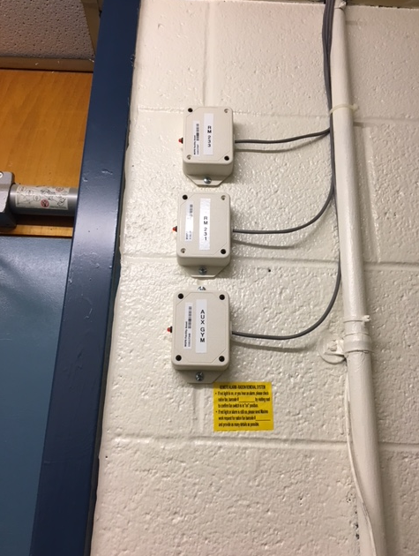
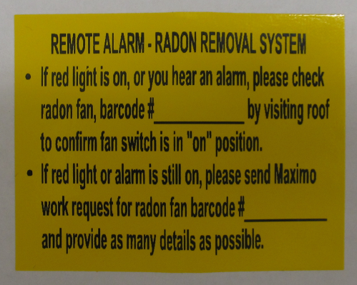
The Mitigation Program
Notes:
Here are three such stack monitors.

Slide 23
Mitigation Program Challenges
68 facilities needing mitigation work during first year (~30%; all passed post-mitigation sampling)
19 facilities needing mitigation work during year two (~25%)
Bid developed to solicit qualified contractors (1 year, plus three 1 year extensions)
Dedicated program manager, different than environmental team leader
Mitigation work concentrated during the summer
Prioritize responses based on levels
Need for multiple mitigation contractors to keep pace with schedule
Most work restricted to weekends/holiday break times.
Inform school staff of mitigation schedules and delays
On recurrent testing, some previously mitigated schools had rooms with undiagnosed elevated levels during year 2 testing L
Notes:
For the last couple rounds of testing we have been running about 25-30% of our facilities with problems. This should be going down.
Schools showing confirmed results of over 10 are responded to quickly and mitigation systems will be installed well before the end of the school year. Less than that and most mitigation work is completed during summer break.
Setting to mitigation response priority is important. Customers are smart and they will pick up on why their school isn’t getting urgent response. We focused on facilities with high values and them those with many lower values. Try to select a strong prioritization method so schools don’t get too upset when they hear their’ s not first.

Slide 24
Mitigation Program Successes
Most mitigated schools showed no problems in year 2 testing
  Great relief to all!
Communication is essential
Program verifies Tools for Schools Approach works:
  Organize with senior buy-in and effective team; select SOP
  Communicate starting at a high level; address staff and community questions and “what ifs..”
  Assess with floor plans
  Plan testing during the week, avoid holidays, direct questions to POC
  Evaluate with certified mitigator (and tester) L
Notes:
Most of our initially mitigated schools showed no new problems in year 2 testing. This included our more problematic sites.
Our approach seems to validate the general approach described in Tools for Schools

Slide 25
Future of the Testing and Mitigation Programs
Facilities with SSDS’s tested every 2 years
Facilities with no systems tested every 5 years
Testing needs to include:
  New facilities
  Facilities with HVAC updates
  Facilities getting new windows or ext. doors
  Facilities with new additions L
Notes:
Going forward- we will rely increasingly on the result database to determine when sites need future testing.
We anticipate testing in 70-95 (30-39%) facilities per year, depending on many factors

Slide 26
Questions?
Richard Cox, Richard_CoxJr@mcpsmd.org, 240-740-2323
Lynne Zarate, Lynne_M_Zarate@mcpsmd.org, 240-740-2507
Radon in Schools Webinar: https://www.epa.gov/iaq-schools/forms/webinar-radon-schools-what-you-need-know-properly-manage-radon-your-school
  A thank you to Bruce Snead, Director, Engineering Extension, Kansas State University

