Slide 1
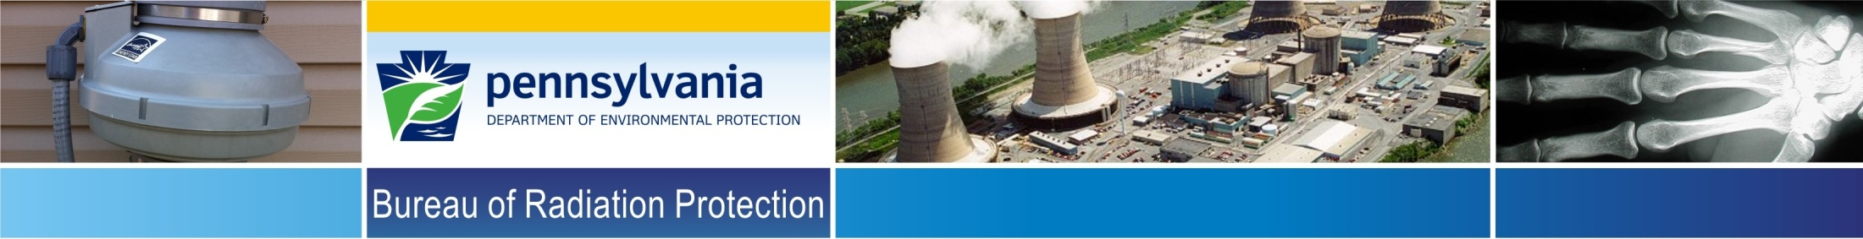
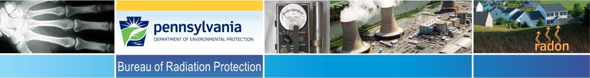
Low-Level Radioactive Waste
Program Update
Rich Janati, M.S.
Chief, Division of Nuclear Safety
Administrator, Appalachian Compact Commission
Tom Wolf, Governor
Patrick McDonnell, Secretary

Slide 2

Low-Level Radioactive Waste (LLRW)
LLRW is trash or other materials that have been contaminated with radioactivity such as protective clothing, paper, metal and glass items, ion exchange resins, filter media, incinerator ash, radioactive sealed sources, and some reactor components.
Who Generates LLRW?
Nuclear power plants
Medical facilities
Industrial facilities
Government facilities
Research facilities

Slide 3
Low-Level Radioactive Waste (LLRW)
LLRW Classification
NRC regulations in 10 CFR Part 61 has specified a waste classification system for LLRW
There are three (3) classes of LLRW: Class A, Class B and Class C
The majority of LLRW is Class A waste

Slide 4
Federal LLRW Policy Act
Federal
Low-Level
Radioactive
Waste
Policy Act
States Responsible
Compacts Encouraged
Exclusion of Out-of-Compact Waste

Slide 5
Appalachian States LLRW
Compact Commission
Appalachian States LLRW Compact Act of 1985 established the Appalachian Compact
Congress consented to the Compact in May 1988
Appalachian Compact Commission became operational in June 1990
Commission provides for the regional management and disposal of LLRW
Commission consists of 10 members from the party states of PA (4), MD (2), DE (2), WV (2)

Slide 6

LLRW Disposal Facility Siting Process
PA LLRW Disposal Facility Siting Process
Statewide Screening 1991
Regional Screening 1993
Local Screening 1994
Volunteer Process 1996-1998
Siting Process Suspended Dec 1998
Eliminated 78% of Land

Slide 7
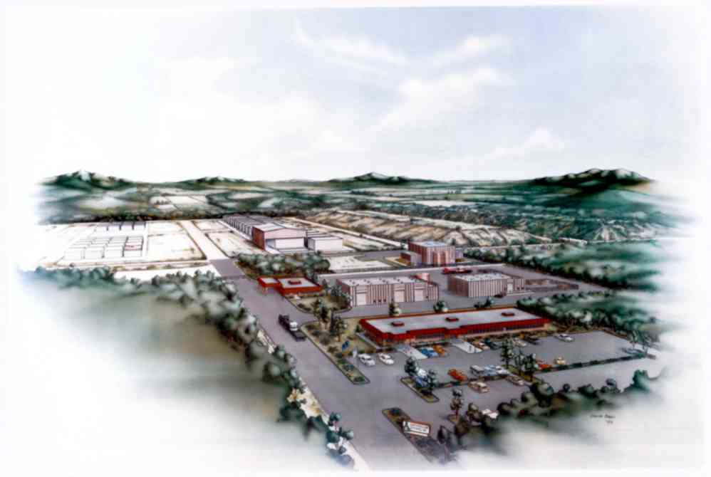
Conceptual Design of the PA LLRW Disposal Facility

Slide 8
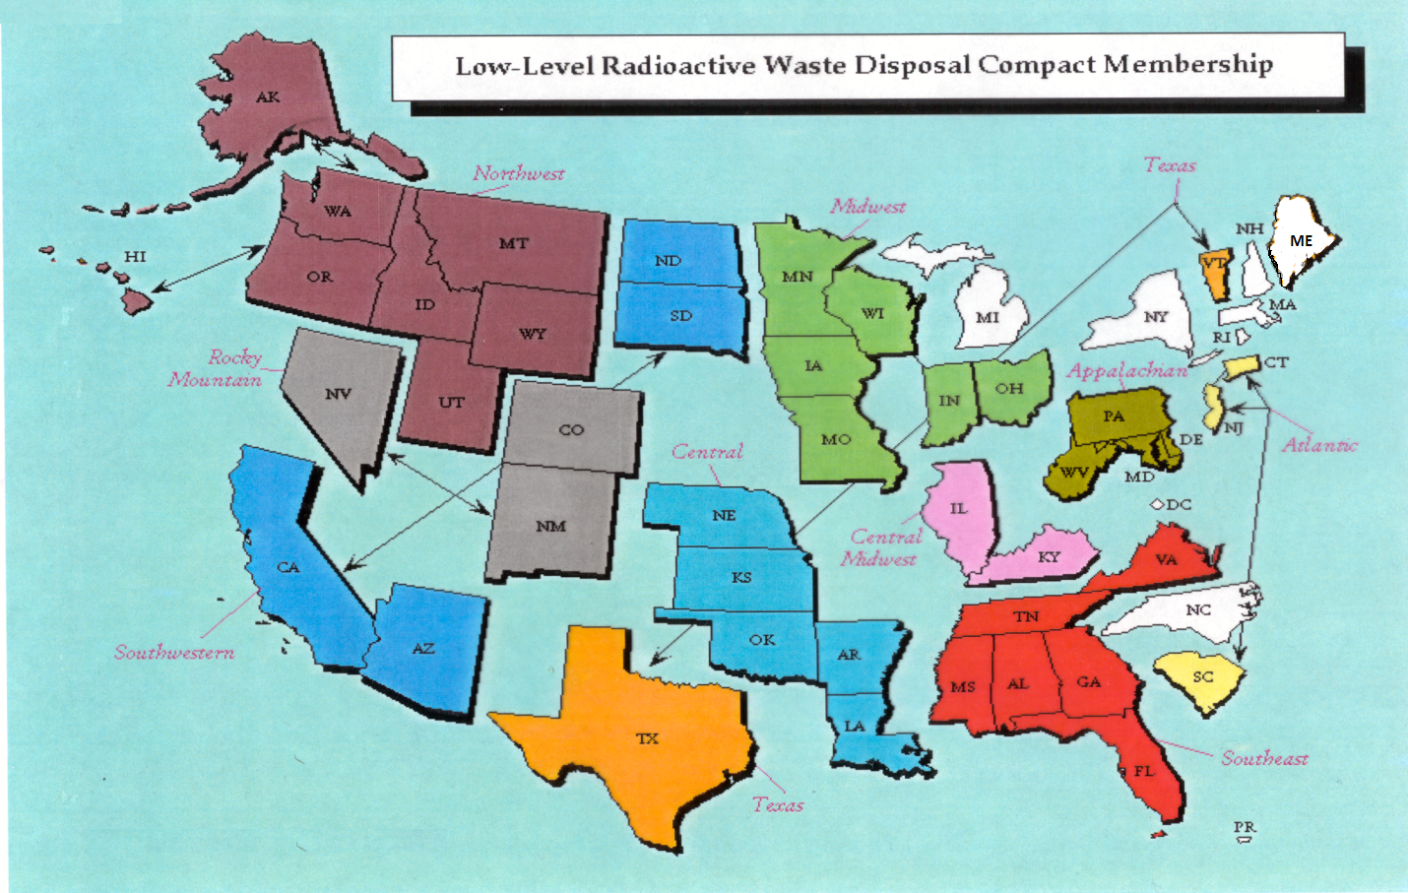
Status of LLRW Compacts

Slide 9
Status of Commercial LLRW Disposal Facilities
Barnwell Disposal Facility in South Carolina (Regional Facility)
  Accepts Class A, B and C wastes from the Atlantic Compact (CT, NJ, SC)
  Closed to generators outside the Atlantic Compact as of July 1, 2008
  Current projected closure date is 2038
  Richland Facility in Washington (Regional Facility)
  Accepts Class A, B and C wastes from the Northwest and Rocky Mountain Compacts (11 states in 2 compacts)
  Current projected closure date is 2056
  EnergySolutions Facility in Utah (not a Regional Facility)
  Accepts Class A waste from the entire nation except the Northwest and Rocky Mountain Compacts
  Provides for disposal of bulk waste, containerized waste, large components, and mixed waste
  Transports large components such as steam generators for disposal
  Current projected closure date is 2050

Slide 10
Status of Commercial LLRW Disposal Facilities
WCS Disposal Facility in Texas (Regional Facility)
Two facilities: one license
    Compact facility (9 Mft³ and 3.9 MCi)
    Federal facility for DOE waste (26 Mft³ and 5.6 MCi)
Accepts commercial LLRW (Class A, B and C) and federal LLRW and mixed waste
Annual limit on radioactivity of out-of-compact waste is 275,000 Ci
No annual limit on volume of out-of-compact waste
Disposal of Depleted Uranium (DU) and Greater-Than-Class C (GTCC) waste is being considered
Current projected closure date is 2045

Slide 11
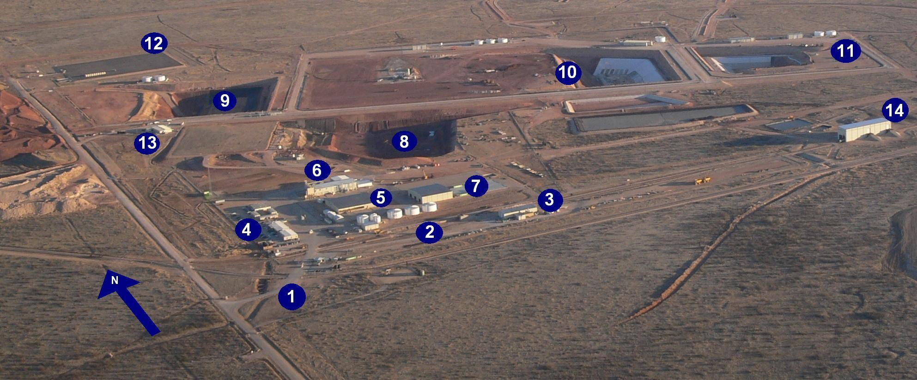
WCS Disposal Facility in Texas
1. Access road to 1,338-acre fenced site (guard house entrance) 2. On-site rail spur and rail-unloading facility 3. Maintenance building 4. Administration buildings with analytical and radiological laboratories 5. Container Storage Building (CSB) 6. Stabilization Building (SB) (West portion) and Mixed Waste Treatment Facility (MWTF) (East portion) 7. Bulk/Bin Storage Units (BSUs)1-3 (bin storage area [BSA-1] is covered) | 8. RCRA Subtitle C landfill will expand to the East, with closed cells to the West 9. 11e (2) Byproduct material landfill 10. Federal Waste Disposal Facility (FWF) for LLW and LLMW will expand to the West 11. Compact Waste Disposal Facility (CWF) for LLW will expand to the East 12. Ten-acre storage area for low-specific-activity (LSA) waste 13. Low-level disposal operations administration building 14. Rail unloading building for emptying gondola cars

Slide 12
Appalachian Compact Percent LLRW Volume by Disposal Site - 2017
EnergySolutions

Slide 13
Appalachian Compact Percent LLRW Activity by Disposal Site - 2017
EnergySolutions

Slide 14
Host State and Appalachian Compact Commission Activities
Coordination and Hosting of Annual Meetings
Annual LLRW Program Report
NRC Working Group on LLRW Storage
Large-Scale LLRW Blending Proposal
LLW Forum Working Group on 10 CFR Part 61
LLW Forum Working Group on Disused Radioactive Sealed Sources
Information Notices re Availability of the Texas Facility and Disposal of Radioactive Sealed Sources

Slide 15
Questions?
Rich Janati, M.S.
Chief, Division of Nuclear Safety
Administrator, Appalachian Compact Comm.
Phone: 717.787.2163 rjanati@pa.gov

