Slide 1
Presented by:
Mark Stewart
Climate Change Program Manager
Maryland’s Climate
Pollution Reduction Plan

Slide 2
Presentation Agenda
Overview of the Plan
Policies and Next Steps
Discussion

Slide 3
Part 1: Overview of the Plan

Slide 4
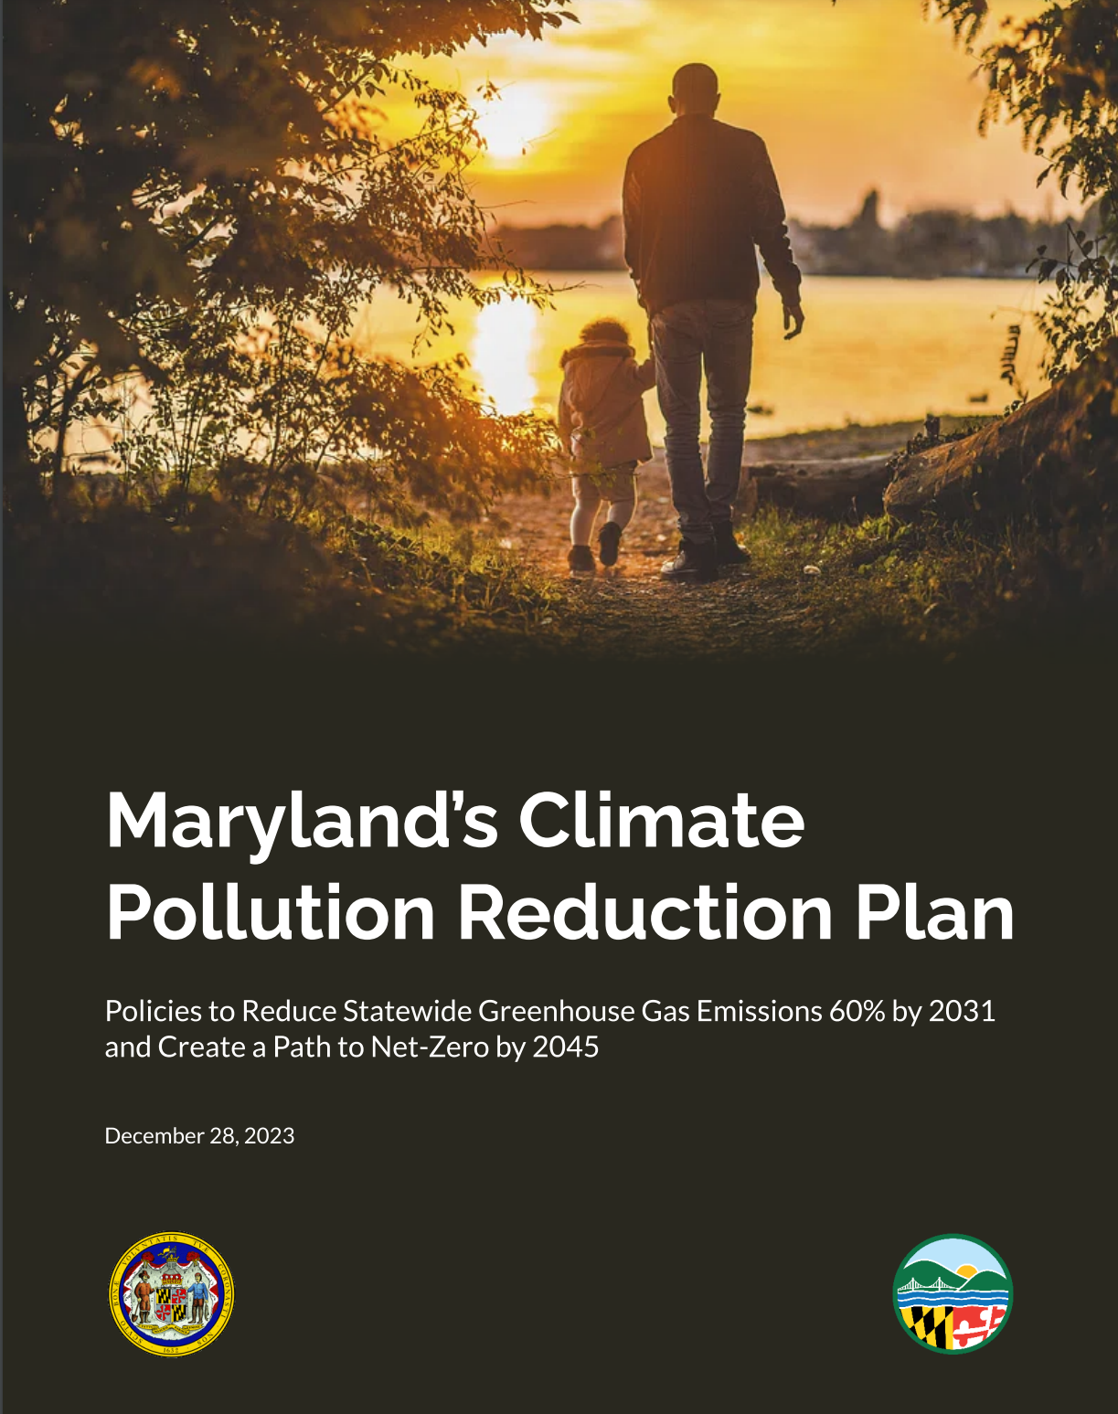
What is the Climate Pollution Reduction Plan?
MDE’s final plan to:
Reduce statewide greenhouse gas emissions 60% by 2031 (from 2006 levels)
Set the state on a path to achieve net-zero emissions by 2045
Create net economic benefits for Maryland
The full plan is available at mde.maryland.gov

Slide 5
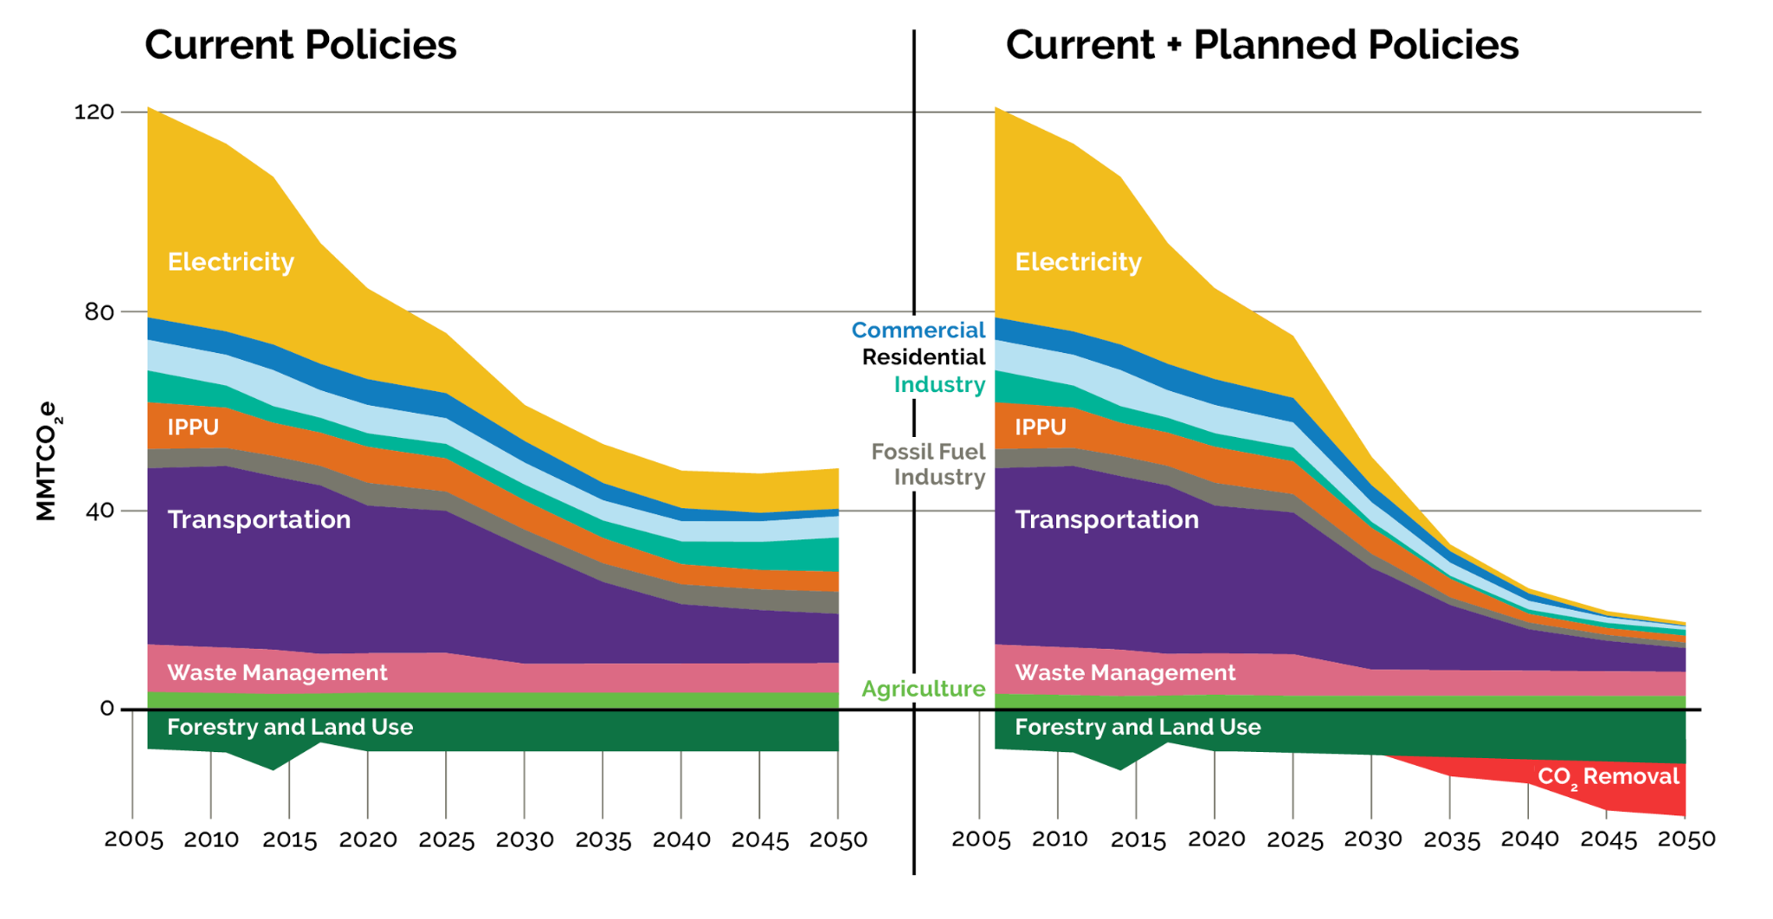
Achieving the State’s Goals
42 policies that, if fully implemented, will achieve Maryland’s goals
60% by 2031
Net Zero
by 2045

Slide 6
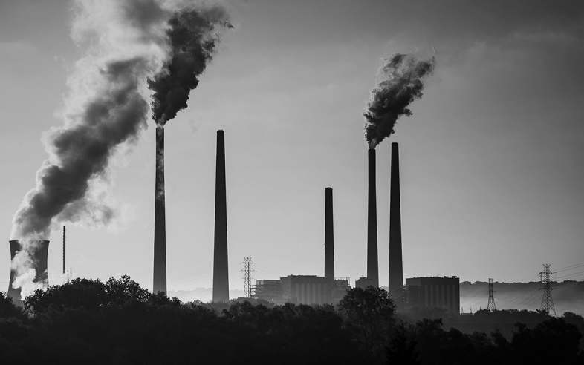
Maryland has Already Come so Far
Maryland once had the worst air quality in the eastern half of the U.S.
8 coal-fired power plants in 2006 (2 left today)
Countless cases of respiratory illness and hospitalizations

Slide 7
From the Dirtiest Air to the Cleanest
In 2022, Maryland met all national air quality standards for the first time since the Clean Air Act was established over 50 years ago

Slide 8
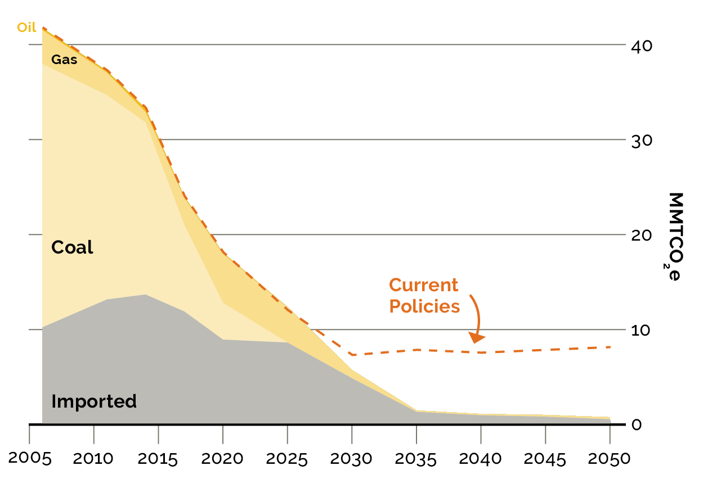
Greatest Improvements from the Electricity Sector
Today
Emissions from electricity generation plummeted since 2006
Two-thirds of statewide emissions reductions were from this sector
Current policies will further reduce emissions
New policies will provide 100% clean electricity to all Marylanders by 2035

Slide 9
Shifting Focus from Large to Small Sources
To further improve air quality and reduce greenhouse gas emissions, we must electrify millions of small sources of emissions including cars, trucks, furnaces, boilers, and water heaters.

Slide 10
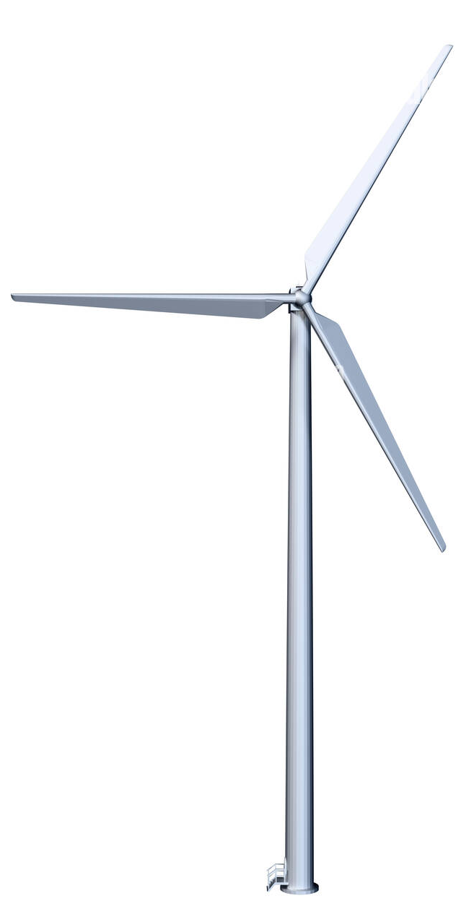
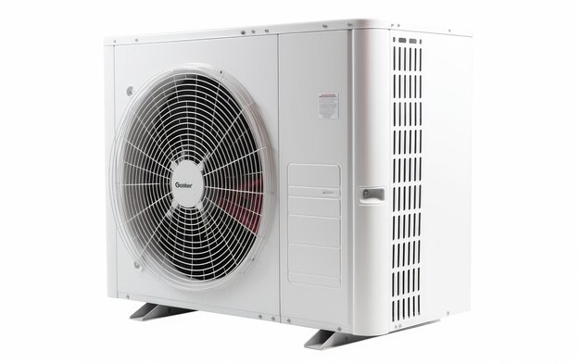
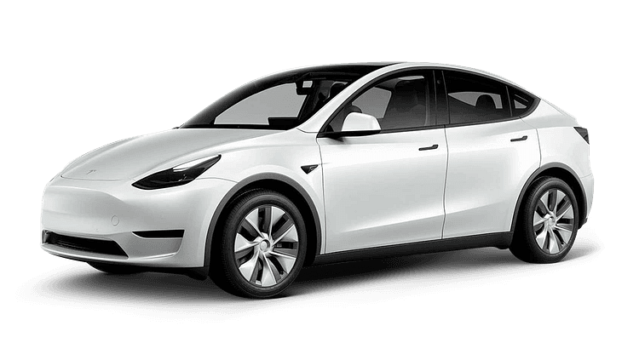
Electrification is Underway
Heat pumps started outselling gas furnaces in the U.S. in 2022
The best-selling car in the U.S. in 2023 was an EV
Electric devices are increasingly powered by clean electricity

Slide 11
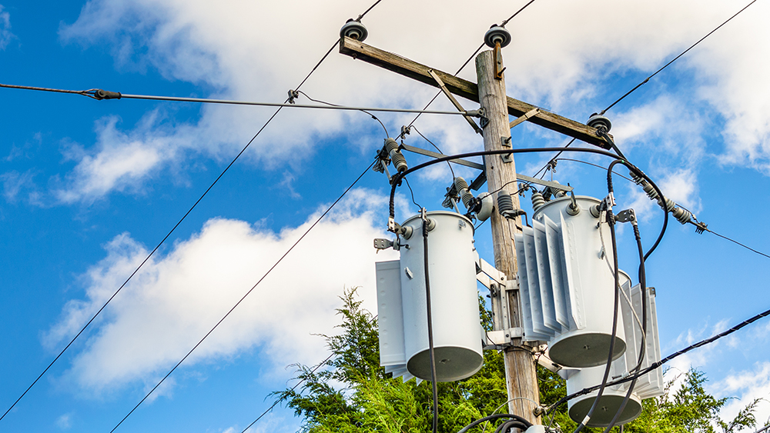
Can the Grid Handle It?
Yes.
The Climate Solutions Now Act required the Maryland Public Service Commission (PSC) to study this issue.
The PSC study found that efficient electrification of buildings and vehicles will require modest electric grid investments below historic levels.

Slide 12
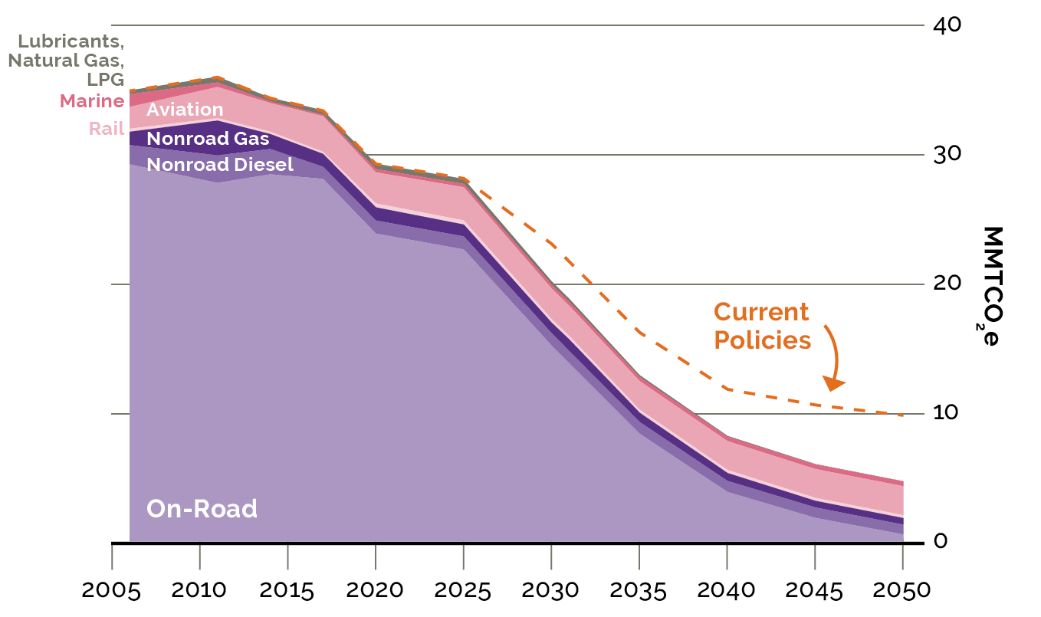
Transportation Decarbonization is Driven by Electrification
Today
Advanced Clean Cars II and Advanced Clean Trucks guide the transition to zero-emission electric cars and trucks
MDOT’s efforts to develop transit projects and reduce vehicle miles traveled (VMT) will further reduce emissions

Slide 13
Maryland’s EV Charging Network is Poised for Additional Growth

Slide 14
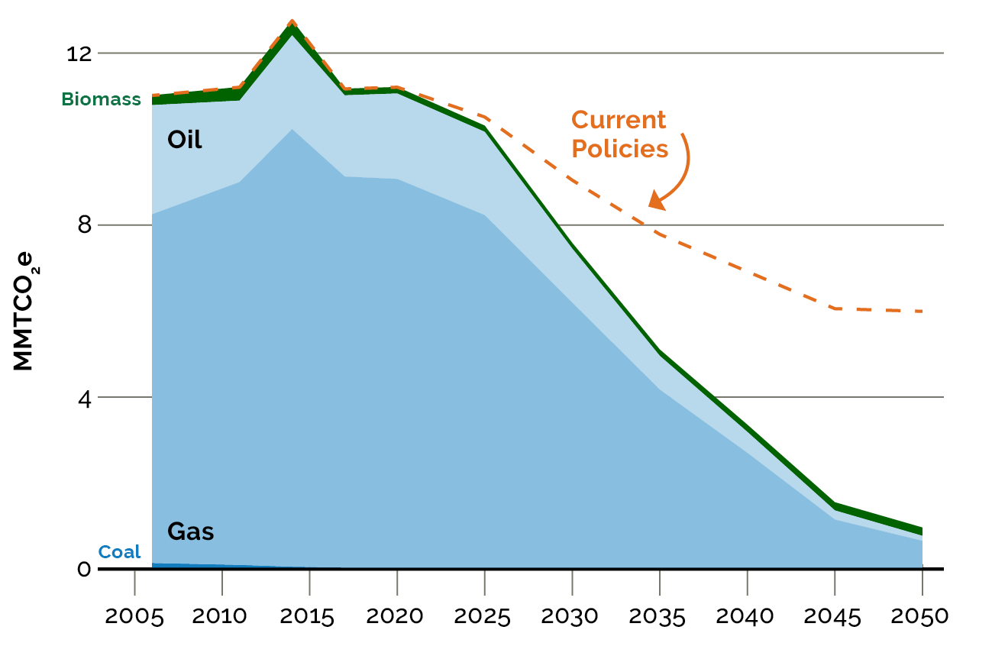
Building Decarbonization is Driven by Electrification
Today
Building Energy Performance Standards and federal incentives for heat pumps reduce emissions, but not enough
New policies such as Zero-Emission Heating Equipment Standards and Clean Heat Standards will reduce emissions fast enough to achieve the state’s goals

Slide 15
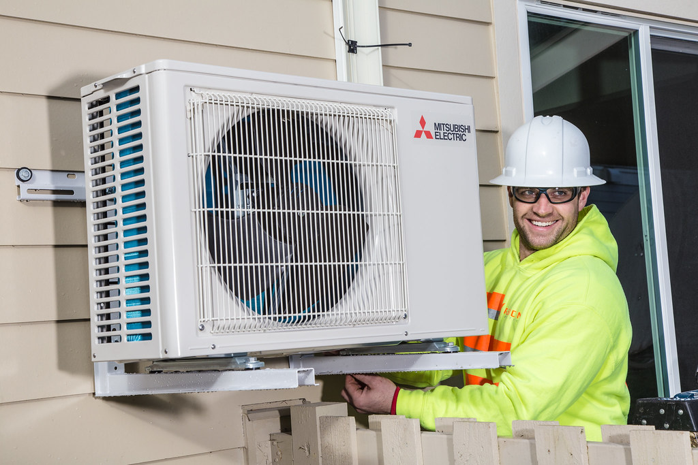
Electrification Creates Local Jobs
Upgrading a boiler to a heat pump is work that can’t be outsourced
Implementing this Plan will create an additional 27,000 jobs in Maryland between now and 2031
Electricians and heat pump installers are among the job sectors that will see strong demand

Slide 16
Lower Energy Costs
The average Maryland household saves $2,600 annually by using heat pumps and EVs instead of gas appliances and gas cars
Savings increase to $4,000 annually for households that switch from oil or propane to heat pumps and EVs

Slide 17
Take Advantage of Existing Federal Tax Credits

Slide 18
Amping Up Electrification with Rebates
Rebates will be available starting in 2024 for low, moderate, and middle-income households.
This Plan proposes to keep electrification rebates flowing when federal funding runs out.

Slide 19
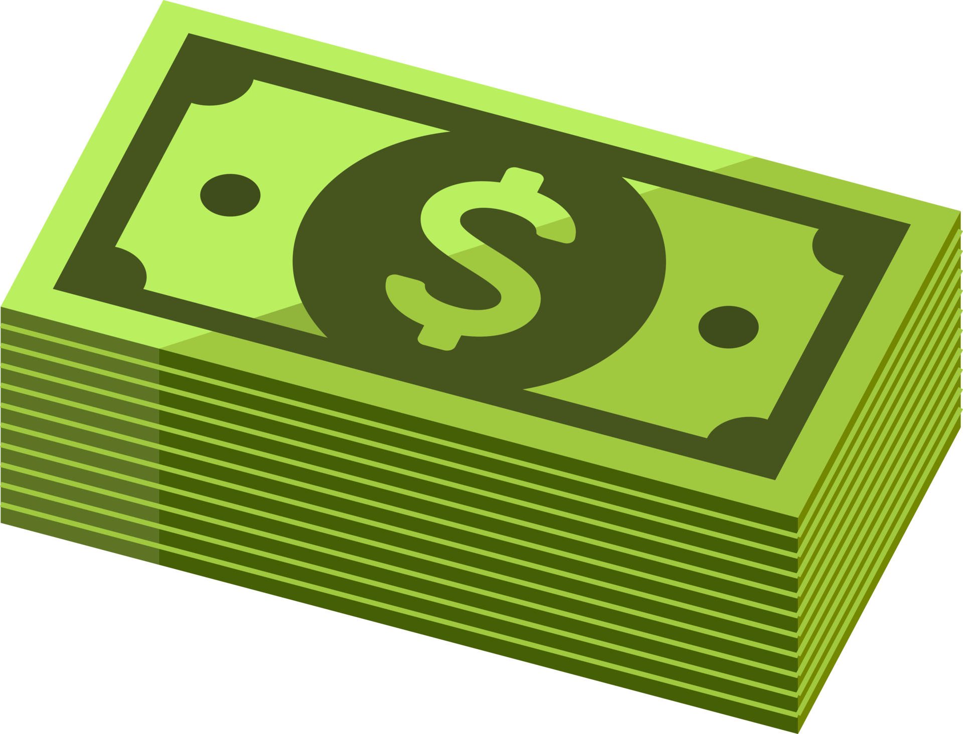
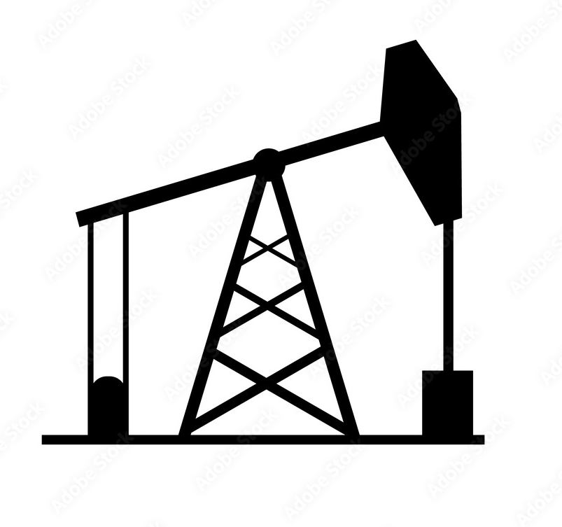
Potential Funding Sources
Federal grants and loans
Green revenue bonds
Cap and invest program
Carbon fee
Hazardous substance fee
Fees on fuel-burning vehicles

Slide 20
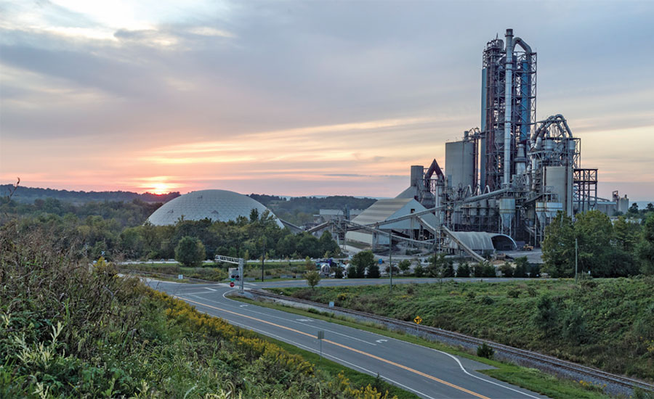
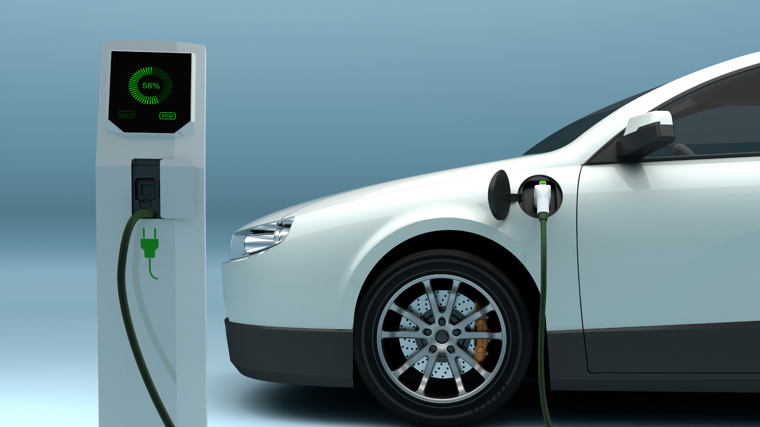
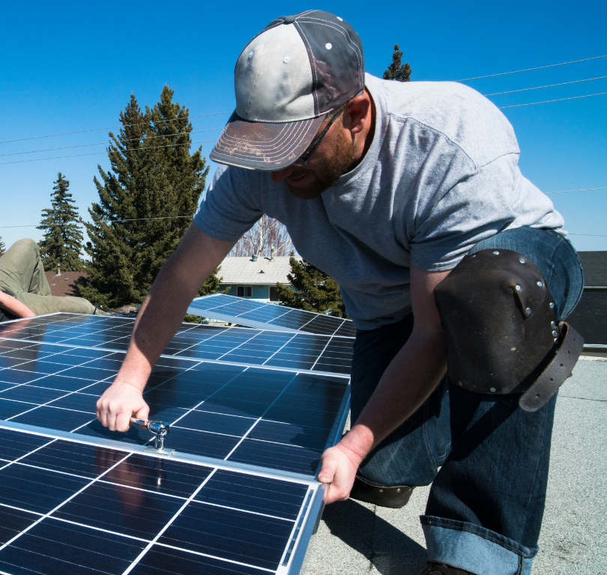
New Investments
With new funding sources established, the state will provide at least $1 billion annually to incentivize:
Building electrification
Transitioning to EVs
Industrial decarbonization
Workforce development
and more

Slide 21
Economic Benefits
In addition to lowering household energy costs and creating 27,000 jobs, this Plan will also
increase total personal income by $2.5 billion
and grow Maryland’s gross domestic product by $5.3 billion between now and 2031

Slide 22
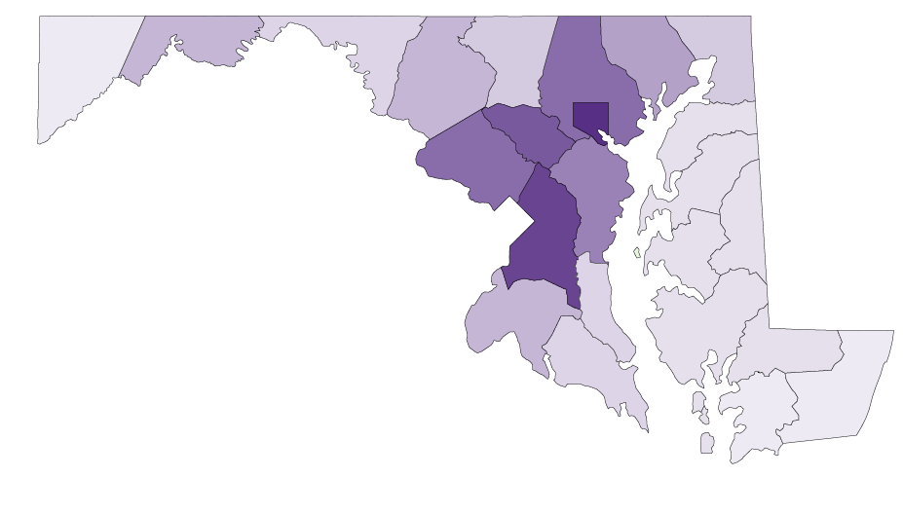
Health Benefits
This Plan delivers between $142 million and $321 million in additional health benefits in 2031 compared to current policies
Most of the health benefits occur in historically disadvantaged communities

Slide 23
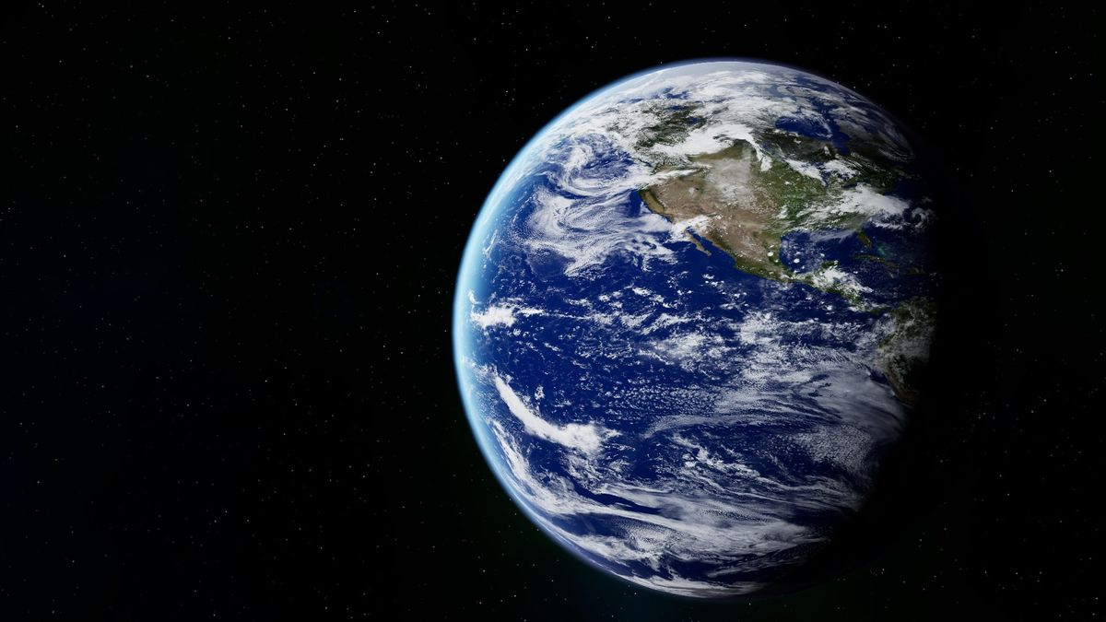
Global Benefits
Maryland’s new policies are modeled to reduce emissions by 646 million metric tons of carbon dioxide equivalent (MMTCO2e) between now and 2050
The global benefit is estimated to be $135 billion!

Slide 24
Part 2: Policies and Next Steps

Slide 25
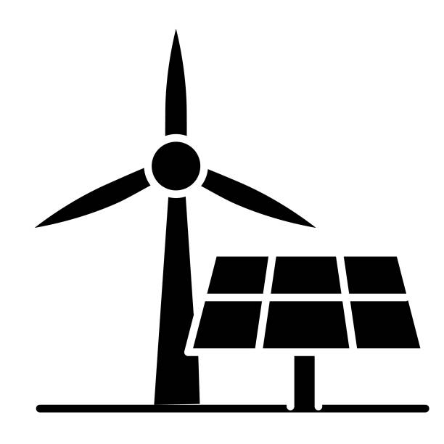
Policies: Electricity Sector
POWER Act (current)
Energy Storage Act (current)
Incentives for Renewable Energy (current)
Renewable Portfolio Standard (current, modified)
Regional Greenhouse Gas Initiative (current, modified)
Clean Power Standard (new)

Slide 26
Policies: Transportation Sector
Zero-Emission Vehicle Infrastructure Plan (current)
Advanced Clean Cars II (current)
Advanced Clean Trucks (current)
ZEV Transit Buses (current)
ZEV School Buses (current)
Incentives for Purchasing EVs (current, modified)
Advanced Clean Fleets (potential)
Maryland Transportation Plan (new)

Slide 27
Policies: Buildings Sector
Energy Codes and Standards (current)
Building Energy Performance Standards (current)
State Government Lead by Example (current)
EV-Ready Standards for New Buildings (current, modified)
EmPOWER (current, modified)
Incentives for Building Decarbonization (current, modified)
Zero-Emission Heating Equipment Standard (new)
Clean Heat Standard (new)
Gas System Planning (new)

Slide 28
Policies: Industrial and Agricultural Sectors
Hydrofluorocarbon Regulations (current)
Control of Methane Emissions from the Natural Gas Industry (current)
Buy Clean (current)
Incentives for Industrial Decarbonization (current, modified)
Incentives for Agricultural Decarbonization (current, modified)

Slide 29
Policies: Waste Sector
Landfill Methane Regulations (current)
Food Residuals Diversion Law (current)
Sustainable Materials Management (current)
Incentives for Waste Sector Decarbonization (current, modified)

Slide 30
Policies: Forestry and Land Use Sector
Maryland 5 Million Trees Initiative (current)
Sustainable Growth (current)
Forest Management (current)
Coastal Wetland Management (current)
Agricultural Resource Conservation Programs (current)
Forest Preservation and Retention Act (current)
Incentives for Forestry and Land Use (current, modified)

Slide 31
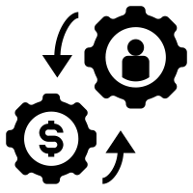
Policies: Economywide
Clean Economy Standard (new)
Expanded Strategic Energy Investment Fund (current, modified)
New Funding Sources (potential)

Slide 32
Next Steps
Maximize federal funding opportunities
Launch & implement regulatory processes
Coordinate with the Maryland Commission on Climate Change
Evaluate funding mechanisms
Please read the full plan at mde.maryland.gov

Slide 33
Part 3: Discussion

Slide 34
Questions? Contact Us

