Slide 1
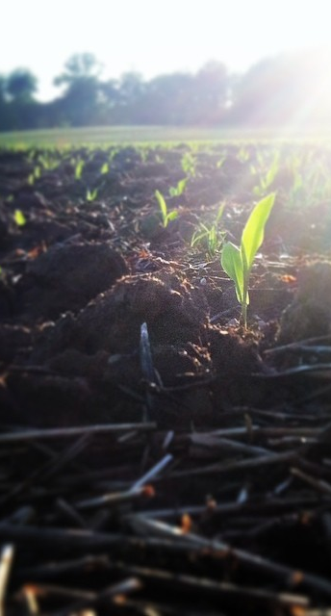
Agricultural Credit Generation
Susan Payne
Maryland Department of Agriculture
January 21, 2016

Slide 2
AGRICULTURAL NONPOINT SOURCE TRADING Fundamental Principles
To be eligible to trade, a generator of agricultural nonpoint source credits must meet a numeric baseline level of nutrient and sediment reduction which is the more stringent of either the applicable Chesapeake Bay or local TMDL as calculated on the entire farm in aggregate.
Credit generators must be in compliance with all applicable local, state, and federal laws, regulations, and programs.
BMPs funded by federal or state cost share or county mitigation banking programs cannot be used to generate credits during the lifespan specified in the cost-share contract.

Slide 3
AGRICULTURAL NONPOINT SOURCE TRADING Fundamental Principles Continued
Credits cannot be generated by taking whole or substantial portions of farms out of production for the sole purpose of generating credits.
To ensure that a net decrease in loads is achieved, 10% of the credits sold in a trade will be retired and applied toward TMDL goals.
An agricultural practice can generate credits only when it is installed and verified or placed in operation.

Slide 4
HOW TO GENERATE CREDITS
Tradable credits can be generated from any planned agronomic, land conversion, or structural practice.
Some practices (such as setbacks, fencing, manure incorporation) are excluded because they are required by nutrient management regulations.

Slide 5
PROGRAM STRUCTURE
Voluntary
Market-driven
Performance-based
Uses an online suite of tools (based on NutrientNet):
Calculator
Registry
Marketplace
Administrative module
Interactive mapping feature
Site-specific, farm-scale calculation tool (Chesapeake
Bay Nutrient Trading/Tracking Tool or CBNTT)
State-specific tools for MD (MNTT), VA, and PA

Slide 6
NUTRIENT TRADING TOOL DEVELOPMENT
Original tool based on World Resources Institute (WRI) NutrientNet platform as modified to reflect the Chesapeake Bay Watershed Model land use loads, calculations, and BMP efficiencies
Maryland tool revised to incorporate USDA/NRCS Nutrient Tracking Tool (NTT)
WRI used the Maryland version to create a new multi-state platform, the Chesapeake Bay Nutrient Trading/ Tool or CBNTT, that incorporates state-specific tools for MD (MNTT), VA, and PA

Slide 7
Chesapeake Bay Nutrient Trading Tool Load Calculations
Chesapeake Bay Watershed Model
Management Info
NTT
Spatial Info
NTT Output (Edge of Farm)
Nutrient Tracking Tool
Trading Eligibility
Adj. Factor
CBNTT
Operations
Current Load (EOS)
TMDL Baseline (EOS)
Structural BMPs
Chesapeake
Bay
Watershed
Model

Slide 8
NUTRIENT TRACKING TOOL(NTT)
NTT was created by USDA from APEX to provide user- friendly access to environmental outcomes, such as changes in nutrients, sediment, and yields at the field scale
NTT calculates the change in N, P, sediment, and yield based upon an initial condition and the adoption of agronomic conservation practices
Agronomic options include application methods and type of fertilizer, planting method, harvesting method, cover crops, tillage, irrigation, drainage, etc.
NTT applies parameters (weather, evapotranspiration, crop growth models, temperature, slope, soils) to inputs

Slide 9
CBNTT OPERATIONS
CBNTT is an interface that links NTT to the Bay Model
CBNTT applies BMPs to the NTT model utilizing discounted Bay Model efficiencies
Determines eligibility and credit generation capacity
Can process alternative credit generating activiities

Slide 10
CALIBRATION
Edge of field nutrient estimates were cross-walked with Chesapeake Bay Model for validation
To calibrate, WRI ran NTT on every soil in Maryland and created average values to compare; performed various scenario runs, composed values, and developed multipliers between NTT and Bay Model
Calibration work was performed in conjunction with Chesapeake Bay Program (CBP) modelers; ongoing calibration workgroups at USDA and CBP
WRI and CBP modelers continue to evaluate the performance of NTT and CBNTT

Slide 11
DIFFERENCES
NTT Bay Model
Field/farm scale loads Basin-scale average
Actual field nutrient inputs Extension recommendations
Actual application (time and Fixed sequence of application placement) and timing
Actual animals (type, number, 2012 Census county data
and grazing time)
Actual yields 2012 Census regional data
Actual field soil types/slope No soil types/slope
Actual residual “P” No soil “P” residuals
Actual size and annual Average BMPs
numbers of BMPs
Fifty years of weather data Ten years of weather data

Slide 12
BASELINE AND CREDIT CALCULATION EXAMPLE
Total N/ac
5lbs N/ac
+133lbs N/ac
138lbs N/ac
24lbs N/ac
20lbs N/ac
-11.5lbs N/ac
8.5lbs N/ac
2.5lbs N/ac
0.5lbs N/ac
8lbs N/ac

Slide 13
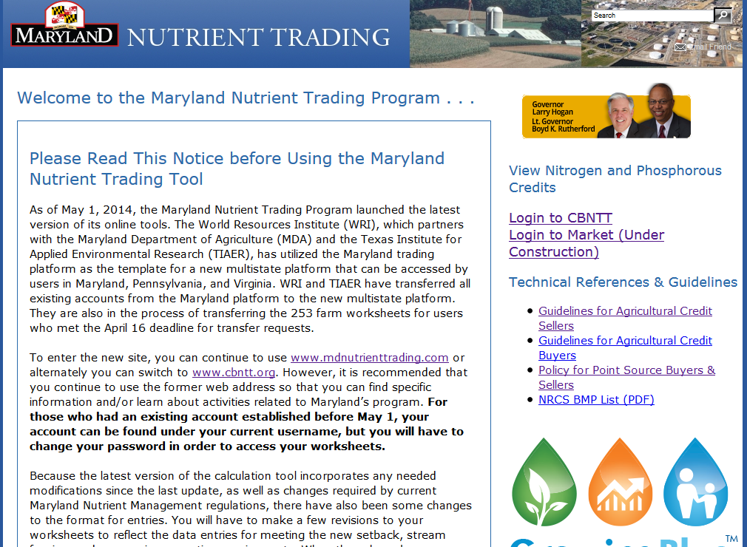
WWW.MDNUTRIENTTRADING.COM

Slide 14
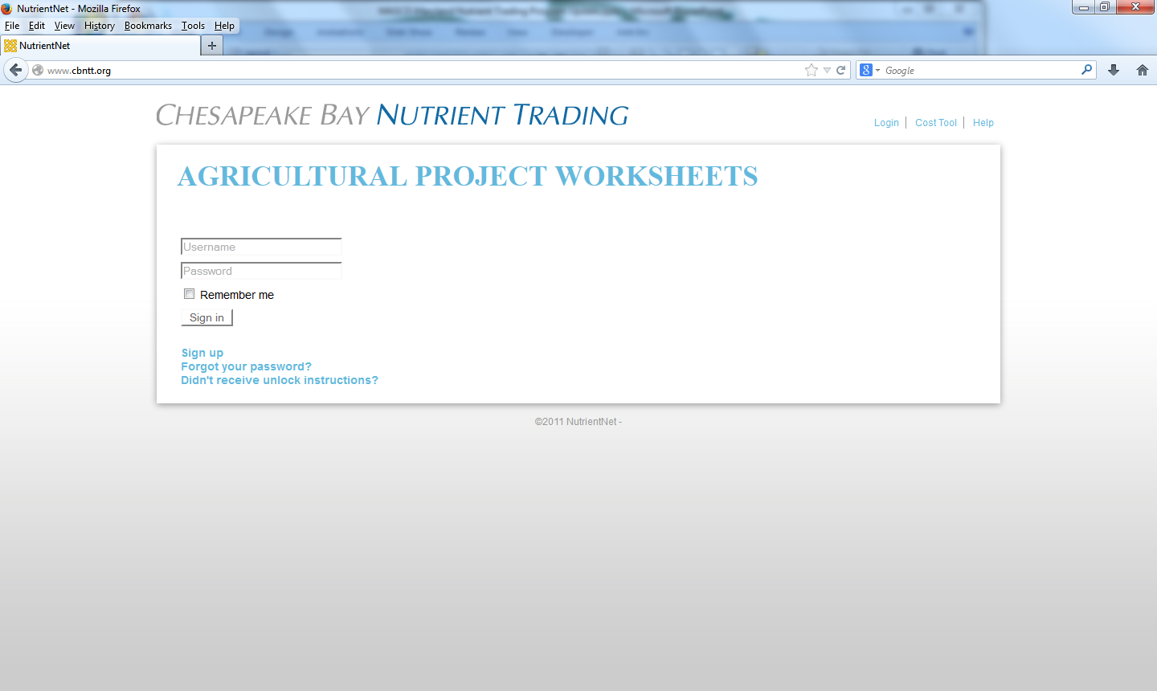

Slide 15
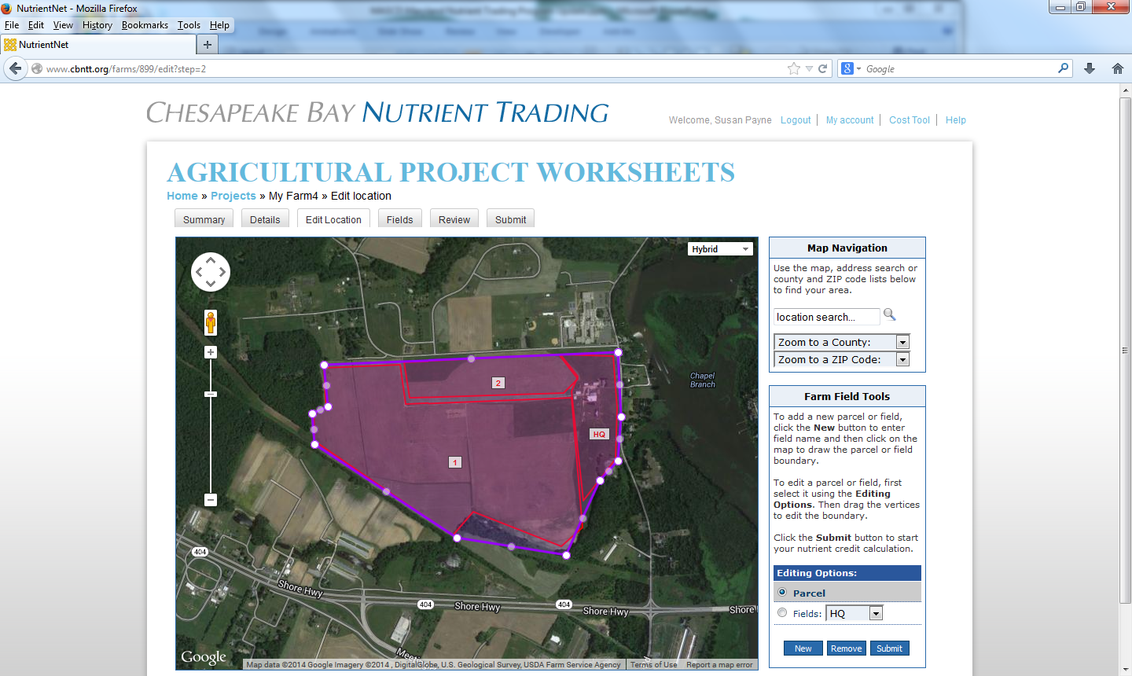

Slide 16
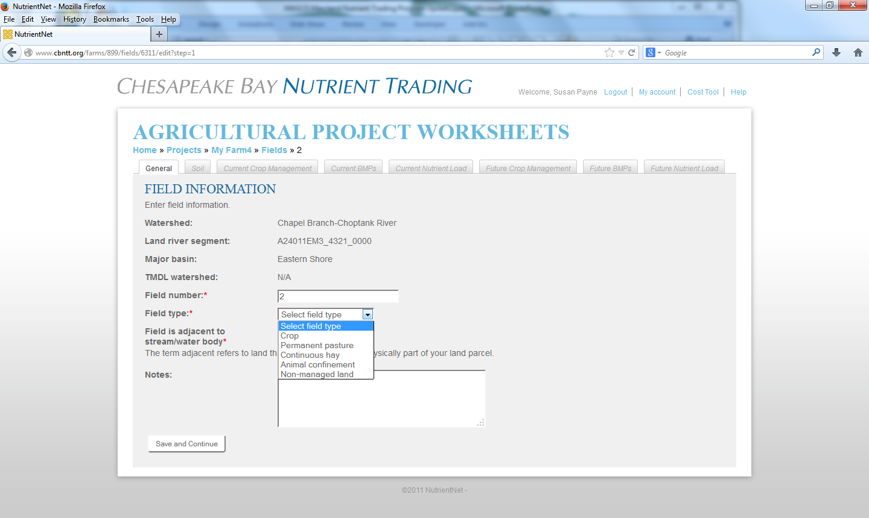

Slide 17
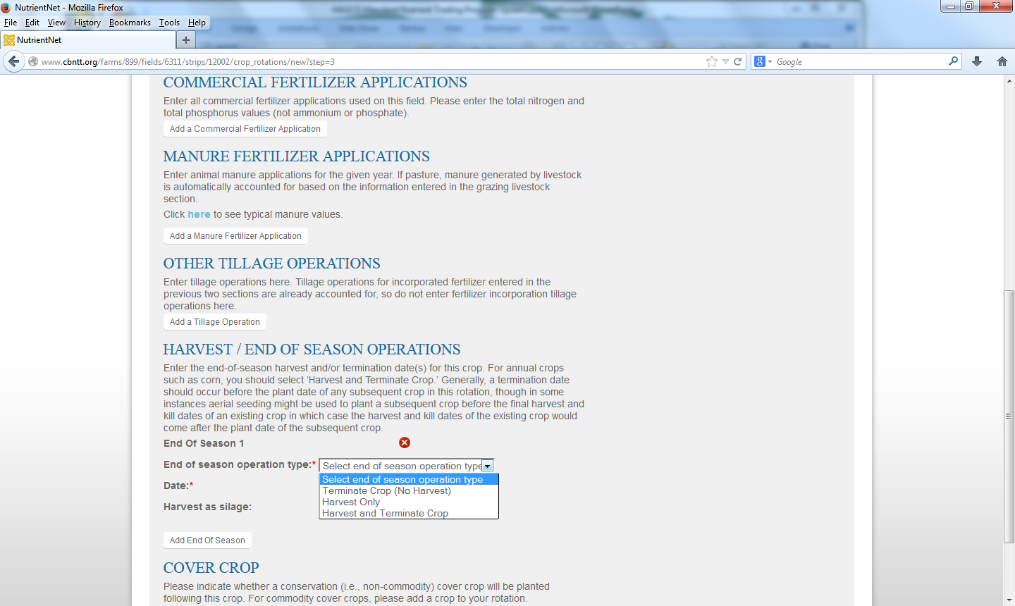

Slide 18
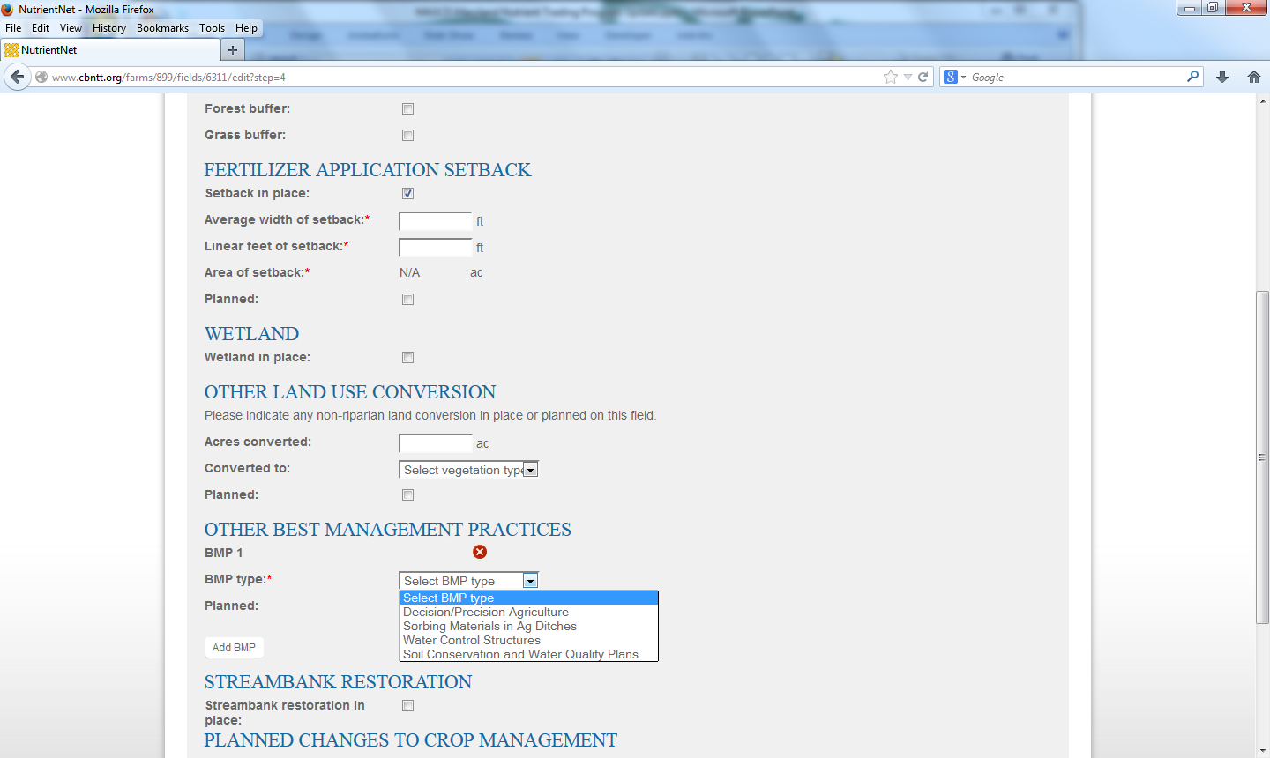

Slide 19
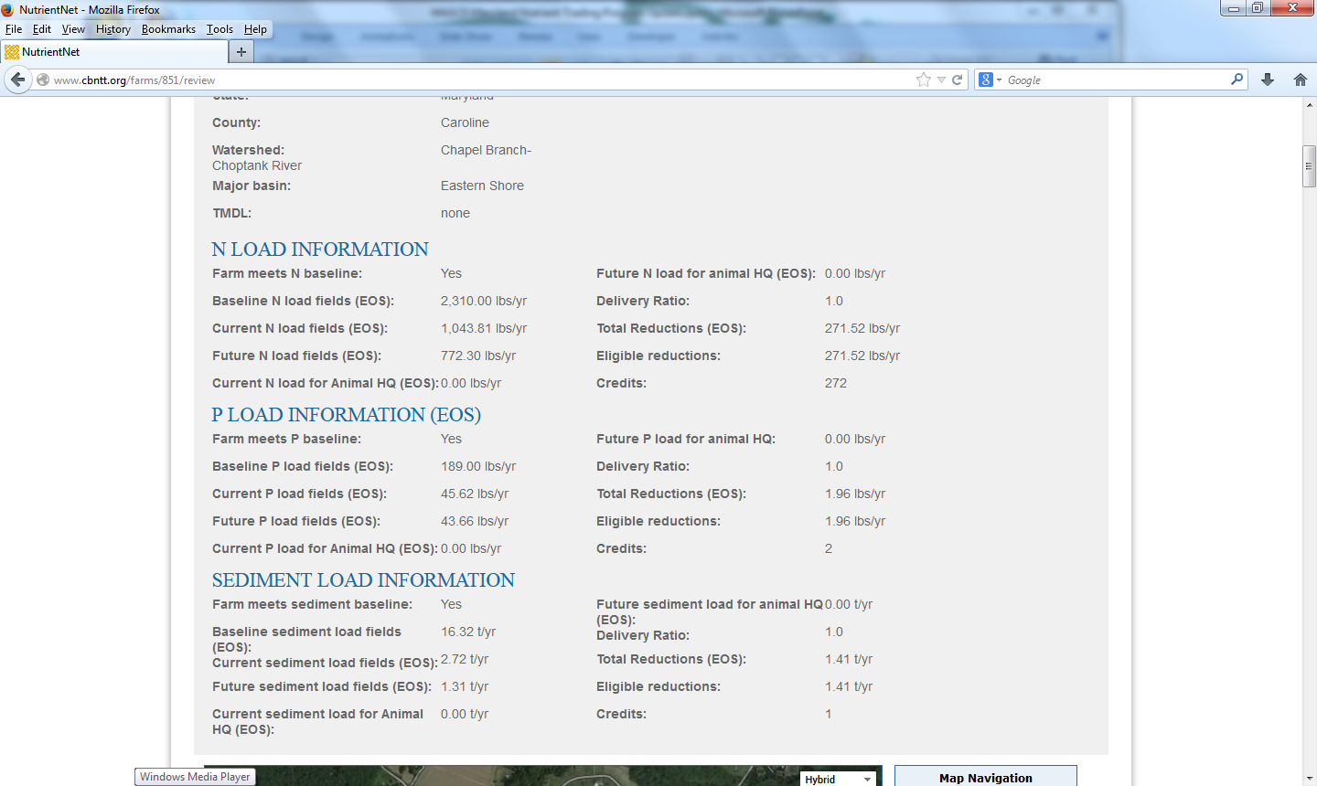

Slide 20
BAY TMDL vs. LOCAL TMDL
Eastern Shore Bay TMDL Nitrogen |  | Chester River (Middle) Local TMDL Nitrogen
Raw | 29.96 lbs/acre | 29.96 lbs/acre
TMDL | 11.70 lbs/acre | 6.91 lbs/acre
% Reduction | 61% | 77%
Phosphorus |  | Phosphorus
Raw | 2.01 lbs/acre | 2.01 lbs/acre
TMDL | 1.03 lbs/acre | 0.49 lbs/acre
% Reduction | 49% | 73%

Slide 21
AGRICULTRAL PROJECT WORKSHEET
N LOAD INFORMATION
Baseline N load fields (EOS) 2,310.00 lbs/yr Delivery Ratio 1.0
Current N load fields (EOS) 1,210.00 lbs/yr Total Reductions 438.00
Future N load fields (EOS) 772.00 lbs/yr Credits 438
P LOAD INFORMATION
Baseline P load fields (EOS) 180.00 lbs/yr Delivery Ratio 1.0
Current N load fields (EOS) 75.00 lbs/yr Total Reductions 29.50
Future P load fields (EOS 45.50 lbs/yr Credits 30
SEDIMENT LOAD INFORMATION
Baseline TSS load fields (EOS) 32,600.00 lbs/yr (16.32 t/yr) Delivery Ratio 1.0
Current TSS load fields (EOS) 5,430.00 lbs/yr (2.72 t/yr) Total Reductions 2,830.00 (1.40)
Future TSS load fields (EOS) 2,600.00 lbs/yr (1.31 t/yr) Credits: 1

Slide 22
Application of Trading Ratios Delivery Ratio Example
Delivery Ratio Example
 | Scenario 1 | Scenario 2
Eligible Reductions | 1,000 | 1,000
Delivery Ratio | X 0.58 | X 0.80
Credits Available to Sell | 580 | 800
Retirement Ratio Example
Credits Sold | 500
Retirement Ratio (10%) | 50
Total Credits Needed | 550

Slide 23
CERTIFICATION
Submission of Credit Registration and Certification form and accompanying documents to MDA for review
Site visit REQUIRED to verify baseline conditions and appropriateness and effectiveness of credit generation proposal

Slide 24
VERIFICATION
Practices subject to verification three additional times:
1. For credits certified pending implementation, after
installation to assure standards and specs are met
and is fully operational
2. Annual inspection of baseline and credit generating
practices by independent, third party
3. Random spot checks by MDA on 10% of all traded
credits
Certified verifiers for initial visits and annual inspections
Certified Nutrient Management Planner
Qualified USDA /NRCS Conservation Planner, Level II
Demonstrated competence in use of online
assessment tool

Slide 25
REGISTRATION
Approved credits are given a unique registration
number and entered in the online Registry available
to public.
Registry lists owner of credits, quantity, type of
pollutant, year, state ,county, and basin location,
and duration.
When credits are posted to the Registry, all
supporting documents and worksheets become
subject to public inspection. These items will also be
part of the documentation for permits as well.
Owner of credits can post them to the marketplace, where buyers can also post credit needs.

Slide 26
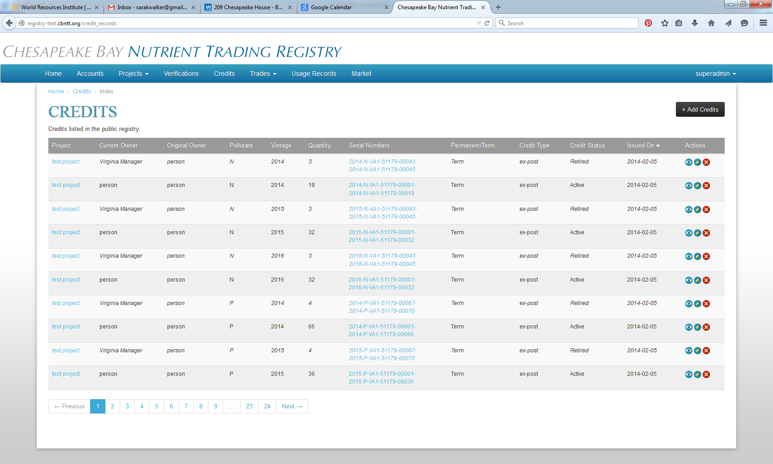

Slide 27
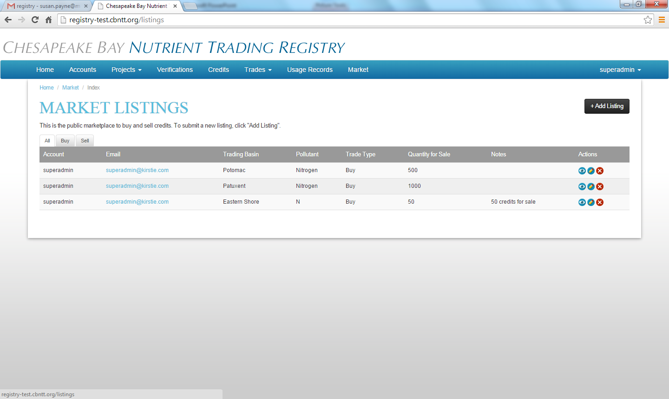

Slide 28
Susan Payne
Coordinator of Ecosystem Markets
410-841-5897
susan.payne@maryland.gov
www.mdnutrienttrading.com
MDA is a member of the National Network on Water Quality Trading
Follow MDA on Twitter @MdAgDept
Follow MDA on Facebook www.facebook.com/MdAgDept

