Slide 1
Maryland Water Quality Trading Committee
Role of Aggregator
George Kelly
Resource Environmental Solutions, LLC
February 22, 2015

Slide 2

About RES
Overview
Mission
RES is the premier provider of ecological offset solutions in the US
Founded 2007
Operations throughout United States
110 mitigation sites permitted/in process
Conservation easements protecting over 425 sites
32,000 restored wetland acres
4,000 acres of custom mitigation solutions
155 miles of stream restoration
Reduced over 240 tons of nutrients
8,000,000+ restorative stems installed
Rehabilitated and preserved over 3,700 acres of endangered species habitats
100 Energy industry clients
Resource Environmental Solutions develops and supplies ecological offsets to help companies obtain required permits for unavoidable project-related impacts to wetlands, streams and habitats.
We help clients proactively manage risk from operations in environmentally sensitive areas by providing proactive project impact analyses, streamlining permitting processes, and limiting liability and regulatory exposure.
2

Slide 3
Third Party Roles in Nutrient Trading
3

Slide 4
Maryland Nutrient Trading: Point Source – Non Point Source
4 Types of Markets to Consider:
  1. Annual Compliance for Existing WWTPs (BRF)
  2. Credits for New or Expanded NPDES Discharges
      10 Year commitment to offset
  3. Offsets for Stormwater (new growth)
  -Permanent solutions
  4. MS4 (10 jurisdictions, including SHA-existing)
      Permanent solutions/Cross-Sector trading?
      Restore an additional 20% of jurisdiction’s impervious area currently not treated
4

Slide 5
Maryland Program – Non-Point Source Trading
Market Structure
  Bilateral agreements versus centralized auction
  Contract between buyers and sellers
  Brokers or aggregators are key components to the market
  Aggregators are prominently recognized in credit generation, implementation and delivery

Slide 6
Role of Aggregator
Understand policies relating to aggregators
Understand basic market factors
Undertake baseline analysis on site technical viability (including site baseline calculations) and buyer eligibility
Certify credits (Ag, Urban, etc.)
Permit approval in conjunction with buyer
Negotiate the sales transaction
Enter into trading contracts
Enter into landowner contracts
Verification
Fund and manage the Project (including landowner payments)
Assume and manage risk
Manage diverse portfolio of credits (annual, structural, multiple farms)
Insure the projects (self or otherwise)
Integrate with other environmental markets and programs

Slide 7
Understand Polices Relating to Role of Aggregators
Is the role of the aggregator prominently recognized?
Is there a process for the aggregator to be approved?
Are these standards for aggregator contracts to be adopted?

Slide 8
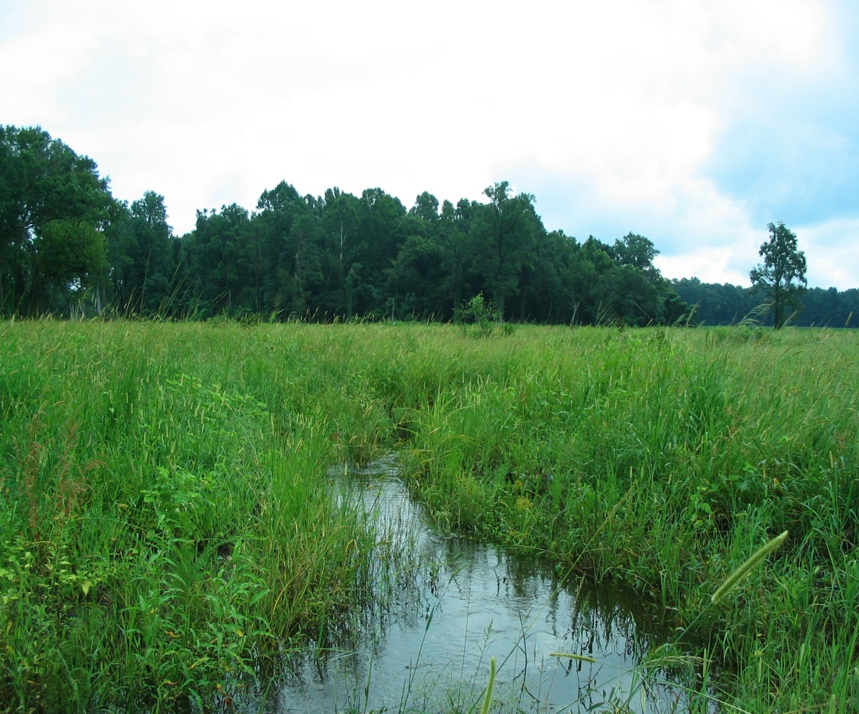
Basic Market Factors
Regulatory Drivers and authorizations-demand?
Eligibility of Buyers and Sellers
Baseline requirements before trade
Lifespan of BMP practices
Sale period requirements
Currency-N,P,S and impervious acre
Service Area-where can you sell credits?
Liability for success
Trading Ratios (Uncertainty, Delivery and/or Retirement)
Options other than trade
Verification process
Pricing

Slide 9
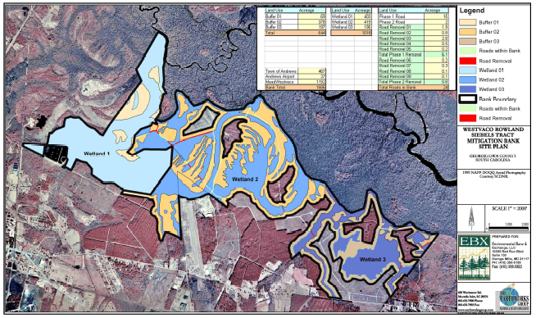
Baseline Assessment of Site Technical Viability and Buyer Eligibility
Preliminary analysis of technical suitability, including baseline and BMP analysis
Comparative analysis of credits with other BMP credits in the marketplace
NMP, SCWQP and other regulatory requirements
Buyer baseline met?

Slide 10
Certify Credits
Pre-certification review
Use MNTT as applicable (if certify for ag)
Complete certification and registration form
Consent from landowners/tenants
Review and approval by MDA with site visits-should there be a timeline for review of application?
Performed and paid for by aggregator

Slide 11
Permit Approval
MDE permit approval of use of credits-need programmatic acceptance
Schedule of implementation and credit generation
Confirmation of credit generation and verification process
Enforcement mechanisms

Slide 12
Negotiate the Sales Transaction
Pricing discovery based on sites and rules
Regulatory process
When does buyer need credit?
Type of credit (annual, 10-year, permanent)
Negotiate trading contracts
Implementation schedule for credit generation

Slide 13
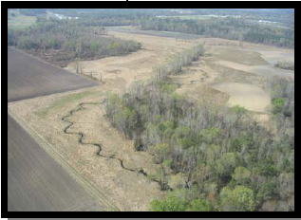
Trading Contracts
Amount and type of credits being sold
Timeline for credit generation
Payment schedule
Duration of trade/term
Price
Project implementation
Insurance for credit deficits?
Financial assurances for work performance?
Liability transfer
Verification
Adaptive management
Force majeure
Restrictions on land?
Default/enforcement provisions
Approval by resource agencies

Slide 14
Landowner Contracts
Approval to submit application and certify and sell credits
Baseline analysis assistance
Acreage and practices for credit generation
Any restrictions on land use or crop rotation?
Timeline (annual/10-years/permanent)
Payment
Responsibilities for installation and management of practices
Responsibilities to maintain baseline and pay property taxes
Access and right of inspection
Performance liability for credit generation and sales
Insurance
Default

Slide 15
Verification
MDA approved verifier
Buyer or seller of credits responsible?
Type of practice and specifications for verification
Lifespan of practice

Slide 16
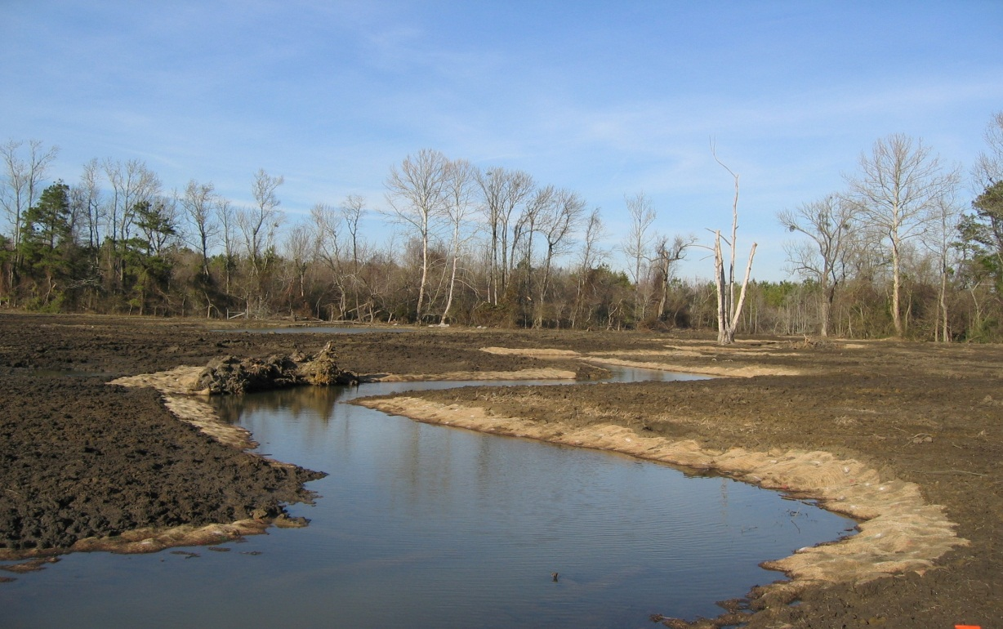
Fund and Manage the Project
Cash flow of project may not cover certification process and BMP implementation
Must install before credits are generated
Project management is keystone to delivering

Slide 17
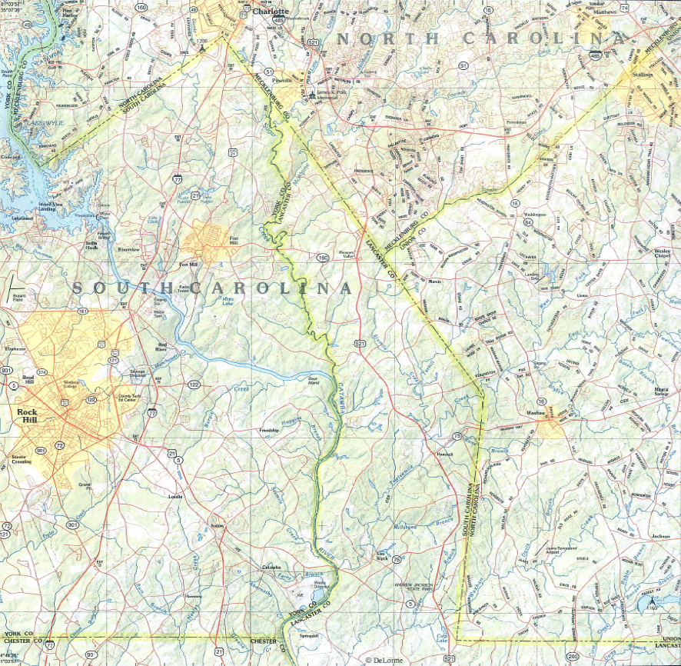
Assume and Manage Risk
Assume risk obligations of projects:
Construction risk
Performance risk
Financial risk
Market risk
Regulatory risk
Portfolio risk

Slide 18
Manage Overall Portfolio
Contract duration with Buyers
Multiple sites and multiple practices
This requires a blend of credits, both annual and long-term structural credits
Diversification of multiple practices and farms helps with delivery risk

Slide 19
Insurance
Self-insurance through each project managed in a portfolio

Slide 20
Integrate with Other Environmental Markets and Programs
Wetland mitigation banking
Stream mitigation banking
Conservation banking
Carbon sequestration
Coordinate with farm conservation incentives and other environmental programs
Property taxes and estate planning

Slide 21

Resource Environmental Solutions, LLC
www.res.us
Baltimore Baton Rouge Charleston Houston Lafayette
Oak Hill Pittsburgh Raleigh Richmond
website wetlands photo here
Questions?
Contact George Kelly at:
gkelly@res.us

