Slide 1


Characterize groundwater quality in area engaged in unconventional drilling
Zacariah L. Hildenbrand, Ph.D.
Inform Environmental, LLC, Dallas, TX 75227
The University of Texas at Arlington, Arlington, TX 76019

Slide 2



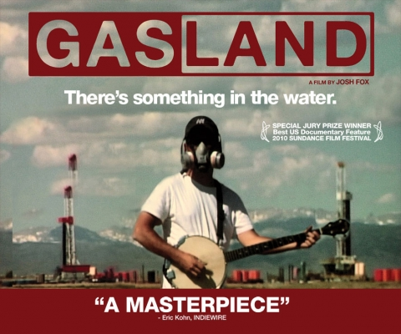
Lots of opinion but is there any data?

Slide 3
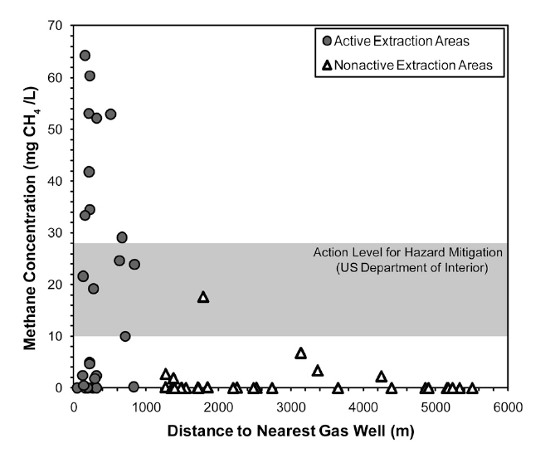
Elevated levels of methane
Geospatial relationship between methane concentration and distance to neighboring gas well
Evidence of deep thermogenic methane contamination
Osborn, S. G., et al. Proc. Natl. Acad. Sci. 2011, 108, 8172-8176.

Slide 4
What is unconventional drilling?
Hydraulic Fracturing
Shale Acidization
Underground Injection Wells (Waste disposal)

Slide 5
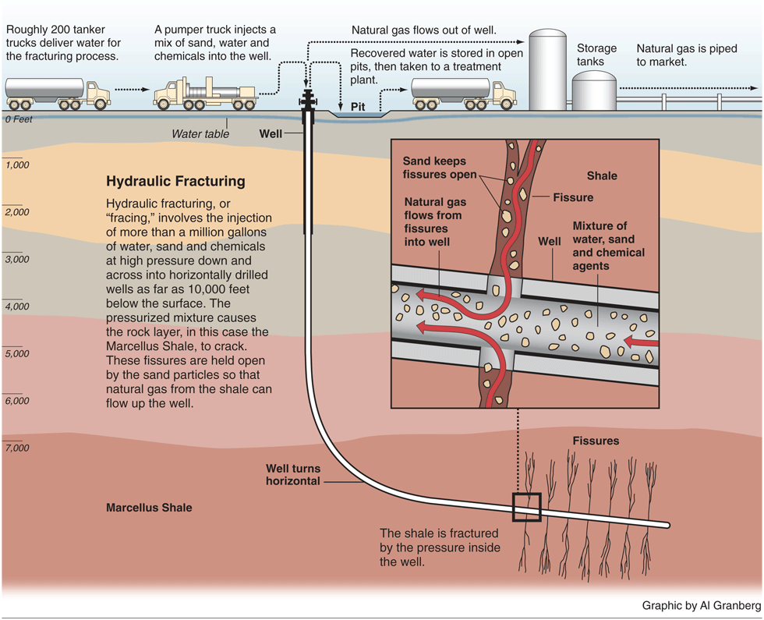

What is Hydraulic Fracturing?

Slide 6
What is unconventional drilling?
Hydraulic Fracturing
Shale Acidization
Underground Injection Wells (Waste disposal)

Slide 7
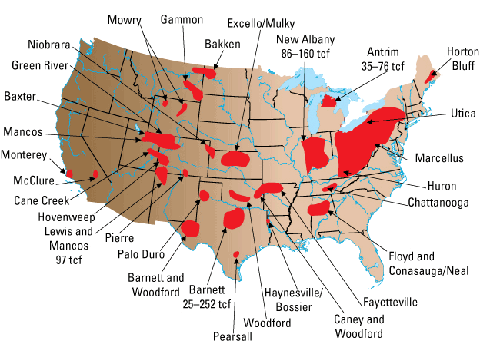
Where is this occurring?

Slide 8
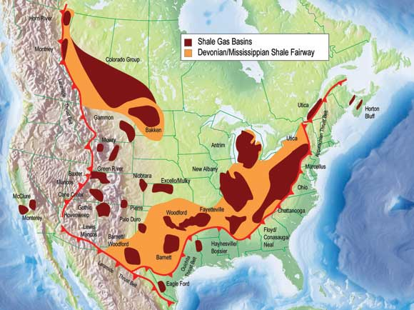

Slide 9
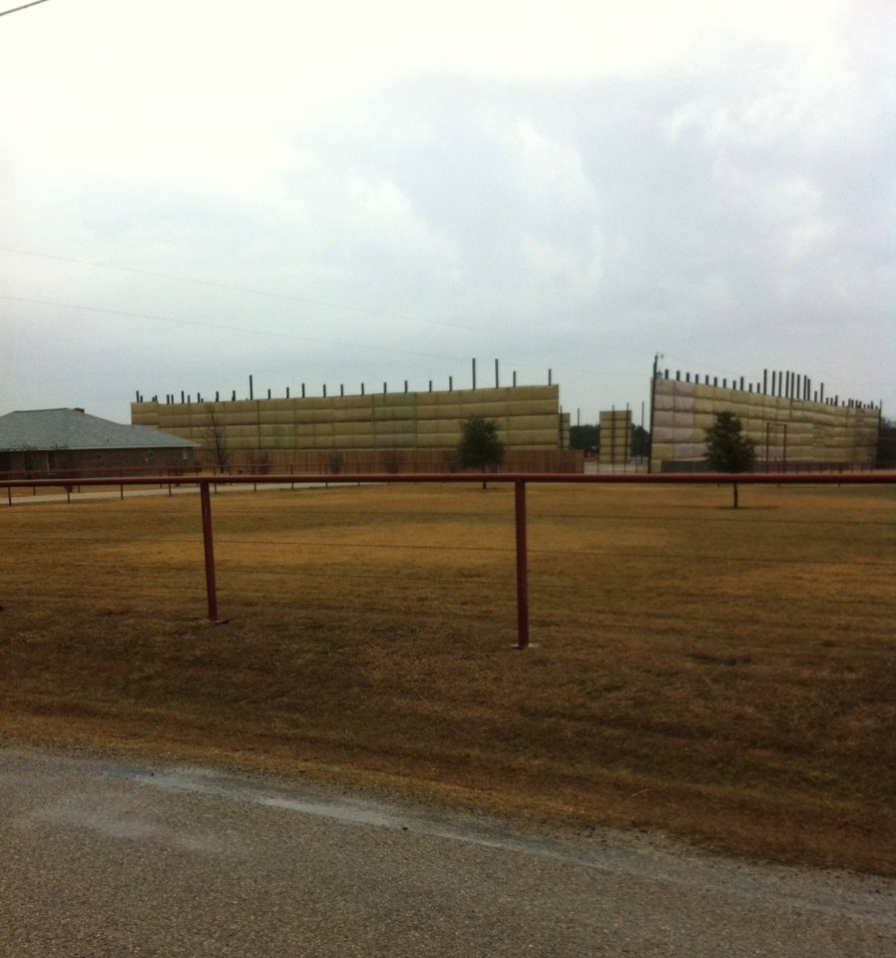
Environmental Concerns
Earthquakes
Cleburne, Irving, Azle, Dallas, OK, AR, Japan
USGS has evidence that underground waste injection can cause small scale earthquakes
Surface water contamination
Waste pits, fluid spills, pipeline leaks
Groundwater contamination
Waste pits, faulty casings
Is there a hydrologic connection to deep fractures?

Slide 10
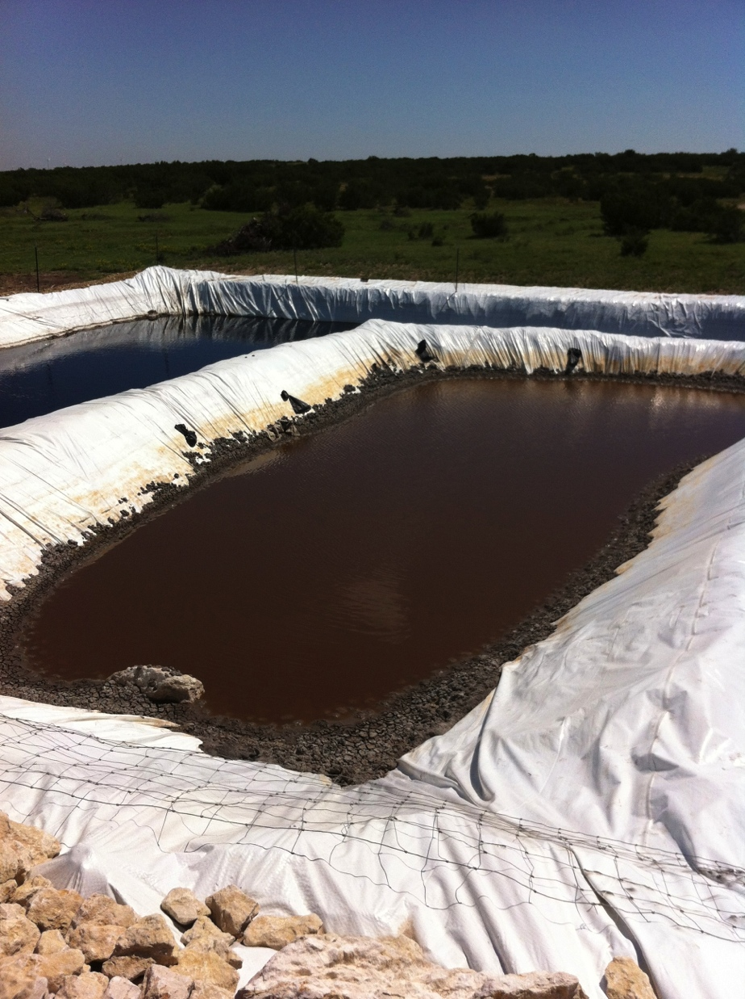
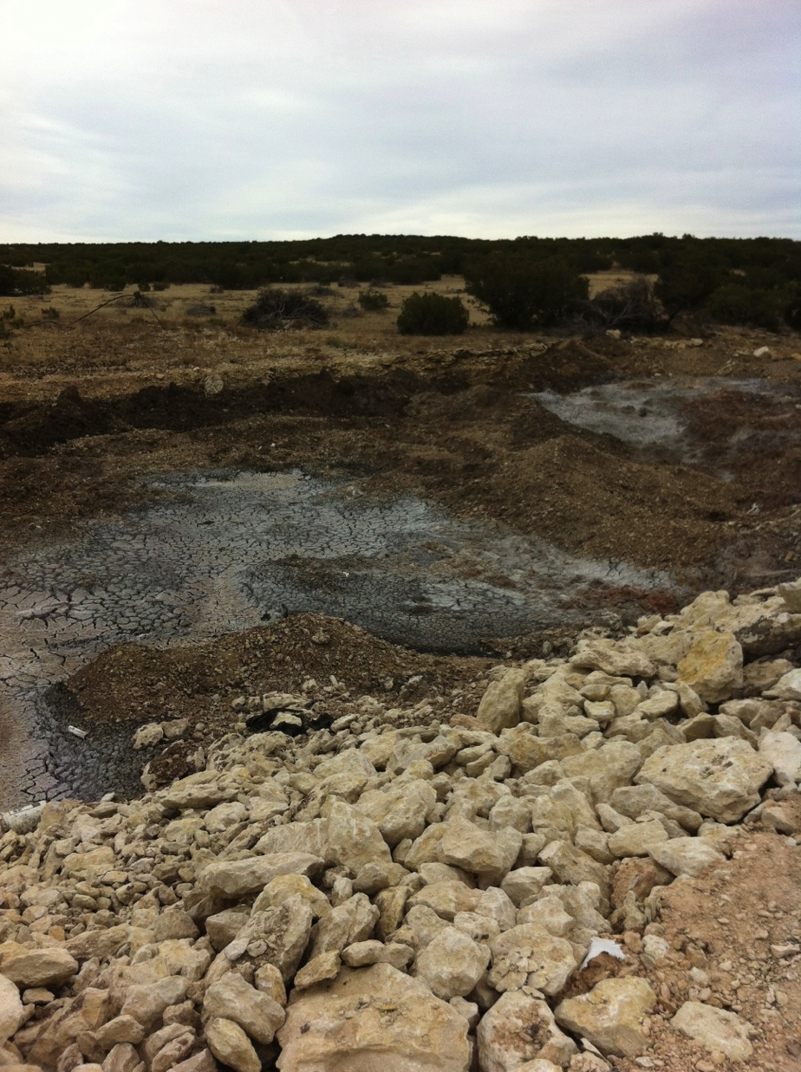

Slide 11
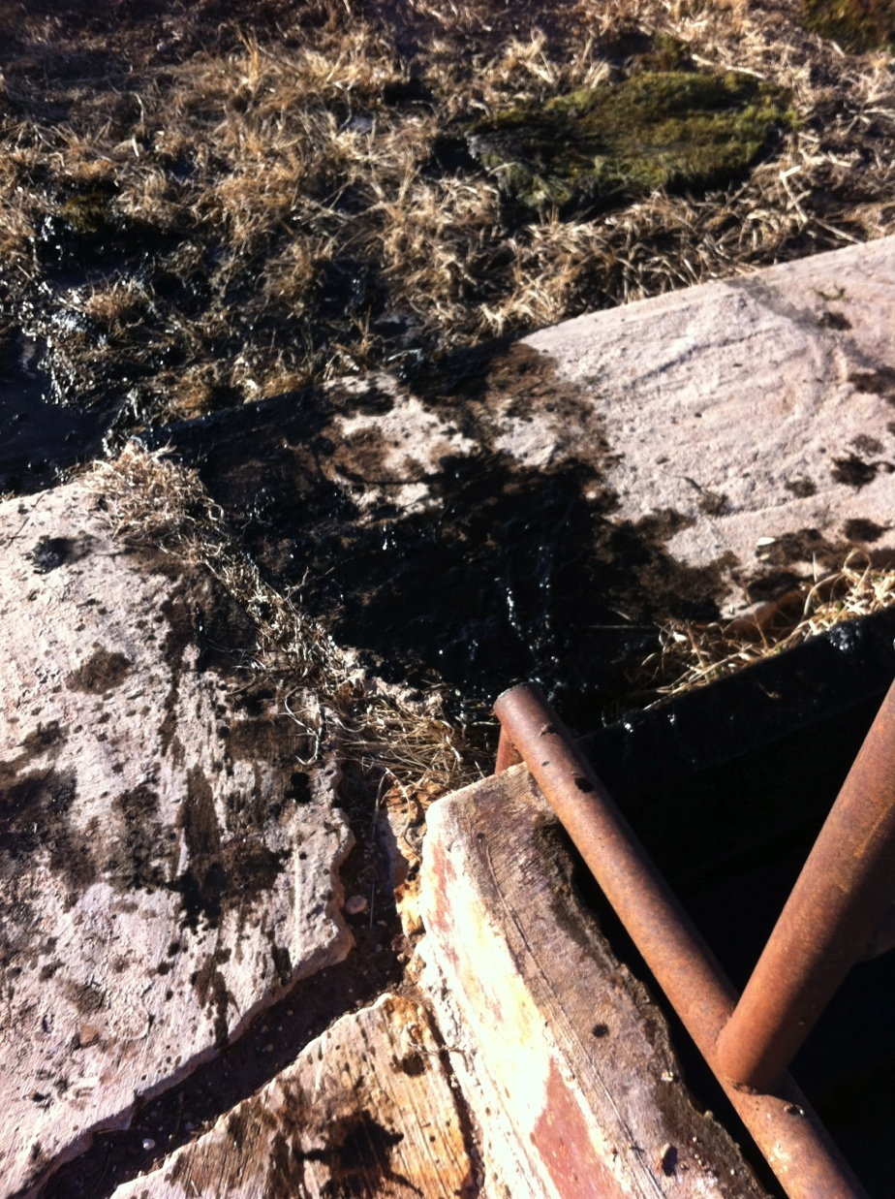
Environmental Concerns
Earthquakes
Cleburne, Irving, Azle, Dallas, OK,AR, Japan
USGS has evidence that underground waste injection can cause small scale earthquakes
Surface water contamination
Waste pits, fluid spills, pipeline leaks
Groundwater contamination
Waste pits, faulty casings
Is there a hydrologic connection to deep fractures?

Slide 12
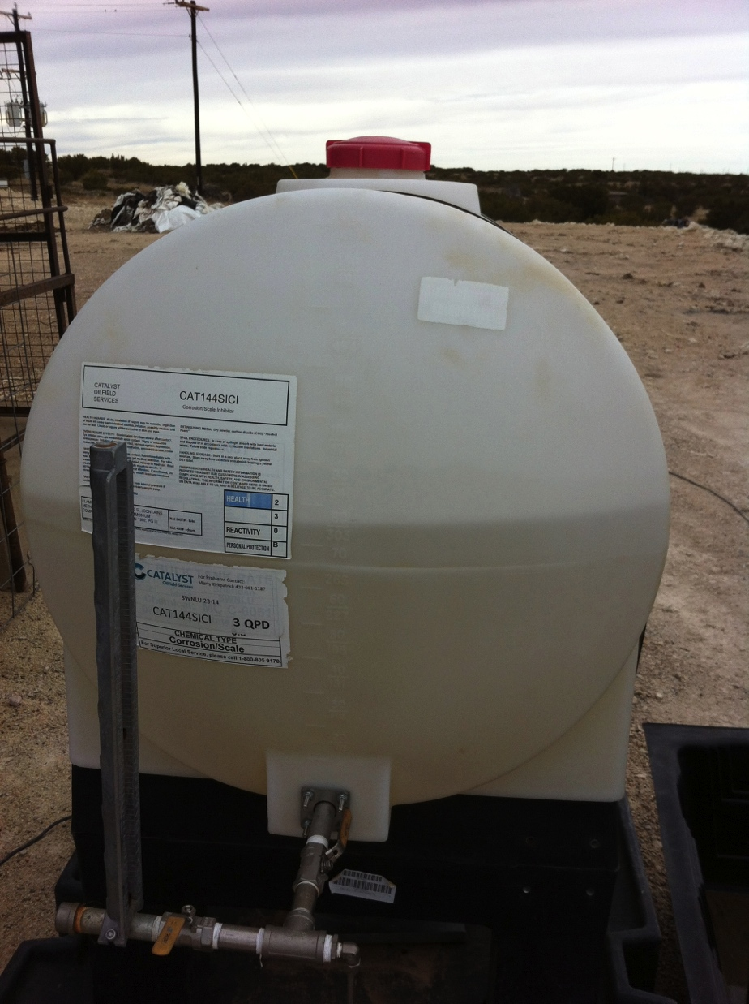
Composition of Fracturing fluid
Water (up to 99%, 3-5 million gallons per well)
Chemical additives (up to 2%)*
Biocides, surfactants, gelling agents, emulsifiers, corrosion inhibitors, BTEX compounds (benzene, toluene, ethylbenzene, xylene)
*Exact recipe is proprietary to each company although information is available at www.fracfocus.org
Proppants (sand and/or ceramics)
Large quantities of HCl (shale acidization)

Slide 13
Fate of fracturing fluids?
10-30% of flowback water is recovered
Flowback water is contaminated
Total Dissolved Solids (TDS), chlorides, Naturally Occurring Radioactive Material (NORM), chemical additives
Flowback can be:
Placed in containment pits, treated at wastewater plants, stored in underground injection wells or recycled (many new technologies are emerging)

Slide 14
Experimental Approach
Baseline measurements are incredibly valuable in assessing the anthropogenic effects of unconventional drilling
Scheduled monitoring can identify changes/fluctuations in groundwater quality
Advanced analytical tools are available to detect the occurrence of contamination events that may be directly or indirectly attributed to unconventional drilling activity
During a contamination event, environmental forensics can be used to identify the exact source

Slide 15
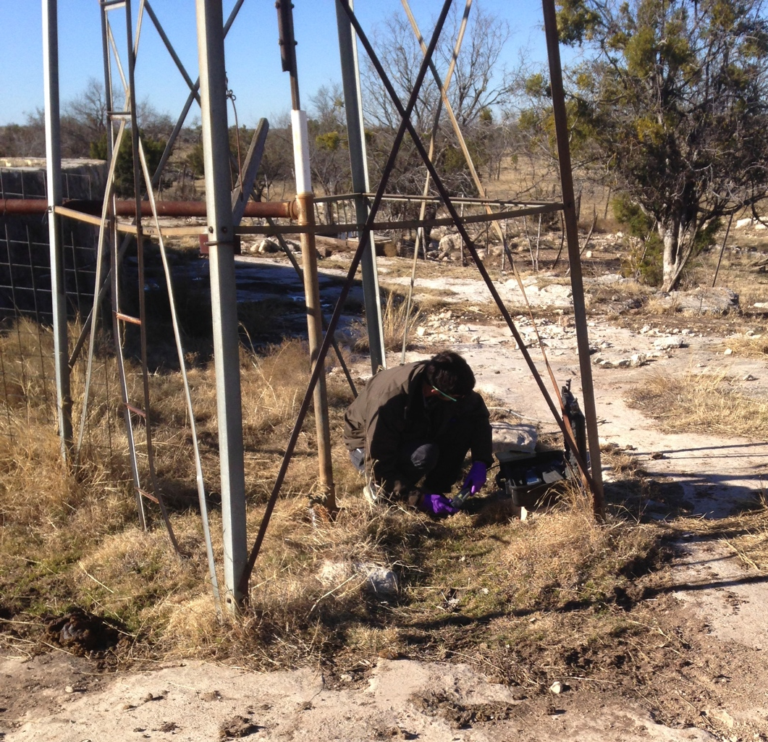
Basic Water Quality
pH
Total Dissolved Solids (TDS)
Salinity
Conductance
Temperature
Dissolved Oxygen (DO)
Oxidation Reduction Potential (ORP)

Slide 16
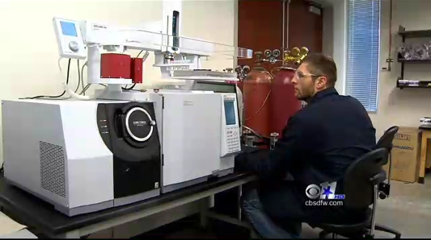
Shimadzu Center for Advanced Analytical Chemistry
$8.5 Million dollar analytical facility
-Method development for the detection and quantification of multiple analytes
-Highly sensitive detection thresholds and screening applications allow for data to be collected rapidly, accurately and cost-effectively
More data equates to more informed decisions

Slide 17
Developed Methodologies
Gas-Chromatography Mass-Spectrometry (GC-MS)
Methanol
Ethanol
n-propanol
Isopropanol
n-Butanol
2-Ethylhexanol
2-Butoxy Ethanol
Propargyl Alcohol
Benzene
Toluene
Phenol
Benzylchloride
Ethylbenzene
0-, m-, & p-Xylenes
1,2,4-Trimethyl Benzene
1,3,5-Trimethyl Benzene
Isopropyl Benzene
d-Limonene
Naphthalene
1-Methyl Naphthalene
2-Methyl Naphthalene
1-Naphthol
2-Naphthol
Ethylene Glycol
Polyethylene Glycol
Propylene Glycol
Dipropylene Glycol Monomethyl Ether
PEG 200
Glycerol
Acetophenone
Dimethylformamide
Glutaraldehyde
Acetaldehyde
Di(2-Ethylhexyl) Phthalate
Pthalic Anhydride
Bisphenol A

Slide 18
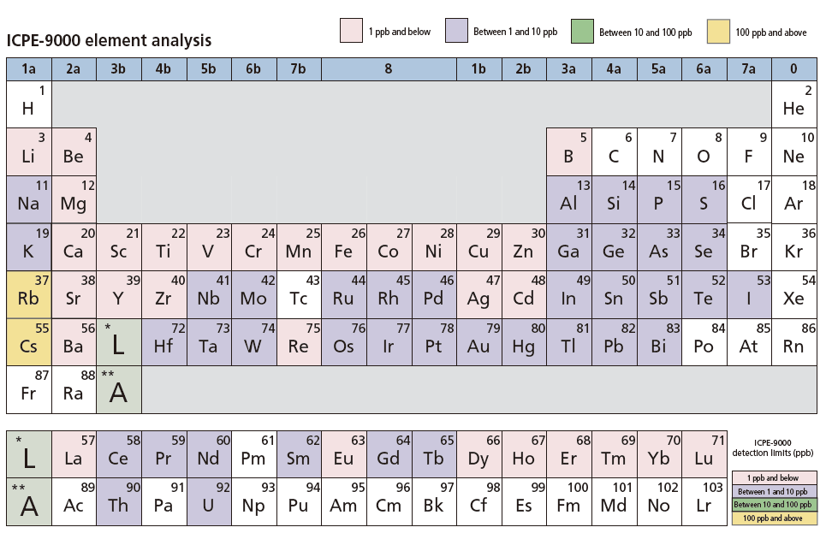
Inductively Coupled Plasma-Optical Emission Spectrometry (ICP-OES)
Quantification of 70+ minerals and metals

Slide 19
Developed Methodologies
Quantification of Total Organic Carbon (TOC), Inorganic Carbon (IC)
Detection of petroleum hydrocarbons, volatile organics
    Subsequent characterization with GC-MS, HS-GC-FID
Quantification of Total Nitrogen (TN)
Method to assess the relative effect of agriculture on groundwater quality
Quantification of major water ions
Fluoride, chloride, carbonate, sulfate, boron, bicarbonate

Slide 20
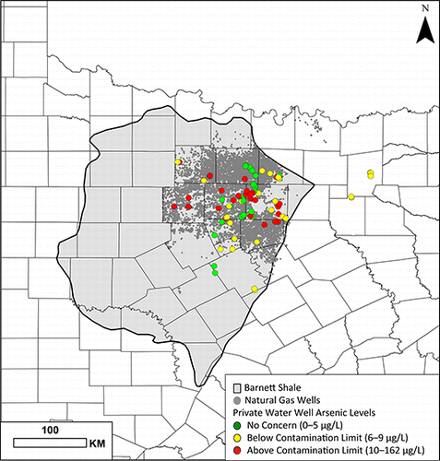
Elevated Levels of Arsenic
29 of the 91 samples collected with active extraction areas contained elevated levels of arsenic (>10 μg/L)
Highest concentration that was detected was 161 μg/L
Arsenic was not found to be elevated in any of the control sites
Fontenot, B. E., et al. Environ. Sci. Tech. 2013, 47, 10032-10040.

Slide 21
Geospatial analysis of TDS and Arsenic
Fontenot, B. E., et al. Environ. Sci. Tech. 2013, 47, 10032-10040.

Slide 22
Geospatial analysis of Selenium and Strontium
Fontenot, B. E., et al. Environ. Sci. Tech. 2013, 47, 10032-10040.

Slide 23
Geospatial analysis of Barium
Fontenot, B. E., et al. Environ. Sci. Tech. 2013, 47, 10032-10040.

Slide 24
Comparison to historical data
Fontenot, B. E., et al. Environ. Sci. Tech. 2013, 47, 10032-10040.

Slide 25
Geospatial analysis of TDS and Arsenic
Fontenot, B. E., et al. Environ. Sci. Tech. 2013, 47, 10032-10040.

Slide 26
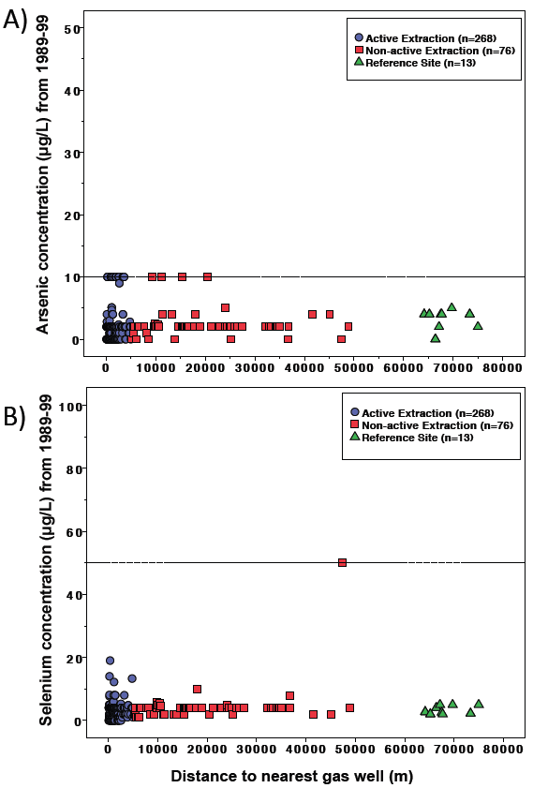
Comparison to historical data
Fontenot, B. E., et al. Environ. Sci. Tech. 2013, 47, 10032-10040.

Slide 27
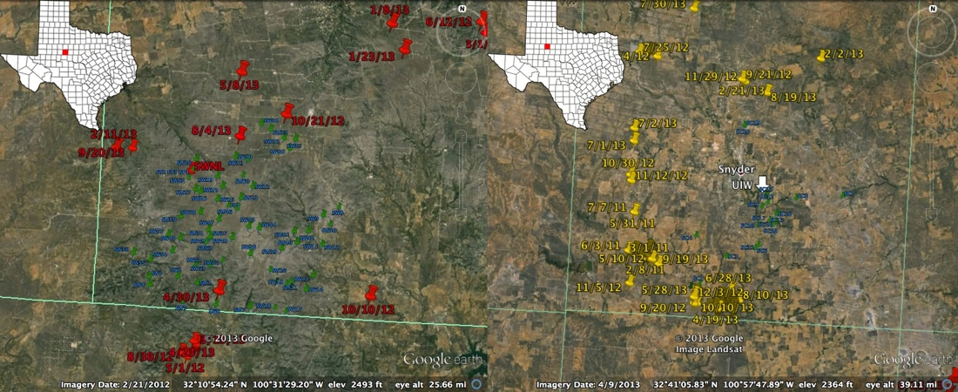
Time-lapse analyses in the Cline Shale
NOLAN COUNTY
SCURRY COUNTY
60+ samples collected before, during and after unconventional drilling in Nolan county (left), and 50 samples collected in Scurry county (right)

Slide 28
Future Directions
Expand our reach into other shale formations
Across the United States, Canada and Europe
Become more involved into other components of the unconventional drilling process and other industrial processes
Use our advanced analytical capabilities to characterize a wide range of environmental events/catastrophes
Develop new technology and best management practices for instances of drilling-related contamination events
Remediation, recycling, appropriate waste disposal

