Slide 1
Illustrations of Groundwater Flow concepts for Supply Wells
For Marcellus Shale Commission
March 10, 2014

Slide 2
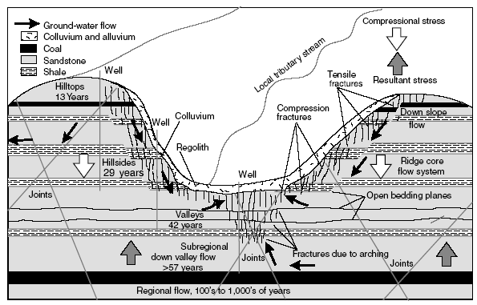
Groundwater Flow in Appalachian Plateau

Slide 3
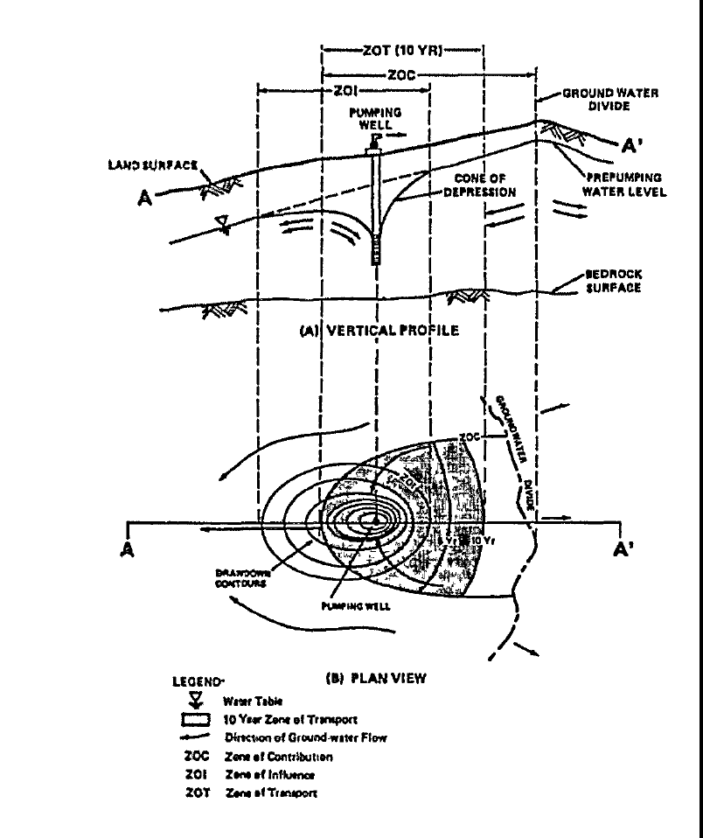

Slide 4
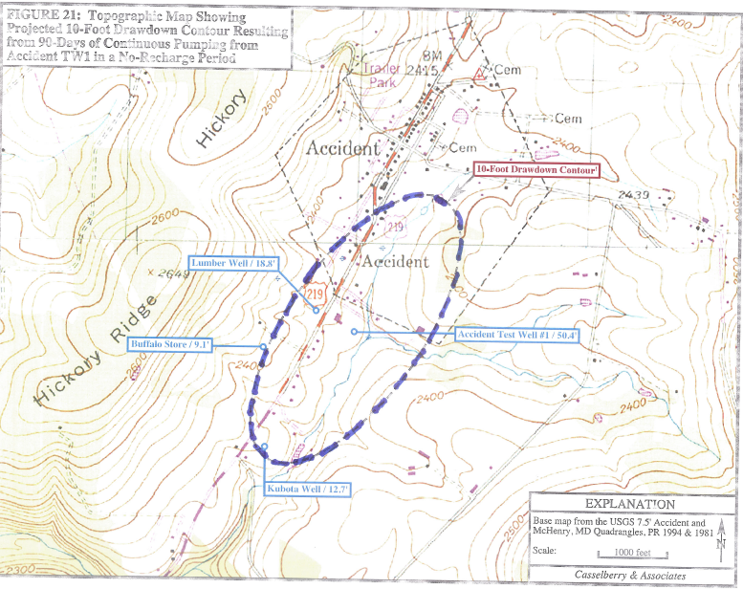

Slide 5
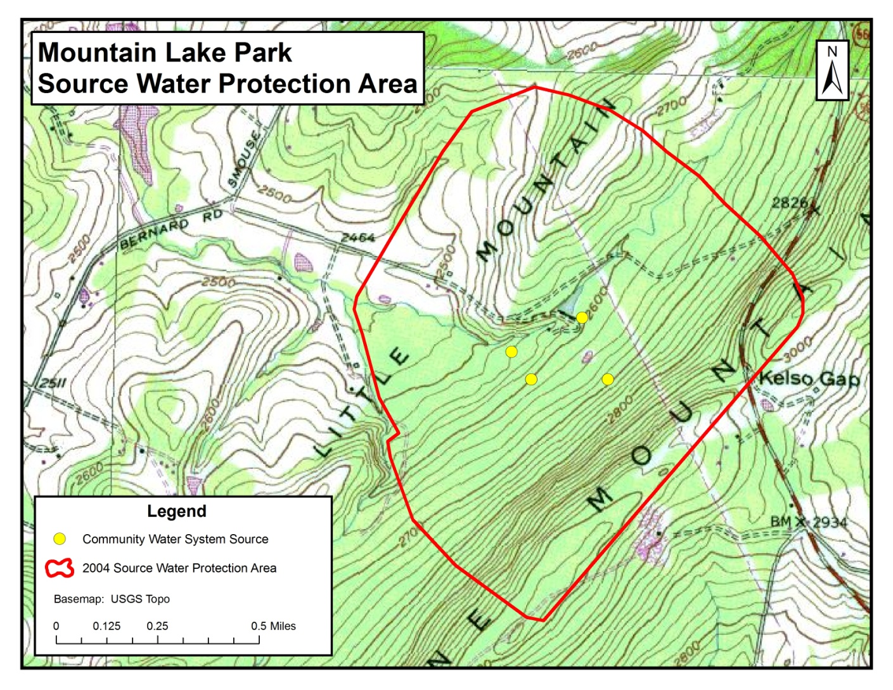
Example community water system source protection area

